Slide 1
Think, Pair, Share
Read the introduction for today's activity.
Once you are done reading, find a partner and discuss the following question:
  What are concussions and how are they caused?

Slide 2





It’s All in Your Head

Slide 3
Learning Objectives
Capture slow motion videos of a modeled concussive event.
Interpret video data to understand the mechanism of a concussion.
Collect force data for a collision of a dropped object with the ground.
Analyze collision data to determine the most protective material.
Design a helmet following the provided criteria and constraints.

Slide 4
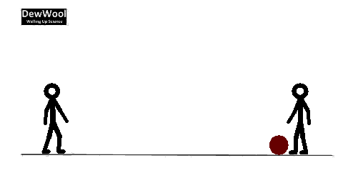
Newton’s Laws of Motion

Slide 5
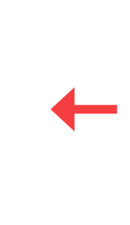
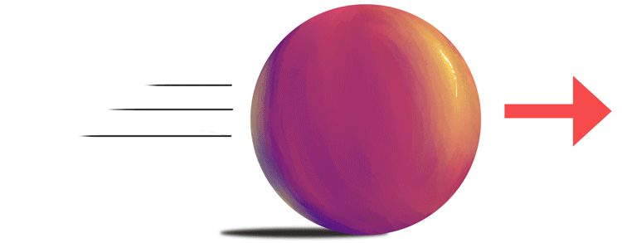
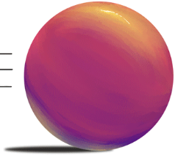
Newton’s First Law of Motion
An object at rest will stay at rest and an object in motion will stay in motion unless acted on by an external force.

Slide 6
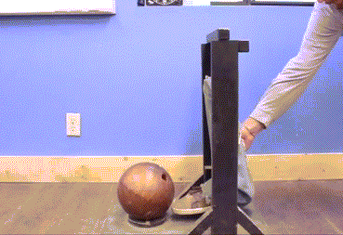
Newton’s Second Law of Motion
The force on an object is equal to the object’s mass multiplied by its acceleration.
F
=
m
a
Bowling Ball
Balloon
F
=
m
a
F
=
m
a
F is force in Newtons (N), m is mass in kilograms (kg), and a is acceleration in meters/second2 (m/s²)

Slide 7
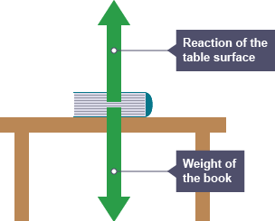
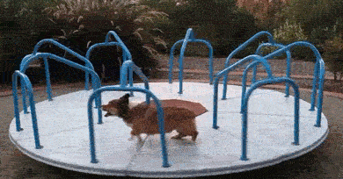
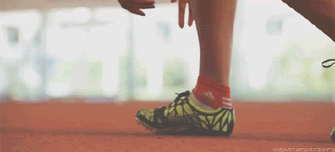
Newton’s Third Law of Motion
For every action there is an equal and opposite reaction.

Slide 8
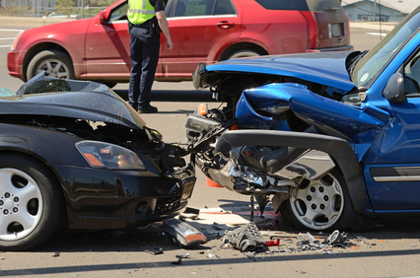
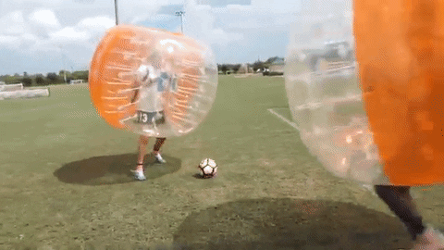
Collisions Part 1

Slide 9
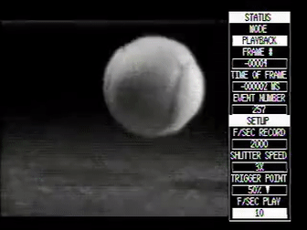


Collisions Part 2
Ball A
Ball B
$$\text{F}\text{=}\text{ma}$$
m= 20 kg
m= 20 kg
v_{i}= 10 m/s
v_{f}= 0 m/s
$$\text{F}\text{=}\text{m}\text{(}\frac{{\text{v}}_{\text{f}}\text{−}{\text{v}}_{\text{i}}}{\text{t}}\text{)}$$
v_{i}= 10 m/s
v_{f}= 0 m/s
t= 0.001 s
t= 0.002 s
F= 200,000 N
F= 100,000 N

Slide 10

Today’s Investigation
Notes:
Click image to open hyperlinked video

Slide 11
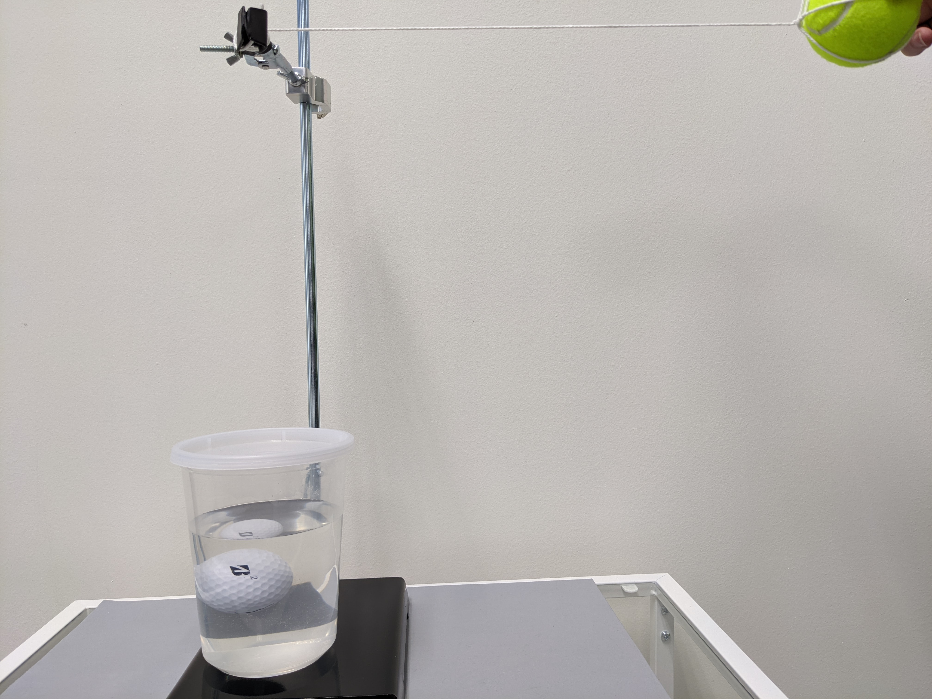
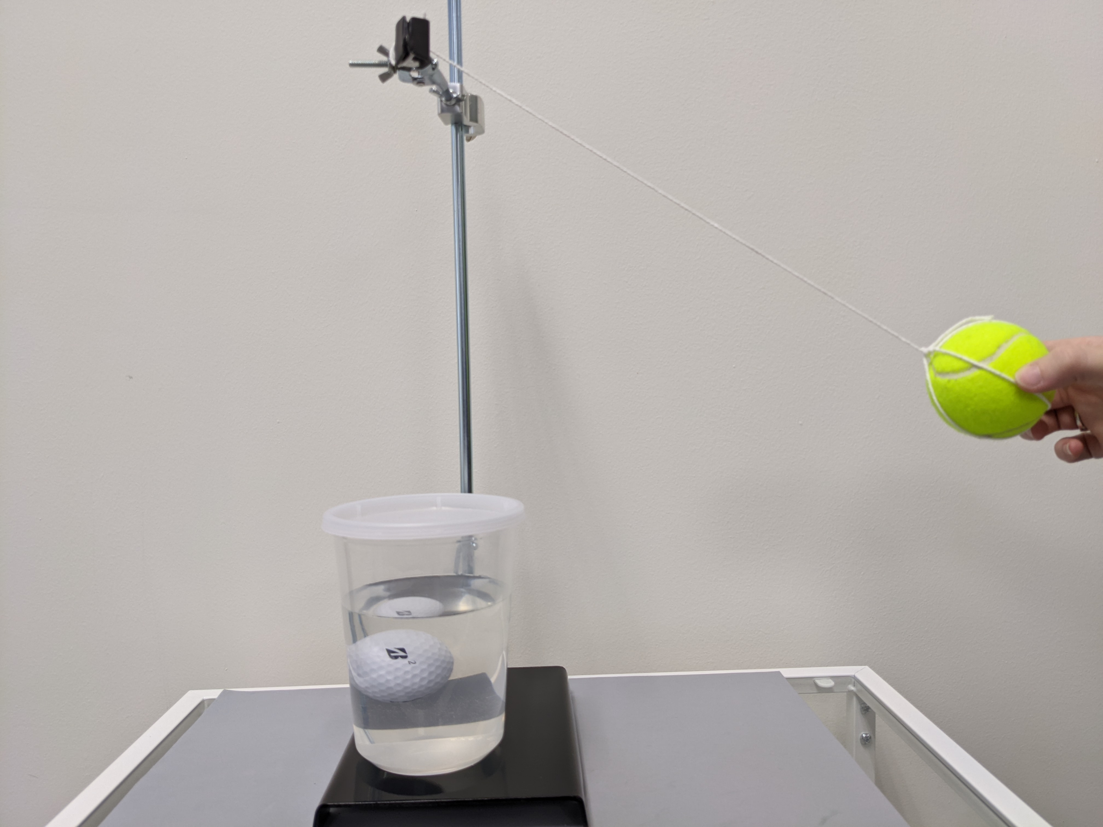
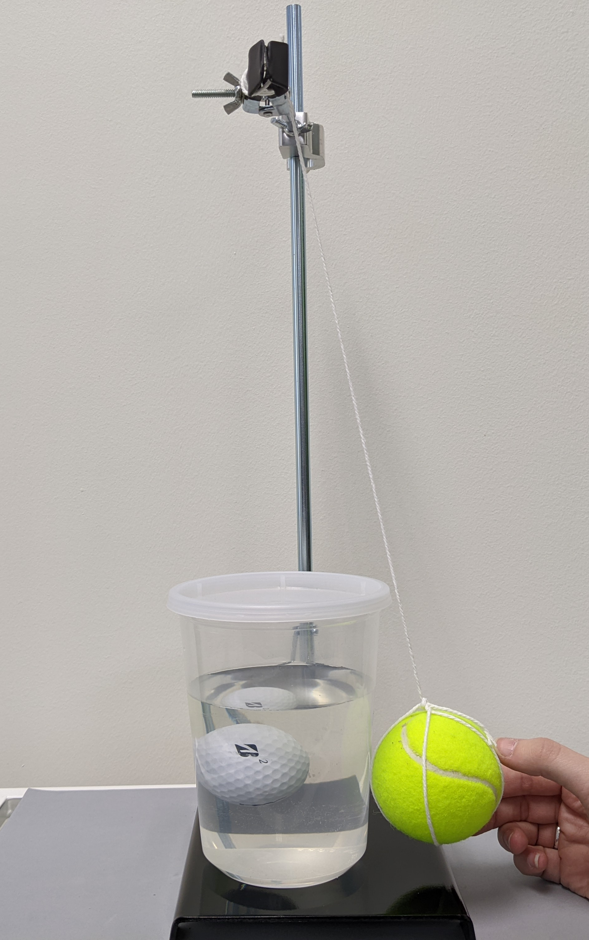
Part 1: Understanding Concussions Through the Use of a Model
90°
45°

Slide 12

Part 2: Materials Testing for a Helmet
Notes:
Click Image to open hyperlinked video

Slide 13
Part 2: Materials Testing for a Helmet
No Helmet Materials | Peak Force in N (max) | Time in ms (Δx)
Average
Styrofoam | Peak Force in N (max) | Time in ms (Δx)
Average
Flexible Foam | Peak Force in N (max) | Time in ms (Δx)
Average
Microbeads | Peak Force in N (max) | Time in ms (Δx)
Average

Slide 14
Lab Clean Up
The meter stick can be taken down and any tape used to secure it can be disposed of in the trash.
The pendulum can be taken down. If the string is unable to be untied, it can be cut and disposed of in the trash. If it can be untied, it can be left at the station. Any tape used can be disposed of in the trash.
All other materials should be left at the station as they were when you arrived.

