Slide 1
Magnets Push, Magnets Pull
Notes:
Hello everyone, today we’re going to learn about magnets!

Slide 2
Read Aloud (Leer en Voz Alta)
Notes:
Read the storybook Magnets Push, Magnets Pull
Ask students what they thought was the most interesting thing they learned about magnets.
Ask if they can think of any jobs that let people work with magnets for a living.
Ask students what jobs they think work with magnets. Explain to students that there are jobs that specialize in the use of magnets to help make our lives better. For example, there are trains that use magnets to make them go very fast and shorten how long it takes to go from once place to another.

Slide 3
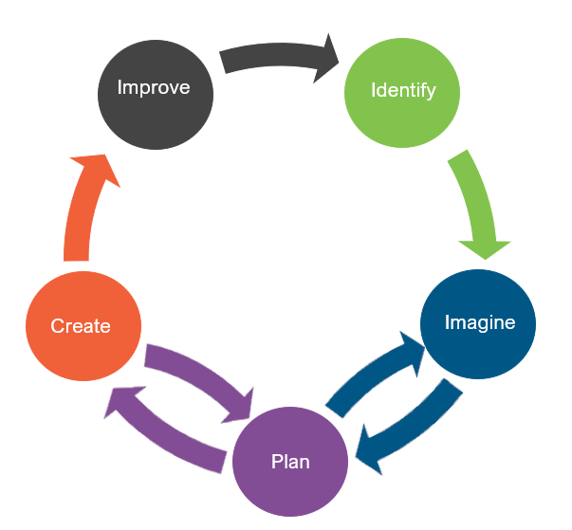
Engineering Design (Diseño de Ingeniería)
What is engineering?
(¿Qué es la ingeniería?)

Slide 4
Engineering Design (Diseño de Ingeniería)
What is engineering?
(¿Qué es la ingeniería?)
What are engineering jobs?
(¿Qué son los trabajos de ingeniería?)

Slide 5
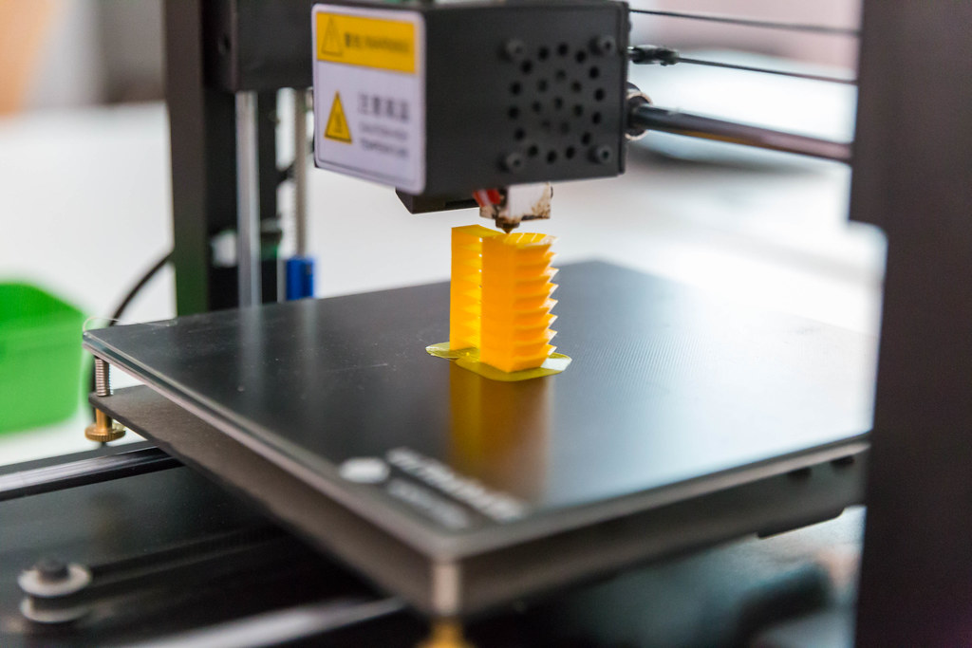
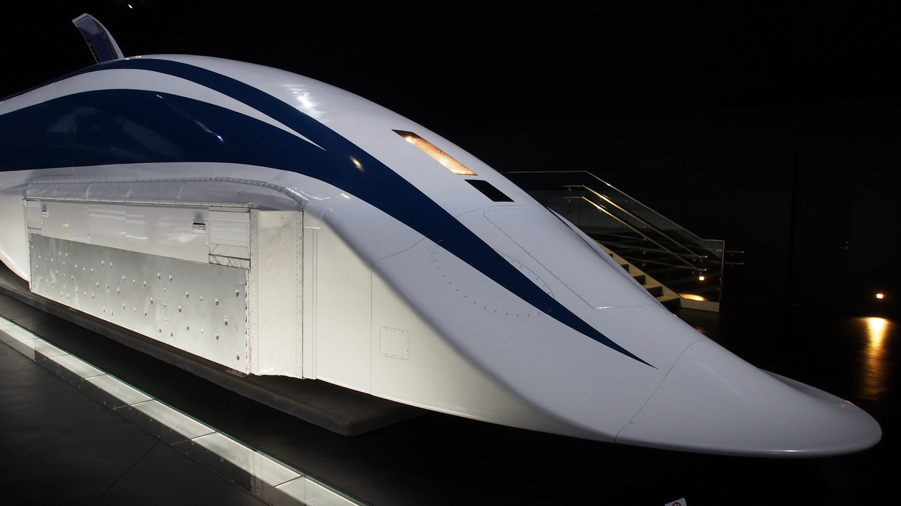
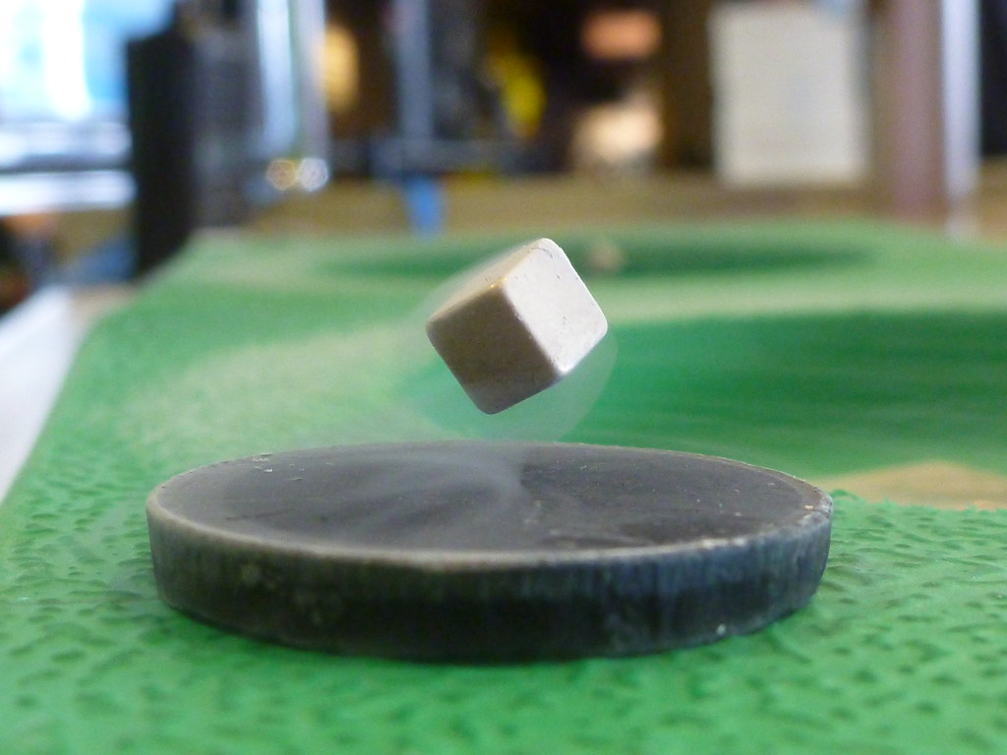
Engineering Jobs (Trabajos de Ingeniería)
This Photo by Unknown Author is licensed under CC BY-SA
This Photo by Unknown Author is licensed under CC BY-ND
This Photo by Unknown Author is licensed under CC BY
Notes:
Materials Engineering
Ask students what they see in the pictures.
Explain to students that learning about and using different materials is called material engineering.
Ask students if all the magnets in the book looked the same
Ask students if the materials that were attracted to the magnets were the same.
Explain to students that not all things have the same strength of attraction to magnets.

Slide 6
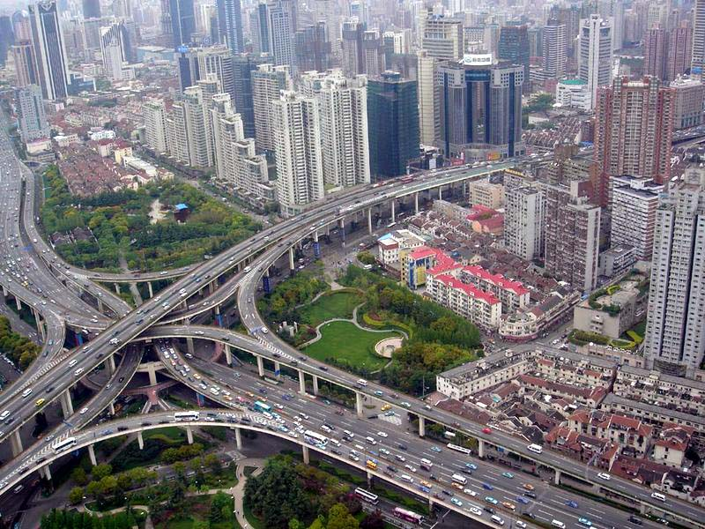
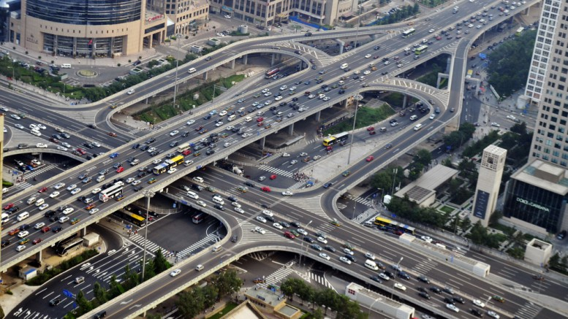
Engineering Jobs (Trabajos de Ingeniería)
This Photo by Unknown Author is licensed under CC BY
This Photo by Unknown Author is licensed under CC BY-SA
Notes:
Ask students what they see in the pictures.
Explain to students what they are seeing in the pictures is called civil engineering. Civil engineers use a type of science called physics and math to build structures that help people. Civil engineers will build many different things like bridges, highways, towers, and water systems!
Ask students if they think we use magnets in our buildings. Explain to students that civil engineers have started to use magnetic materials to improve our buildings and streets!

Slide 7
Engineering Design (Diseño de Ingeniería)
What is engineering?
(¿Qué es la ingeniería?)
What are engineering jobs?
(¿Qué son los trabajos de ingeniería?)
Who can be an engineer?
(¿Quién puede ser ingeniero?)

Slide 8
Engineering Design Process (Proceso de Diseño de Ingeniería)

Slide 9
Problem
Jose loves to entertain his community by designing hay mazes every year. He needs some help this year in thinking of a new maze design.
Today, you will be putting on your engineering hat to build a maze!
Notes:
Teacher will read the bolded scenario to students
Ask students what problem Jose is having right now.
Explain to students that they will put on their engineering hat today to help Jose design a maze.

Slide 10
Problema
A José le encanta entretener a su comunidad diseñando laberintos de heno cada año. Necesita ayuda este año para pensar en un nuevo diseño de laberinto.
¡Hoy te pondrás tu sombrero de ingeniero para construir un laberinto!
Notes:
Teacher will read the bolded scenario to students
Ask students what problem Jose is having right now.
Explain to students that they will put on their engineering hat today to help Jose design a maze.

Slide 11
Criteria (Desired Outcomes) (Criterios (Resultados Deseados))
A successful maze design should include the following:
One path connecting one entrance and one exit
Paths wide enough for a magnet to fit
All key elements drawn (connected walls, entrance, and exit)
Bonus Points: The maze takes at least 20 seconds to solve.
Bonus Points: The maze barriers stay up on their own.
Un diseño de laberinto exitoso debe incluir lo siguiente:
Un camino que conecta una entrada y una salida
Caminos lo suficientemente anchos como para que quepa un imán
Todos los elementos clave dibujados (paredes conectadas, entrada y salida)
Puntos de bonificación: El laberinto tarda al menos 20 segundos en resolverse.
Puntos de bonificación: Las barreras del laberinto se mantienen en pie por sí solas.

Slide 12
Constraints (Limitations)
Time Limit: You will have 25 minutes to build the maze.
Materials: You will be able to use 20 items to build the maze.
Counters: You will have 20 counters to complete this challenge.
Collaboration: One design element from each team member must be used in the final design.
Redesign: Each team can test their prototype as many times as needed during the 25-minute design phase.

Slide 13
Restricciones (Limitaciones)
Límite de tiempo: Tendrás 25 minutos para construir el laberinto.
Materiales: Podrás usar 20 artículos para construir el laberinto.
Contadores: Tendrás 20 contadores para completar este desafío.
Colaboración: El diseño final debe de incluir un elemento diseñado por cada miembro del equipo.
Rediseño: Cada equipo puede probar su prototipo tantas veces como sea necesario durante la fase de diseño de 25 minutos.

Slide 14
Explore Materials (Explorar Materiales)
Materials (Materiales)​ | Cost (Costo)​
Thick Foam Sheet (Hoja de Espuma Gruesa) | No cost
Magnets (Imanes) | No cost
Magnetic Wand (Varita Magnética) | No cost
Chopsticks (Palillos) | 1 counter per stick
Marker (Marcador) | 1 counter per marker
Colored Pencils (Lápices de Colores) | 1 counter per pencil
Glue Stick (Barra de Pegamento) | 4 counters per stick
Scissors (Tijeras) | 1 counter per pair
Construction Paper (Papel de Construcción) | 1 counter per sheet
Toilet Paper Rolls (Rollos de Papel Higienico) | 1 counter per roll
Chenille Sticks (Limpiapipas) | 1 counter per stick

Slide 15
Brainstorm (Idea Genial)
1 minute: Individual Design
Draw a plan of how you think Jose should build his maze.
5 minutes: Each member presents their ideas to the group.
Share your ideas and focus on things you like the most about your idea that you would like to see be used as a design element for the final design.
1 minuto: Diseño Individual
Dibuja un plan de cómo crees que Jose debería construir su laberinto.
5 minutos: Cada miembro presenta sus ideas al grupo.
Comparte tus ideas y señala las cosas que más te gustan de tu idea que te gustaría que se use como un elemento para el diseño final.

Slide 16
Gather Materials (Reunir Materiales)
A successful maze design should include the following:
One path connecting one entrance and one exit
Paths wide enough for a magnet to fit
All key elements drawn (connected walls, entrance, and exit)
Bonus Points: The maze takes at least 20 seconds to solve.
Bonus Points: The maze barriers stay up on their own.
Un diseño de laberinto exitoso debe incluir lo siguiente:
Un camino que conecta una entrada y una salida
Caminos lo suficientemente anchos como para que quepa un imán
Todos los elementos clave dibujados (paredes conectadas, entrada y salida)
Puntos de bonificación: El laberinto tarda al menos 20 segundos en resolverse.
Puntos de bonificación: Las barreras del laberinto se mantienen en pie por sí solas.

Slide 17
Team Member Responsibilities (Responsabilidades de los Miembros del Equipo)
Assign responsibilities to each team member during the process.
Material Manager: collects materials
Banker: manages the counters
Head Engineer: measure the maze
Quality Control Manager: match the design to the prototype
Asignar responsabilidades a cada miembro del equipo durante el proceso.
Administrador de Materiales: recopila materiales
Banquero: maneja los contadores
Ingeniero Jefe: medir el laberinto
Gerente de Control de Calidad: haga coincidir el diseño con el prototipo

Slide 18
Design Your Maze! (¡Diseña Tu Laberinto!)

Slide 19
Criteria (Desired Outcomes) (Criterios (Resultados Deseados))
A successful maze design should include the following:
One path connecting one entrance and one exit
Paths wide enough for a magnet to fit
All key elements drawn (connected walls, entrance, and exit)
Bonus Points: The maze takes at least 20 seconds to solve.
Bonus Points: The maze barriers stay up on their own.
Un diseño de laberinto exitoso debe incluir lo siguiente:
Un camino que conecta una entrada y una salida
Caminos lo suficientemente anchos como para que quepa un imán
Todos los elementos clave dibujados (paredes conectadas, entrada y salida)
Puntos de bonificación: El laberinto tarda al menos 20 segundos en resolverse.
Puntos de bonificación: Las barreras del laberinto se mantienen en pie por sí solas.

Slide 20
Scorecard
CRITERIA | POINTS |  |  | SCORE
 | 2 | 1 | 0
COLLABORATION | The design has elements contributed by all team members. | The design has elements contributed by two team members. | The design does not have elements contributed by each team member.
SOLVABLE MAZE | The design has a solvable entrance and exit. | The design does not have a solvable entrance and exit. | The design does not have an entrance and/or exit.
PATH WIDTH | The design has enough space for the magnet/maze runner to fit everywhere. | The design has some areas where the magnet/maze runner does not fit. | The design does not have enough space for the magnet/maze runner.
KEY ELEMENTS DRAWN | The design has all three key elements drawn (connected walls, entrance, exit). | The design has two of three key elements drawn (connected walls, entrance, exit). | The design does not have key elements drawn.
COUNTERS | 15 counters or less. | 16 – 20 counters. | 21 counters or more.
BONUS: TIME | The maze took more than 20 seconds to solve. | The maze took between 10 seconds and 19 seconds to solve. | The maze took less than 10 seconds to solve.
BONUS: BARRIERS | The design has barriers that all stay up on their own. | The design has some barriers that stay up on their own. | The design does not have barriers that stay up on their own.
 |  |  | TOTAL SCORE

Slide 21
Tanteador
CRITERIOS | PUNTOS |  |  | PUNTAJE
 | 2 | 1 | 0
COLABORACIÓN | El diseño tiene elementos aportados por todos los miembros del equipo. | El diseño tiene elementos aportados por dos miembros del equipo. | El diseño no tiene elementos aportados por cada miembro del equipo.
LABERINTO SOLUCIONABLE | El diseño tiene una entrada y una salida solucionables. | El diseño no tiene una entrada y salida que se puedan resolver. | El diseño no tiene entrada y/o salida.
ANCHO DEL CAMINO | El diseño tiene suficiente espacio para que el imán/corredor de laberinto quepa en todas partes. | El diseño tiene algunas áreas donde el imán/corredor del laberinto no encaja. | El diseño no tiene suficiente espacio para el imán/corredor del laberinto.
ELEMENTOS CLAVE DIBUJADOS | El diseño tiene dibujados los tres elementos clave (paredes conectadas, entrada, salida). | El diseño tiene dibujados dos de los tres elementos clave (paredes conectadas, entrada, salida). | El diseño no tiene elementos clave dibujados.
CONTADORES UTILIZADOS | 15 contadores o menos. | 16 – 20 contadores. | 21 contadores o más.
PUNTOS ADICIONALES: TIEMPO | El laberinto tardó más de 20 segundos en resolverse. | El laberinto tardó entre 10 y 19 segundos en resolverse. | El laberinto tardó menos de 10 segundos en resolverse.
PUNTOS ADICIONALES: BARRERAS | El diseño tiene barreras que se mantienen solas. | El diseño tiene algunas barreras que se mantienen por sí solas. | El diseño no tiene barreras que se mantengan solas.
 |  |  | PUNTAJE TOTAL

Slide 22
Redesign: Discussion (Rediseño: Discusión)
What worked?
What did not work?
What do you want to improve?
¿Qué funcionó?
¿Qué fue lo que no funcionó
¿Qué quieres mejorar?

