Slide 1
Maintaining a Balance

Slide 2
Ecosystem Ecosistema
Hawk (Halcón)
Snake (Víbora)
Rabbit (Conejo)
Lizard (Lagartija)
Mouse
(Ratón)
Grasshopper
(Saltamontes)
Grass (Césped)

Slide 3
Predator vs. Prey
Establish in your team who is the picker for this round.
Lay your piece of turf on the table (grass side up) and dump the biodiversity box on top of the turf. Make sure to empty all contents onto the turf.
Using just one hand the picker will pick up as many pieces of wildlife (beads and seeds) for 30 seconds. Picker can only pick up one species at a time.
Once the 30 seconds is up, separate your species into the mini cups according to their color and size and count.

Slide 4
Depredador vs. Presa
Establece en tu equipo quién es el seleccionador de esta ronda.
Coloca tu trozo de césped sobre la mesa (con el césped hacia arriba) y descarga la caja de biodiversidad encima del césped. Asegúrate de vaciar todo el contenido en el césped.
Con una sola mano, el recolector recogerá la mayor cantidad posible de vida silvestre (cuentas y semillas) durante 30 segundos. El recolector solo puede recoger una especie a la vez.
Una vez que hayan pasado los 30 segundos, separe su especie en las mini tazas según su color, tamaño y cantidad.

Slide 5
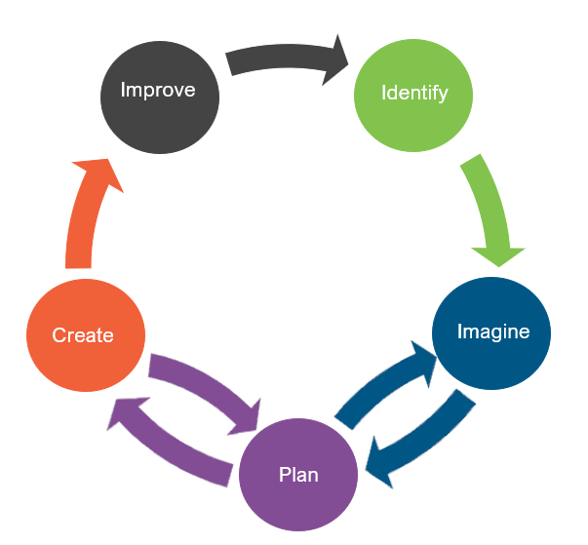
Engineering Design (Diseño de Ingeniería)
What is engineering?
(¿Qué es la ingeniería?)

Slide 6
Engineering Design (Diseño de Ingeniería)
What is engineering?
(¿Qué es la ingeniería?)
What are engineering jobs?
(¿Qué son los trabajos de ingeniería?)

Slide 7
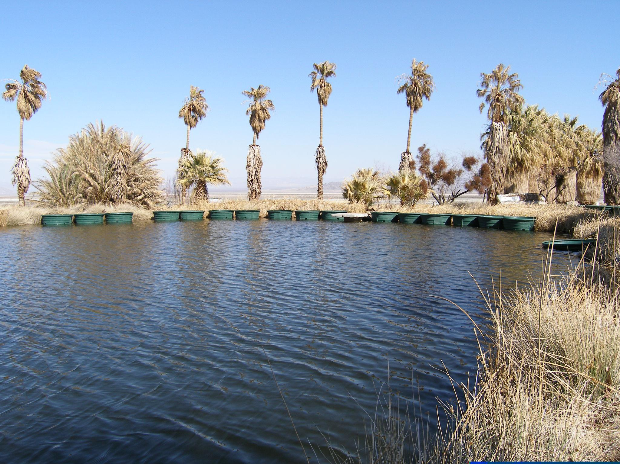
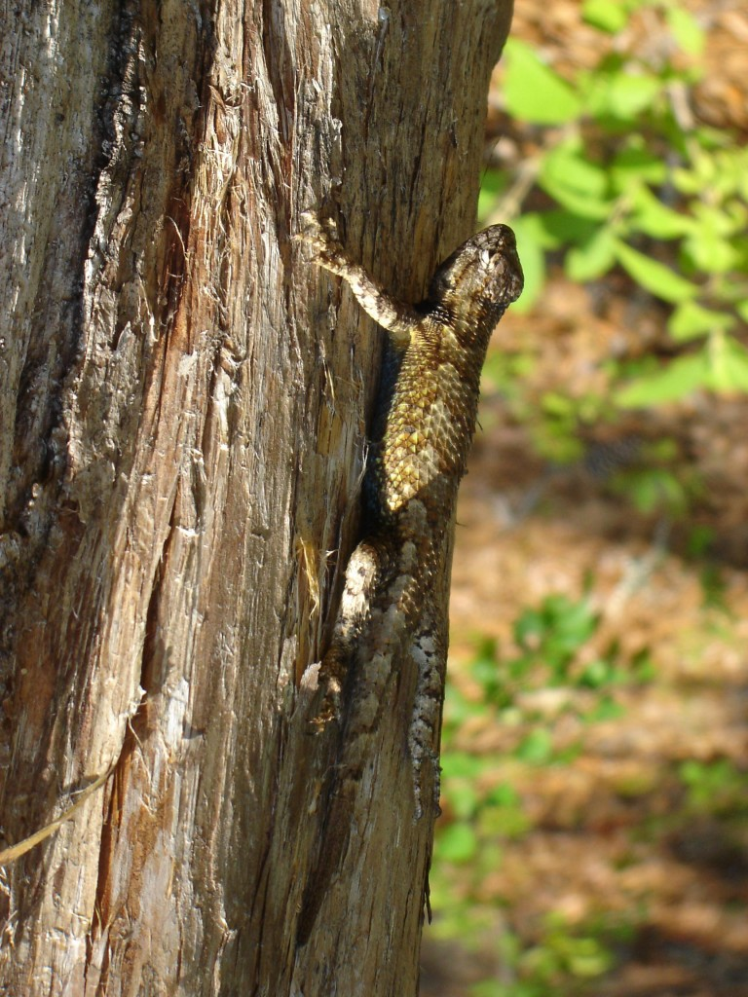
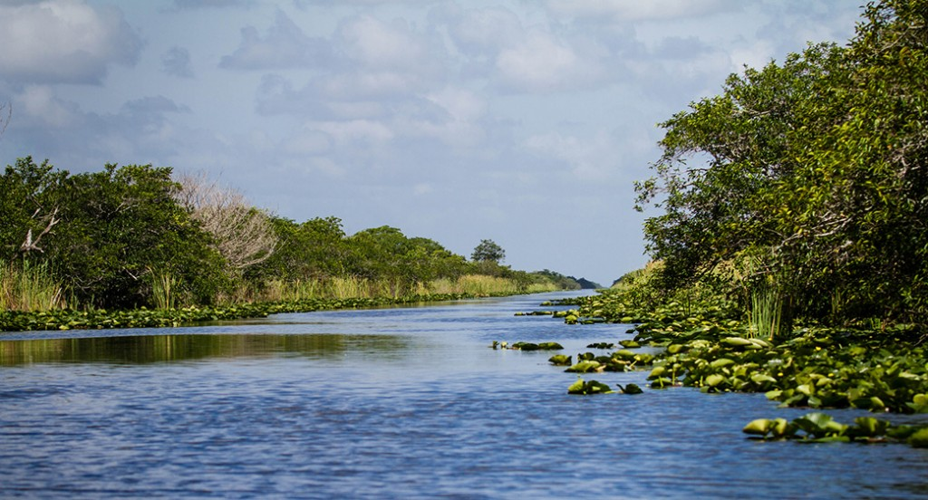
Engineering Jobs (Trabajos de Ingeniería)
This Photo by Unknown Author is licensed under CC BY-SA-NC
This Photo by Unknown Author is licensed under CC BY-NC-ND
This Photo by Unknown Author is licensed under CC BY-SA

Slide 8
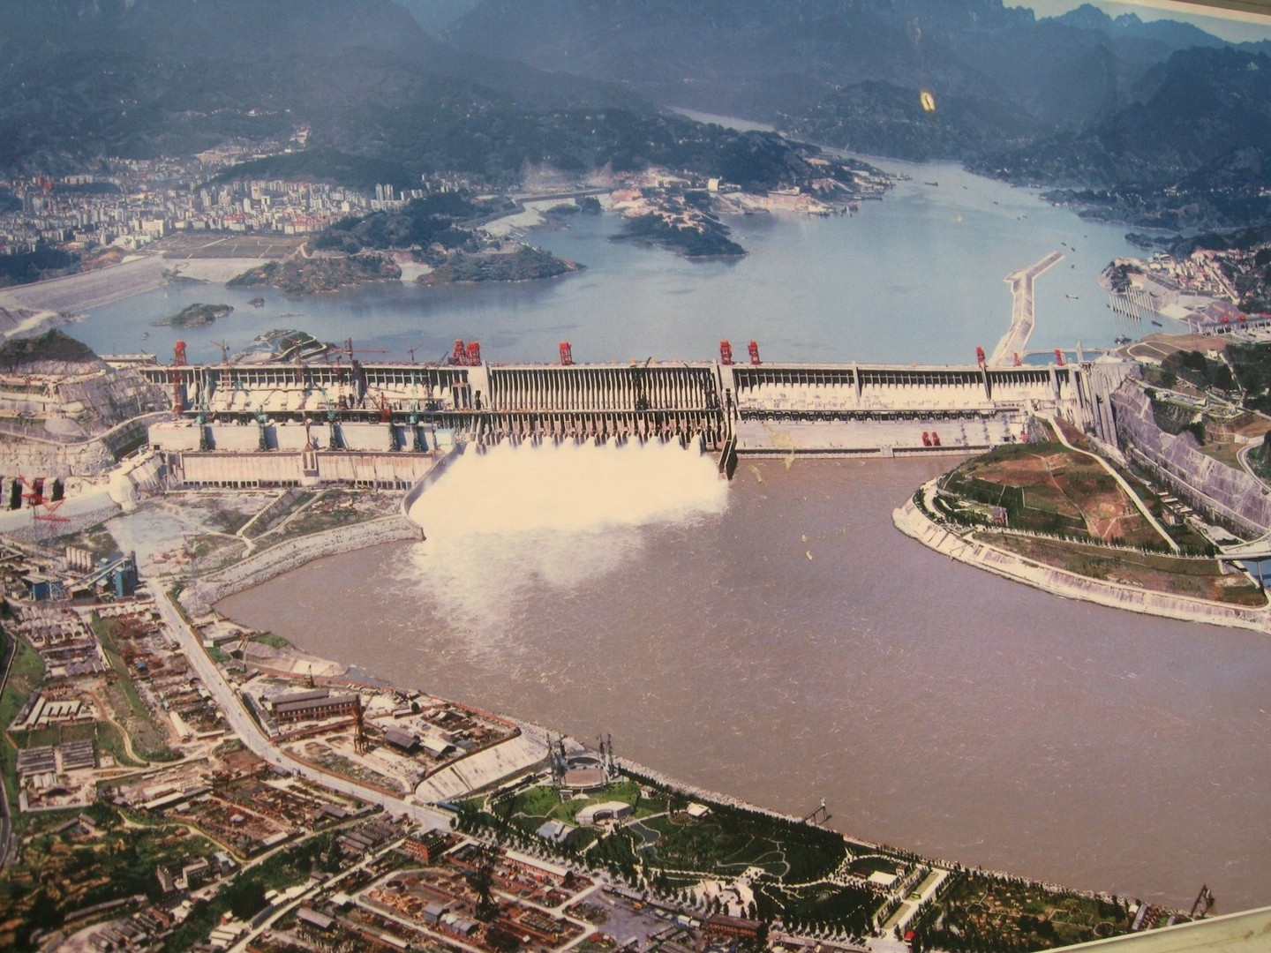
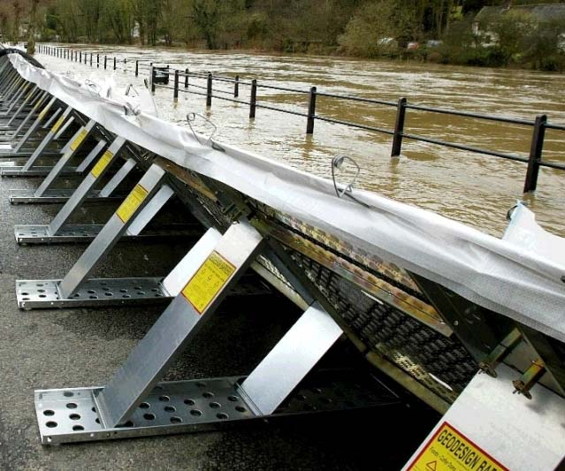
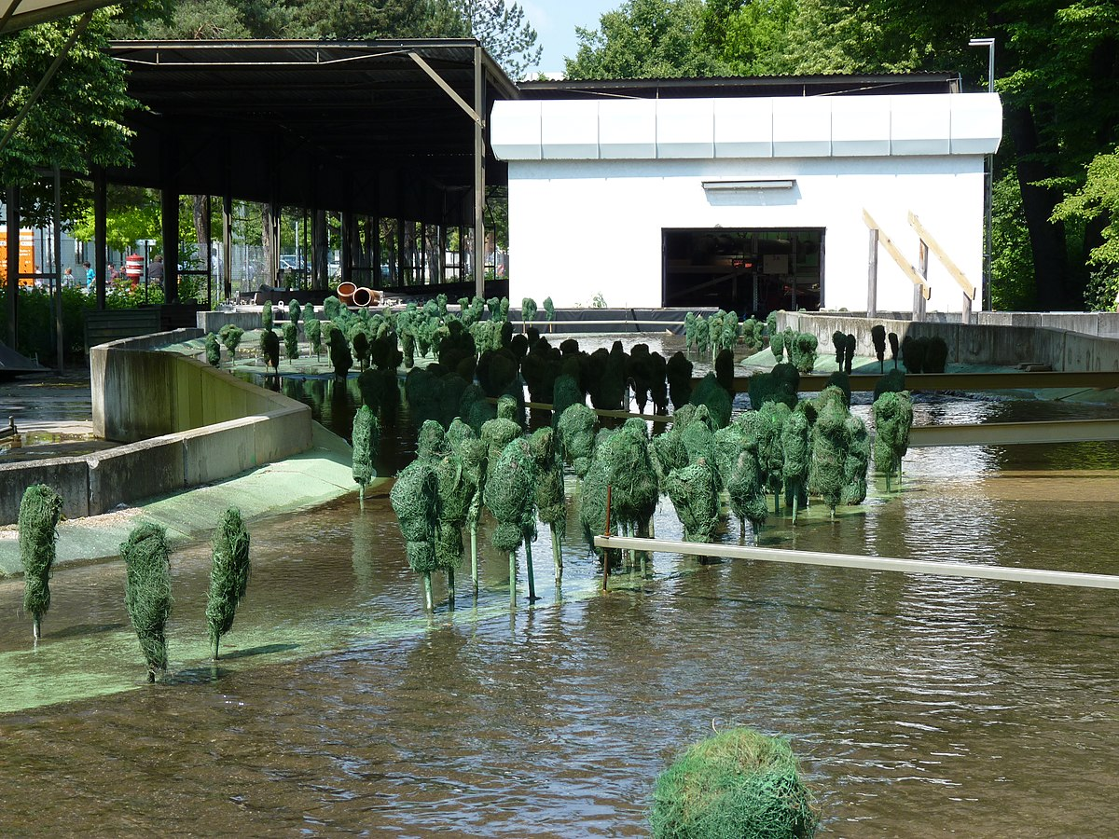
Engineering Jobs (Trabajos de Ingeniería)
This Photo by Unknown Author is licensed under CC BY-SA
This Photo by Unknown Author is licensed under CC BY-SA-NC
This Photo by Unknown Author is licensed under CC BY-SA

Slide 9
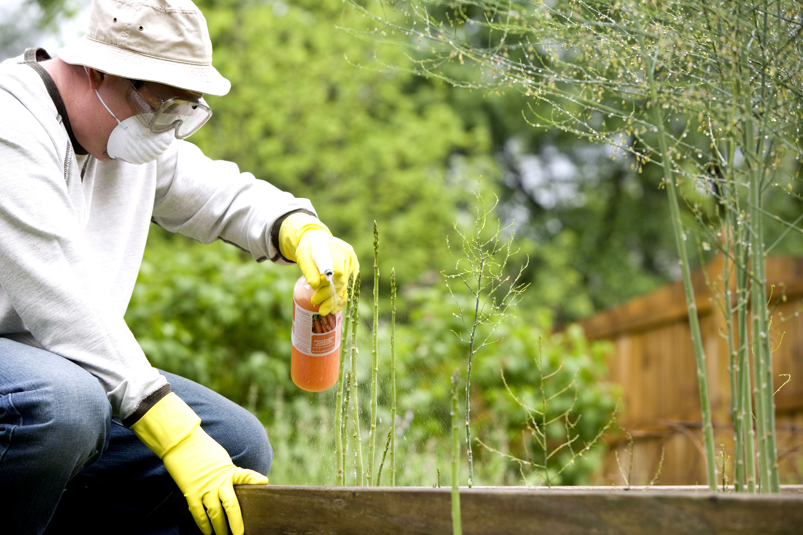
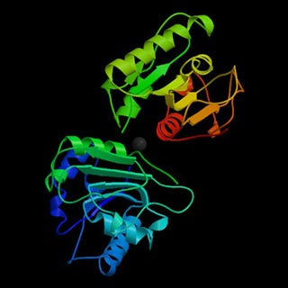
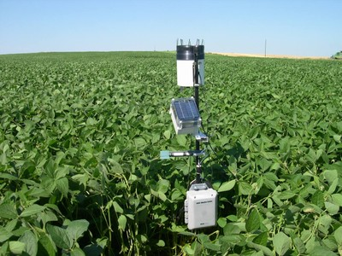
Engineering Jobs (Trabajos de Ingeniería)
This Photo by Unknown Author is licensed under CC BY-SA-NC
This Photo by Unknown Author is licensed under CC BY-SA
This Photo by Unknown Author is licensed under CC BY

Slide 10
Engineering Design (Diseño de Ingeniería)
What is engineering?
(¿Qué es la ingeniería?)
What are engineering jobs?
(¿Qué son los trabajos de ingeniería?)
Who can be an engineer?
(¿Quién puede ser ingeniero?)

Slide 11
Engineering Design Process (Proceso de Diseño de Ingeniería)

Slide 12
Problem
Our ecosystem’s population balance has a problem with an invasive species. It is running rampant and out of control. There are simply too many of them due to having no natural predator. As a result, some of the native species are being negatively impacted.
Today, you will put on your engineering hat to assist in removing an invasive species population within an ecosystem. Your team will have an opportunity to design a process that will remove the invasive species and restore the health of your ecosystem.
Notes:
Have student read the bolded scenario.
Ask students what problem our ecosystem is having right now.
Explain to students that they will put on their engineering hat today to fix our ecosystem by designing a process to eliminate the invasive species.

Slide 13
Problema
El equilibrio de la población de nuestro ecosistema tiene un problema con una especie invasora. Está corriendo rampante y fuera de control. Simplemente hay demasiados debido a que no tienen un depredador natural. Como resultado, algunas de las especies nativas están siendo impactadas negativamente.
Hoy, te pondrás tu sombrero de ingeniero para ayudar a eliminar una población de especies invasoras dentro de un ecosistema. Tu equipo tendrá la oportunidad de diseñar un proceso que eliminará las especies invasoras y restaurará la salud de su ecosistema.

Slide 14
Criteria (Desired Outcomes) (Criterios (Resultados Deseados))
A successfully designed process will do the following in one minute:
Eliminates the invasive species (lettuce seeds)
Protects the native species (beads)
Limits environmental damage
Un proceso diseñado con éxito hará lo siguiente en un minuto:
Elimina las especies invasoras (semillas de lechuga)
Protege las especies autóctonas (perlas)
Limita el daño ambiental

Slide 15
Constraints (Limitations)
Time Limit: You will have 25 minutes to design a process.
Materials: You can only use the materials available.
Budget: You will have $1,000 to complete this challenge.
Collaboration: One design element from each team member must be used in the final design.
Redesign: Each team can test their process as many times as needed during the 25-minute design phase.

Slide 16
Restricciones (Limitaciones)
Límite de Tiempo: Tendrás 25 minutos para diseñar un proceso.
Materiales: Solo puedes usar los materiales disponibles.
Presupuesto: Tendrás $1,000 para completar este desafío.
Colaboración: El diseño final debe de incluir un elemento diseñado por cada miembro del equipo.
Rediseño: Cada equipo puede probar su proceso tantas veces como sea necesario durante la fase de diseño de 25 minutos.

Slide 17
Explore Materials (Explorar Materiales)
Free Materials (Materiales Gratis)​​
Biodiversity Box (Caja de Biodiversidad)
Artificial Turf (Césped Artificial)​
Turf Container (Contenedor de Césped)
Materials (Materiales)​​ | Cost (Costo)​​
Tweezers (Pinzas) | $400 per pair​
Straws (Popotes) | $100 per straw
Scissors (Tijeras) | $100 per pair
Tape (Cinta Adhesiva) | $100 per roll
Hand Rake (Rastrillo de Mano) | $400 per rake
Hand Shovel (Pala de Mano) | $300 per shovel
Sieve (Tamiz) | $300 per sieve
Comb (Peine) | $300 per comb
Materials (Materiales)​​ | Cost (Costo)​​
Plastic Spoon (Cuchara de Plástico) | $150 per spoon
Plastic Fork (Tenedor de Plástico) | $150 per fork
Chenille Sticks (Limpiapipas) | $100 per stick
Fan (Ventilador) | $200 per fan
Flashlight (Linterna) | $200 per flashlight
String (Cuerda) | $100 per 10 cm
Water (Agua) | $200 per 1000 mL

Slide 18
Brainstorm (Idea Genial)
1 minute: Individual Design
Develop a process to eliminate the invasive species.
5 minutes: Each member presents their ideas to the group.
Share your ideas and focus on things you like the most about your idea. Select a component you would like to see used in the final design.
1 minuto: Diseño Individual
Desarrollar un proceso para eliminar las especies invasoras.
5 minutos: Cada miembro presenta sus ideas al grupo.
Comparte tus ideas y señala las cosas que más te gustan de tu idea que te gustaría que se use como un elemento para el diseño final.
Notes:
Give students 1 minute to individually design and draw a plan of how they think the ecosystem and/or tool will look. Students should not talk during this minute or share ideas with each other. Remind students their ideas will be used as design elements for the final design.
After a minute, give students 5 minutes to present and share their ideas with the group. Let students know that they should focus on key aspects of their idea to be used as design elements for the final design when sharing.

Slide 19
Gather Materials (Reunir Materiales)
A successfully designed process will do the following in one minute:
Eliminate the invasive species (lettuce seeds)
Protect the native species (beads)
Limit environmental damage
Un proceso diseñado con éxito hará lo siguiente en un minuto:
Elimina las especies invasoras (semillas de lechuga)
Protege las especies autóctonas (perlas)
Limita el daño ambiental
Notes:
Handout the score card that will be used during the design challenge. Review the testing criteria with the class and answer questions. The testing criteria will inform their design decisions.
Design a process that:
removes invasive species (lettuce seeds)
leaves native species unharmed (beads)
limits environmental damage
Have students collaborate to come up with a final design. Let students know they must include at least one element from each team member for their final design.
Students will need to select the materials to be used for the design and develop a budget for the project. Students will have 100 counters to purchase materials for their build at the classroom supply table. The prices used in this challenge can be found in the materials list. Students will raise their hand when they ready to purchase materials and will be guided by the teacher to ensure that they do not spend more than 100 counters. Students can go over the counter limit if they really want to but remind them that they will lose points on their score card.

Slide 20
Team Member Responsibilities (Responsabilidades de los Miembros del Equipo)
Assign responsibilities of each team member during the process
Material Manager: collects materials
Banker: manages the budget
Head Engineer: counts and groups the removed species
Quality Control Manager: records the process steps
Asignar responsabilidades a cada miembro del equipo durante el proceso.
Administrador de Materiales: recopila materiales
Banquero: maneja presupuesto
Jefe de Ingenieros: cuenta y agrupa las especies eliminadas
Gerente de Control de Calidad: registra los pasos del proceso

Slide 21
Design Your Process! (¡Diseña Tu Proceso!)

Slide 22
Criteria (Desired Outcomes) (Criterios (Resultados Deseados))
A successfully designed process will do the following in one minute:
Eliminates the invasive species (lettuce seeds)
Protects the native species (beads)
Limits environmental damage
Un proceso diseñado con éxito hará lo siguiente en un minuto:
Elimina las especies invasoras (semillas de lechuga)
Protege las especies autóctonas (perlas)
Limita el daño ambiental

Slide 23
Scorecard
CRITERIA | POINTS |  |  |  | SCORE
 | 3 | 2 | 1 | 0
COLLABORATION |  | The design has elements contributed by all team members. | The design has elements contributed by two team members. | The design does not have elements from each team member.
INVASIVE SPECIES | 100% of the invasive species was eliminated. | 75% or more of the invasive species were eliminated and can be partially seen throughout the ecosystem. | Less than 50% of the invasive species were eliminated and can be visibly seen throughout the ecosystem. | None of the invasive species was eliminated.
NATIVE SPECIES | None of the native species were eliminated. | Less than 50% of the native species were eliminated and can be visibly seen throughout the ecosystem. | 75% or more of the native species were eliminated and can be partially seen through the ecosystem. | 100% of the native species were eliminated.
ENVIRONMENT | The environment was not damaged. | The environment was temporarily damaged, but effects were short lasting. | The environment was temporarily damaged, but effects were long lasting. | The environment was permanently damaged.
BUDGET USED | $800 or less. | $801 – $899. | $900 – $1,000. | $1,001 or more.
 |  |  |  | TOTAL SCORE
Notes:
Remember to write down your total score at the bottom right to see how well you did! Remember, you can test as many times as you want during the 25 minutes to get as a high of a score as possible!
Students will calculate their score when testing in front of the teacher or facilitator.

Slide 24
Tanteador
CRITERIOS | PUNTOS |  |  |  |  |  | PUNTAJE
 | 3 |  | 2 | 1 |  | 0
COLABORACIÓN |  |  | El diseño cuenta con elementos aportados por todos los miembros del equipo. | El diseño cuenta con elementos aportados por dos miembros del equipo. |  | El diseño no tiene elementos de cada miembro del equipo.
ESPECIES INVASIVAS | Se eliminó el 100% de las especies invasoras. |  | Se eliminaron el 75% o más de las especies invasoras y se pueden observar parcialmente en todo el ecosistema. | Menos del 50% de las especies invasoras fueron eliminadas y pueden verse visiblemente en todo el ecosistema. |  | Ninguna de las especies invasoras fue eliminada.
ESPECIES NATIVAS | Ninguna de las especies nativas fue eliminada. |  | Menos del 50% de las especies nativas fueron eliminadas y pueden verse visiblemente en todo el ecosistema. | El 75% o más de las especies nativas fueron eliminadas y pueden verse parcialmente a través del ecosistema. |  | Se eliminaron el 100% de las especies nativas.
MEDIO AMBIENTE | El medio ambiente no fue dañado. |  | El medio ambiente fue dañado temporalmente, pero los efectos fueron de corta duración. | El medio ambiente fue dañado temporalmente, pero los efectos fueron duraderos. |  | El medio ambiente quedó permanentemente dañado.
PRESUPESTO UTILIZADO | $800 o menos. |  | $801 - $899. | $900 – $1,000. |  | $1,001 o más.
 |  |  |  |  | PUNTAJE TOTAL

Slide 25
Redesign: Discussion (Rediseño: Discusión)
What worked?
What did not work?
What do you want to improve?
¿Qué funcionó?
¿Qué fue lo que no funcionó?
¿Qué quieres mejorar?

