Slide 1
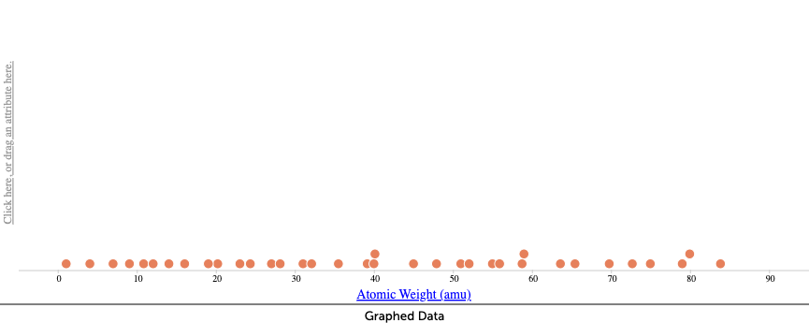
Look for Unique Properties

Slide 2
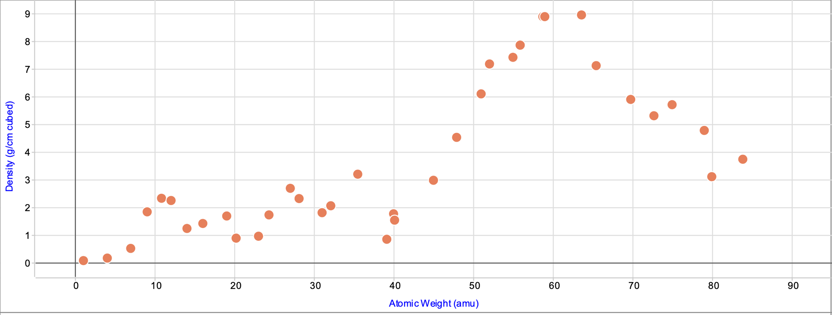
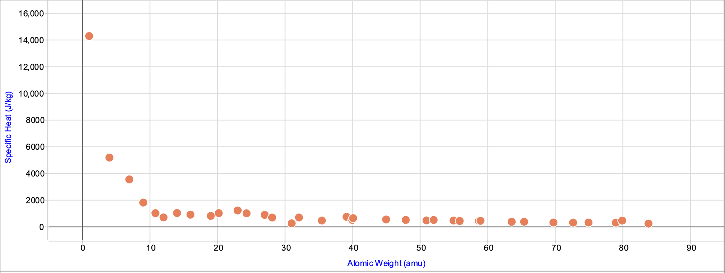
Trends

Slide 3
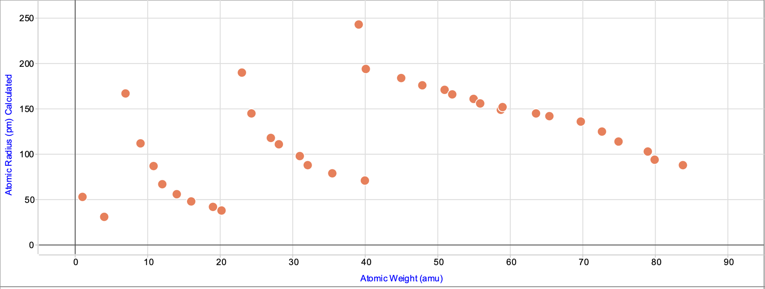
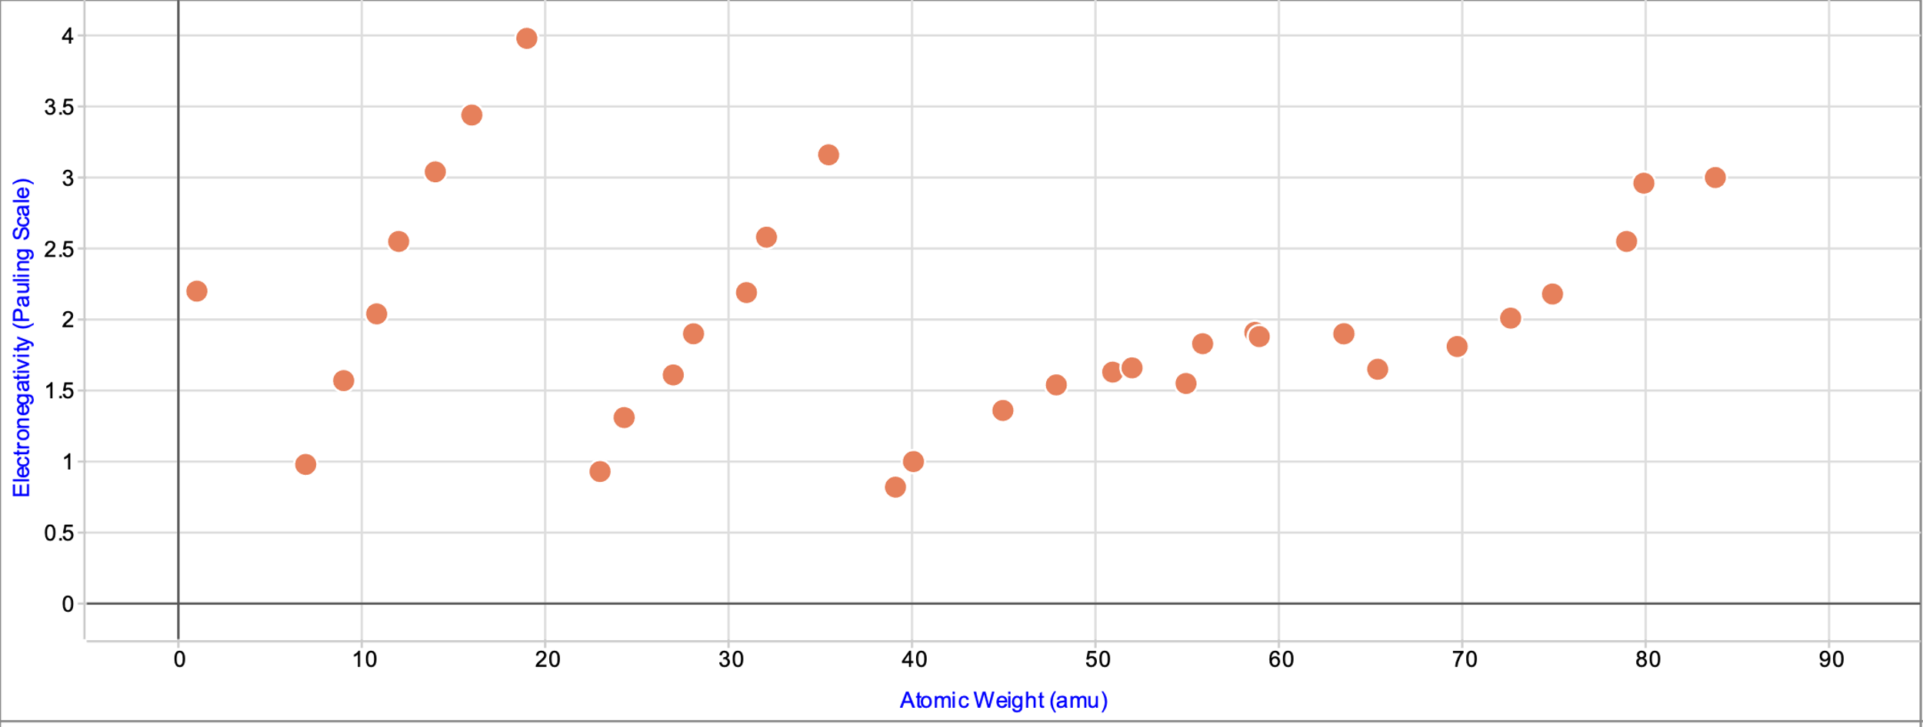
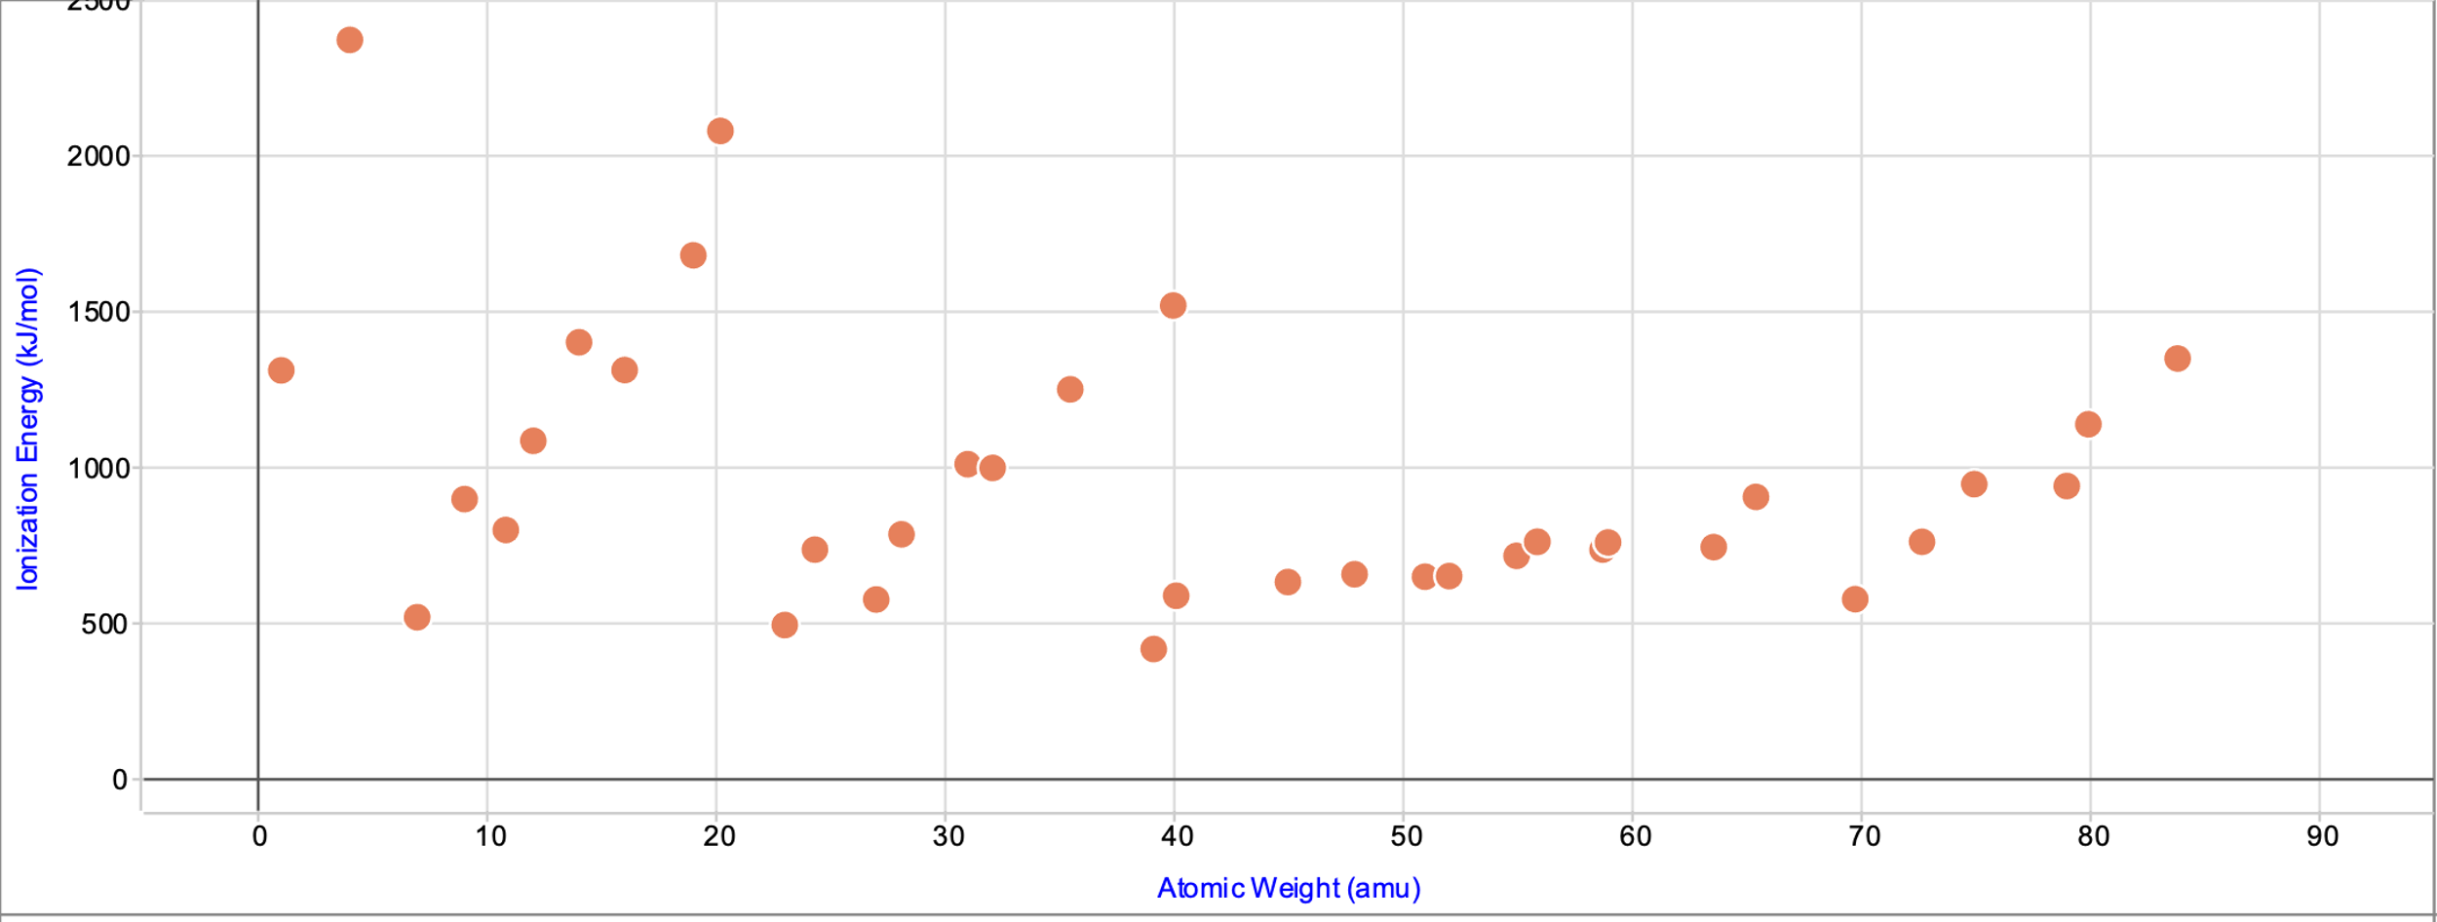
Patterns

Slide 4
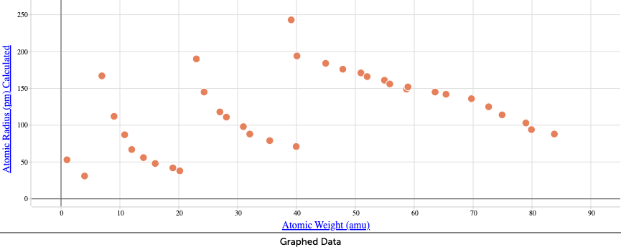
Visualizing the Data

Slide 5
Visualizing the Data
Atomic Weight Increases
Electronegativity and Ionization Energy Increase
Atomic Radius Decreases
Specific Heat Decreases
Ie
It
I
A
It
I
A
Ie
I
Ie
It
I
A
Ie
It
A
I
A
M
D
O
In
G
T
H
E
Wo
R
Ko
F
Ad
At
As
C
Ie
N
Ti
S
Ta
Nd
No
Te
V
En
B
Ei
Ng
P
Ai
Df
Or
It

Slide 6
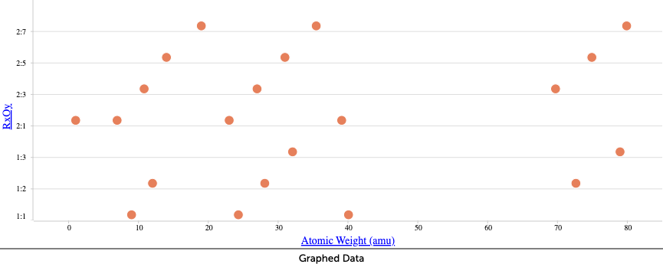
Visualizing the Data
I
A
M
D
O
In
G
T
H
E
Wo
R
Ko
F
Ad
At
As
C
Ie
N
Ti
S
Ta
Nd
No
Te
V
En
B
Ei
Ng
P
Ai
Df
Or
It

Slide 7
Visualizing the Data
Electronegativity and Ionization Energy Decrease
Atomic Weight Increases
Atomic Radius Increases
Specific Heat Decreases
Ie
It
I
A
It
I
A
Ie
I
Ie
It
I
A
Ie
It
A
I
A
M
D
O
In
G
T
H
E
Wo
R
Ko
F
Ad
At
As
C
Ie
N
Ti
S
Ta
Nd
No
Te
V
En
B
Ei
Ng
P
Ai
Df
Or
It

Slide 8
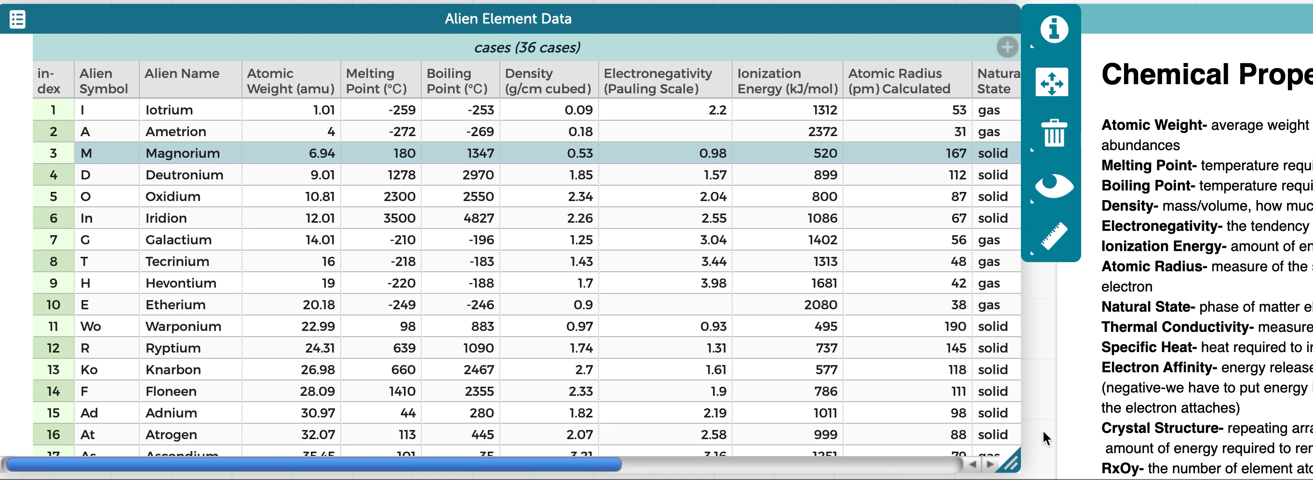
Viewing Valence Electrons

Slide 9
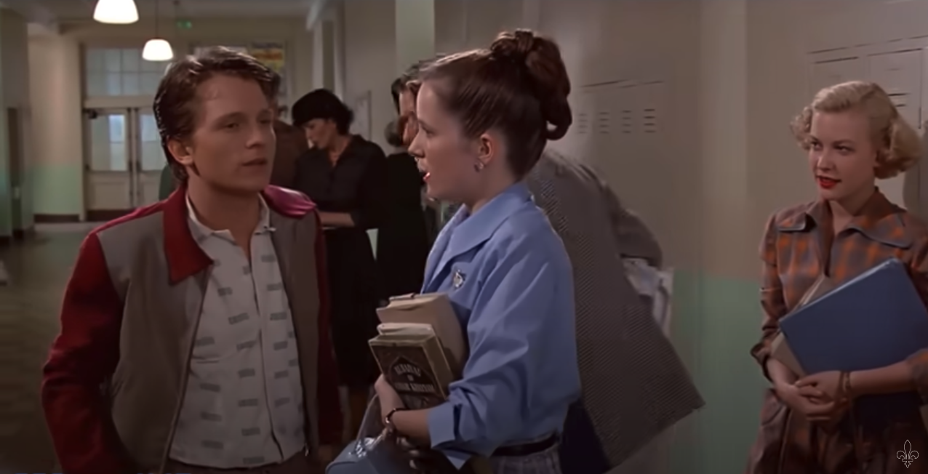

Slide 10


