Slide 1
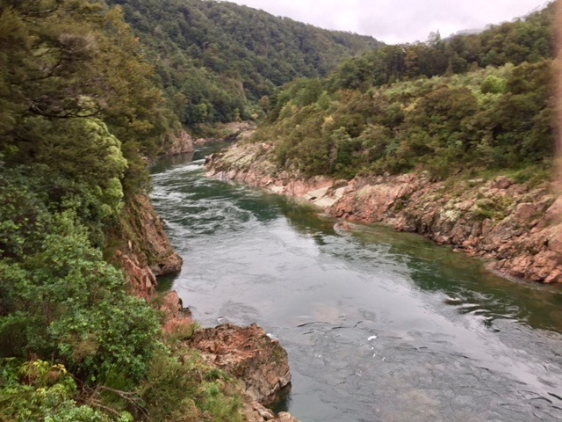
Do Now: Think, Pair, Share
This Photo by Unknown Author is licensed under CC BY-ND
Notes:
As students settle into class, pass out worksheets and ask students to complete the Do Now. They are to answer on their own before sharing out as a class.
Where was the photo taken?
Granite Rapids, Grand Canyon
What created the landform shape seen in the photo?
The movement of water.
Is the water moving and how do we know?
Yes, it is moving. We know from the white tops on the rivers and ripples.
What is the name of the river? Hint: It’s famous for canyons and whitewater rapids!
Colorado River

Slide 2





How Water Moves
Notes:
Introduce today’s activity on the movement of water and how it shapes the land.

Slide 3
Learning Objectives
Students will know:
How the Colorado River formed the Grand Canyon.
How changing the movement of water impacts erosion and sedimentation.
Students will understand:
The role of water in shaping our land.
How humans can impact the movement of water.
How models help us understand our world better.
Students will be able to:
Do the scientific method: Ask, predict, test, analyze, conclude.
Use the AR Sandbox to conduct an investigation.
Notes:
Inform students what we will be covering today.

Slide 4
Class Discussion
What is the disadvantage of using a picture to analyze?
How do you think the Grand Canyon was formed?
What exactly is the water doing to form the Grand Canyon?
What else can water do to shape landforms?
What clues can we use to know if water shaped the land?
Do you think it’s possible to see water actually moving and seeing what it is doing in real-time? How?
Notes:
Assess students understanding on topic.
What is the disadvantage of using a picture to analyze?
Not see how things happen, only what how things are now.
How do you think the Grand Canyon was formed?
Colorado River running through it over a long period of time.
What exactly is the water doing to form the Grand Canyon?
The water is removing the boulders, stones, rocks, and soil over time
What else can water do to shape landforms?
Cause sudden shifts in the land.
What clues can we use to know if water shaped the land?
Water carries the eroded rocks and soil and deposits them elsewhere.
Do you think it’s possible to see water actually moving and seeing what it is doing to the land? How could we do that?
Using models.

Slide 5
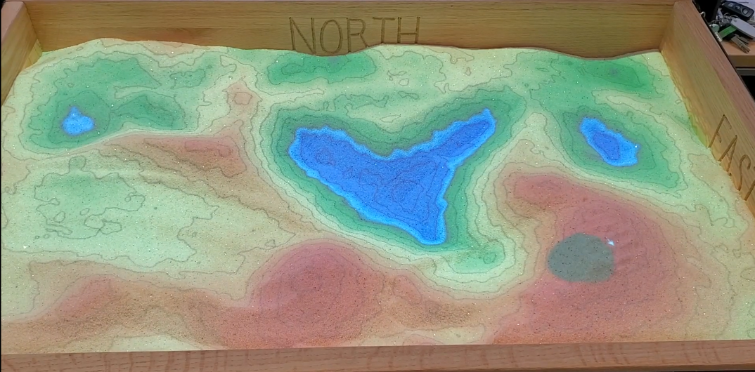
AR Sandbox
Notes:
Briefly explain what an AR Sandbox is, the rules, and that we will do a brief demonstration.
An AR Sandbox is a real sandbox that uses virtual topography (study of landforms and features) and water that is created with the help of a Microsoft Kinect 3D Camera, a projector, and some software from the computer. Using this technology, we can move the sand around in the sandbox and learn about geographic concepts in real time! However, since there are many of you and only one sandbox, we need to go over some rules!
Rules (appear after you click)
Must use gloves.
Only the teacher can water the sand.
Only one group at a time!
If unable to connect computer to project, the number of students who come up to see the demonstration is up to the teacher. During the lab time, only one group at a time may come up.
All sand must stay inside the sandbox.

Slide 6
Lab Investigation
What are the 6 steps in the scientific method?
Ask a question
Background research
Make your hypothesis
Test your hypothesis
Analyze and evaluate
Report your results
Notes:
Introduce lab investigation to the class. Review the scientific method (students will fill in blank on their worksheet).
Ask a question
Background research
Make your hypothesis
Test your hypothesis
Analyze and Evaluate
Report your results

Slide 7
Independent Variable
Notes:
Review independent variables with the class. Class will identify the potential independent variables. There are four that will be used, so help the class if needed to identify all four. You will fill this in real-time with the students.
Slope of the land
How fast/How much water comes down
The shape of the river
Objects/barriers in or along the river
Each variable must be covered collectively by the class. Multiple groups may pick the same variable.

Slide 8
Begin Your Investigation!
Notes:
Monitor groups as they work through their investigation. Groups will require teacher checks along the way to make sure they are on the right track before going up to the AR Sandbox. Groups will be required to draw a model of their hypothesis; some may need assistance in this. Explain that they are to draw what they think will happen based on their hypothesis. Ex. Higher slope will result in more erosion and sedimentation -> Their model should show a landform with a high slope, where the erosion and sedimentation occur after water runs down the high slope.

Slide 9
Share Your Results
Notes:
Groups will have written their conclusion statement on the board; share out results to the whole class. Have each group read out their own conclusion statement. Make sure they state the independent variable they wanted to explore, their question, and their hypothesis before stating the conclusion.

