Slide 1
Do Now: Think, Pair, Share
Read the introduction for today's activity.
Once you are done reading, find a partner and discuss the following question:
The main ingredients in most powdered drink mixes are sugar, citric acid, salt, and natural/artificial flavors. With this information, make a hypothesis; do you think the powdered Gatorade forms a mixture or chemically reacts to create Gatorade? Why?

Slide 2





Mixing Things Up

Slide 3
Learning Objectives
Calculate the density of known and unknown substances
Analyze collected data to determine if a new substance was created
Separate a mixture

Slide 4
What is a mixture?
When two or more different substances are combined and can be separated back into its original substances

Slide 5
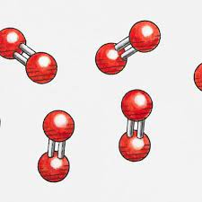
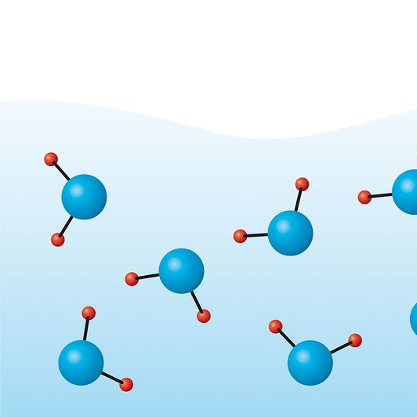
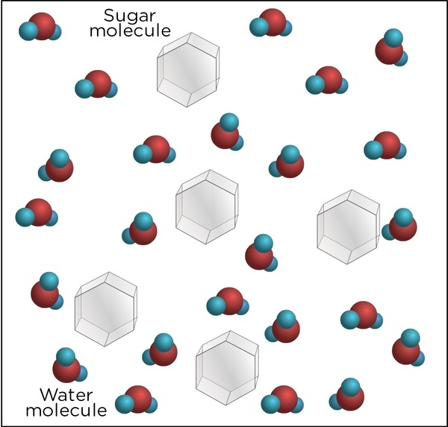
How do mixtures compare to substances?
Matter
Pure Substance
Element
Compound
Mixture

Slide 6
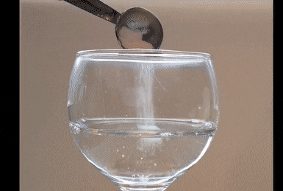
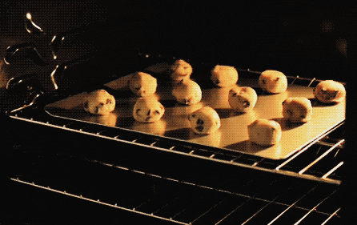
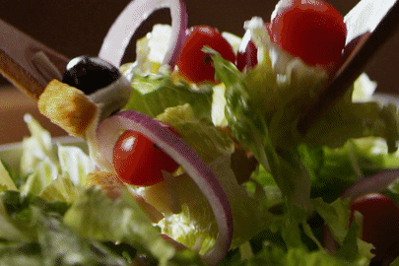
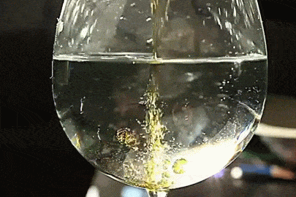
Types of Mixtures
Homogeneous
Heterogeneous
Saltwater
Air
Steel
Chocolate Chip Cookies
Salad
Oil and Water

Slide 7
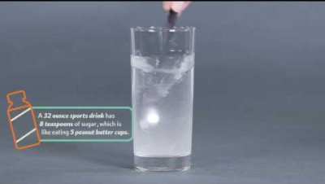
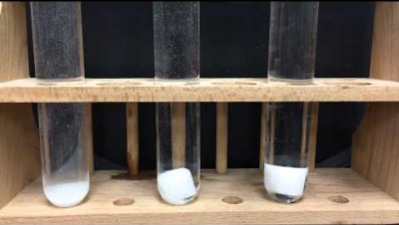
Solubility
The ability of a substance (or solute) to dissolve in solvent (usually a liquid).

Slide 8
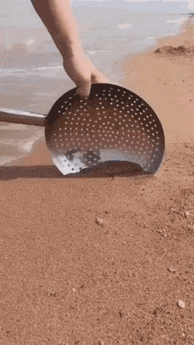
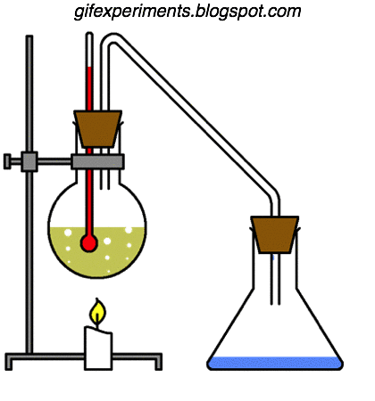
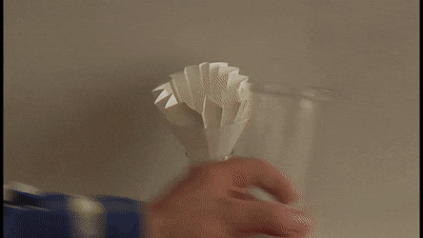
Separating Mixtures
Sifting
Filtration
Distillation

Slide 9
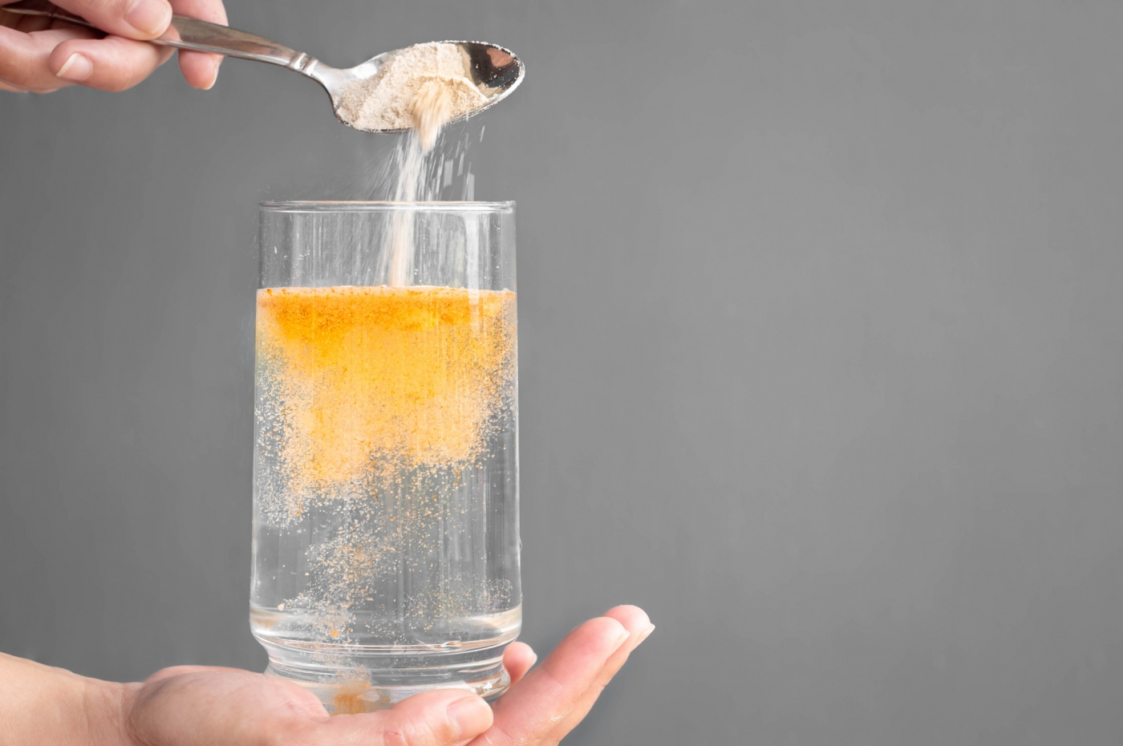
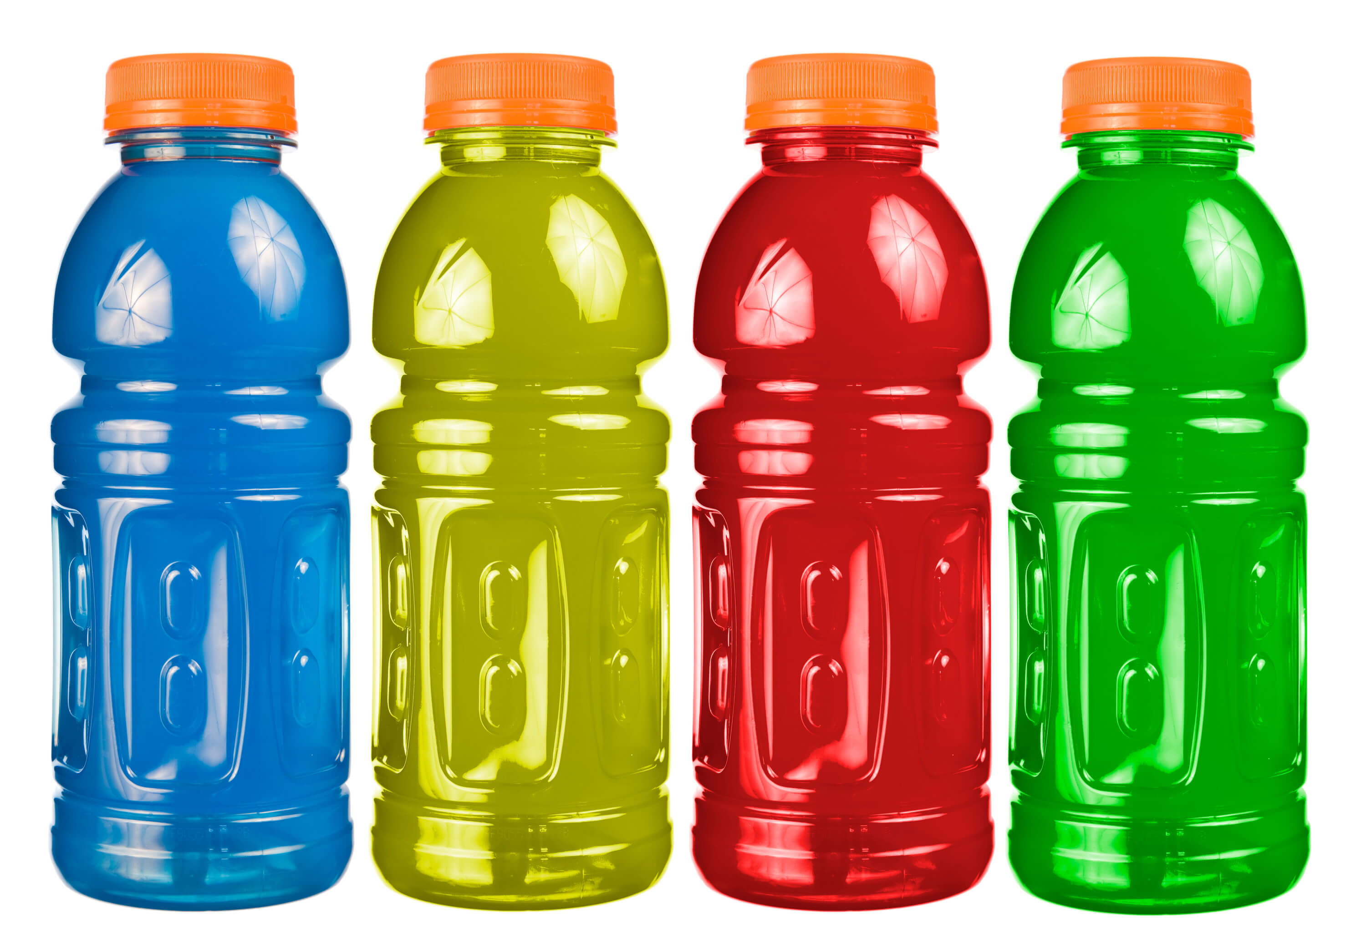
Today’s Investigation
versus

Slide 10
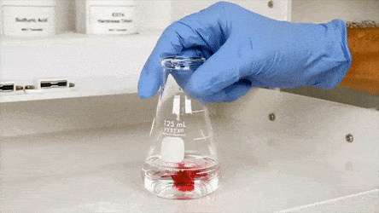
Part 1: Preparing the Powdered Drink Mix

Slide 11
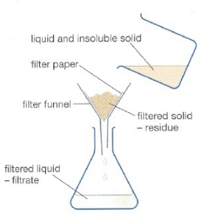
Part 2: Separating by Filtration

Slide 12
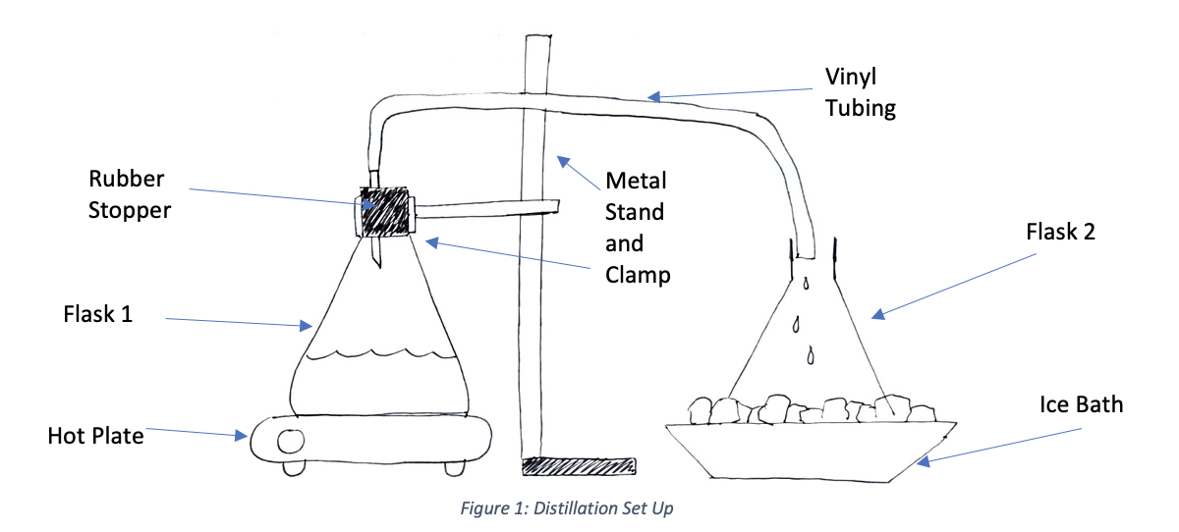
Part 3: Separation by Distillation

Slide 13

Density
The amount of matter an object has in a defined volume
$$Density=\frac{mass (g)}{volume (mL)}$$
Solid
-90 ℃
Liquid
0 ℃
Gas
90 ℃

Slide 14
Part 4: Calculating Density
Initial Components | Powdered Drink | Water
Mass (g) | 1 g
Volume (mL) |  | 20mL
Density (g/mL)

Slide 15
Lab Clean Up I
Used powdered drink mix can be disposed of in the trash
Used water can be poured down the drain
Used filter paper can be disposed of in the trash
The 60mL bottle can be placed next to the sink

Slide 16
Part 5: Analyzing Products
Initial Components | Flask 2 Substance
Mass (g)
Volume (mL)
Density (g/mL)

Slide 17
Lab Clean Up II
Turn off the hot plate and leave flask 1 secured to the hot plate
Water from the 50mL graduated cylinder can be poured down the drain
Flask 2 can be placed next to the sink
All other materials should be capped and left at the station as they were at the beginning

