Slide 1
Do Now: Think, Pair, Share
Read the introduction for today's activity.
Once you are done reading, find a partner and discuss the following question:
  If a reactant has the same properties as the product of an interaction, did a physical or chemical change occur? Why?

Slide 2





What’s in a Change?

Slide 3
Learning Objectives
Observe and record chemical and physical properties of substances
Identify evidence of chemical and physical changes
Analyze data to form conclusions about the type of change demonstrated

Slide 4
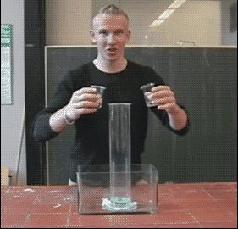
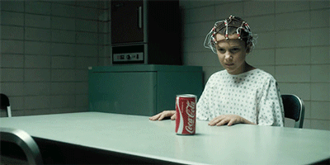
What do you observe?

Slide 5
Physical Change
Matter changes form but the chemical identity remains the same

Slide 6
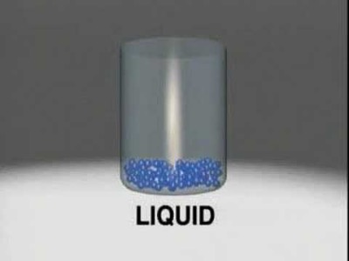
Phase Changes
Solid
Holds its shape
Fixed volume
Liquid
Holds shape of its container
Fixed volume
Gas
Holds shape of container
Volume of the container

Slide 7
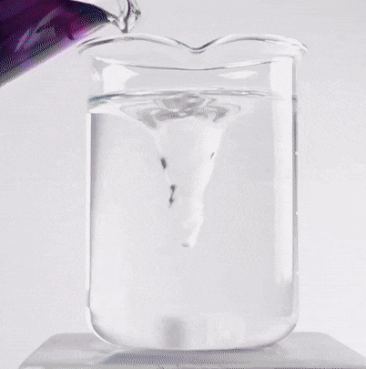
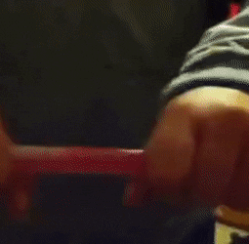
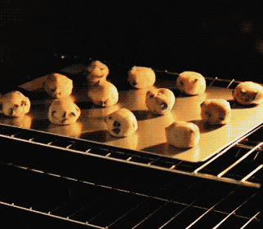
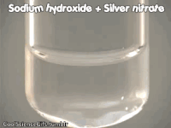
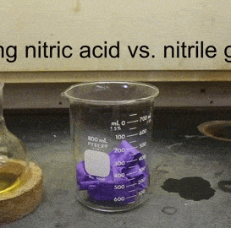
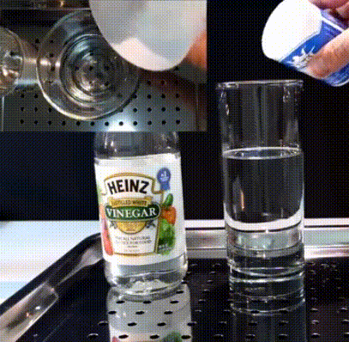
Chemical Changes
Change in Smell
Change in Temperature
Change in Color
Production of a Precipitate
Production of Gas
Production of Light
Molecules rearrange to create new substances.

Slide 8
Properties
Physical
Can be observed and measured without changing the substance in the process
Chemical
Only become evident during or after a chemical reaction
Color, size, shape, mass, hardness, density, boiling point, melting point, solubility
Flammability, heat of combustion, corrosivity, pH

Slide 9
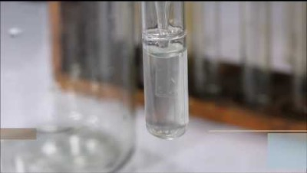
Reactions with Limewater

Slide 10
Today’s Investigation
What happens when dry ice and water are combined?
What happens when acetic acid and calcium carbonate are combined?

Slide 11
Part 1: Observing Physical and Chemical Properties of Reactants
 | Physical Properties |  | Chemical Properties
Reactant | Color | State of Matter | Limewater Precipitate?
Dry Ice (CO₂)
Water (H₂O)

Slide 12
Part 1: Observing Physical and Chemical Properties of Products
 | Physical Properties |  | Chemical Properties
Product | Color | State of Matter | Limewater Precipitate?
Unknown

Slide 13
Part 2: Observing Physical and Chemical Properties of Reactants
 | Physical Properties |  | Chemical Properties
Reactant | Color | State of Matter | Limewater Precipitate?
Calcium Carbonate (CaCO₃)
Acetic Acid (CH₃COOH)

Slide 14
Part 2: Observing Physical and Chemical Properties of Products
 | Physical Properties |  | Chemical Properties
Product | Color | State of Matter | Limewater Precipitate?
Unknown Product

Slide 15
Clean Up :
Liquid from all test tubes can be poured down the drain. Make sure the calcium carbonate rock does not go down the drain.
Empty test tubes can be disposed of in the trash.
All transfer pipettes can be disposed of in the trash.
Liquid from 60mL bottles should be poured down the drain.
The calcium carbonate rock and 60mL bottles should be left near the sink.
All other materials should be capped and left at the station as they were when you arrived.

