Slide 1
LEAN MANUFACTURING

Slide 2
Lean Manufacturing
1. Define Value
2. Map Value Stream
3. Create Flow
4. Establish Pull System
5. Pursue Perfection
Maximize value for customer by eliminating waste
Optimize processes
Notes:
1. Value: Value is determined from the perspective of the customer and relates to how much they are willing to pay for products or services. This value is then created by the manufacturer or service provider who should seek to eliminate waste and costs to meet the optimal price for the customer while also maximising profits.
2. Map the Value Stream: This principle involves analysing the materials and other resources required to produce a product or service with the aim of identifying waste and improvements. The value stream covers the entire lifecycle of a product, from raw materials to disposal. Each stage of the production cycle needs to be examined for waste and anything that doesn’t add value should be removed. Chain alignment is often recommended as a means to achieve this step.
Modern manufacturing streams are often complex, requiring the combined efforts of engineers, scientists, designers and more, with the actual manufacturing of a physical product being just one part of a wider stream of work.
3. Create Flow: Creating flow is about removing functional barriers to improve lead times. This ensures that processes flow smoothly and can be undertaken with minimal delay or other waste. Interrupted and disharmonious production processes incur costs and creating flow means ensuring a constant stream for the production or service delivery.
4. Establish a Pull System: A pull system works by only commencing work when there is demand. This is the opposite of push systems, which are used in manufacturing resource planning (MRP) systems. Push systems determine inventories in advance with production set to meet these sales or production forecasts. However, due to the inaccuracy of many forecasts, this can result in either too much or not enough of a product being produced to meet demand. This can lead to additional warehousing costs, disrupted schedules or poor customer satisfaction. A pull system only acts when there is demand and relies on flexibility, communication and efficient processes to be successfully achieved.
The pull system can involve teams only moving onto new tasks as the previous steps have been completed, allowing the team to adapt to challenges as they arise in the knowledge that the prior work is mostly still applicable to delivering the product or service.
5. Perfection: The pursuit of perfection via continued process improvements is also known as ‘Kaizen’ as created by Toyota Motor Corporation founder Kiichiro Toyoda (see ‘When and Who Invented Lean Manufacturing?’ above). Lean manufacturing requires ongoing assessment and improvement of processes and procedures to continually eliminate waste in an effort to find the perfect system for the value stream. To make a meaningful and lasting difference, the notion of continuous improvement should be integrated through the culture of an organisation and requires the measurement of metrics such as lead-times, production cycles, throughput and cumulative flow.
It is important for the culture of continuous improvement to filter through all levels of an organisation, from team members and project managers right up to the executive level, to create a collective responsibility for improvement and value creation.

Slide 3
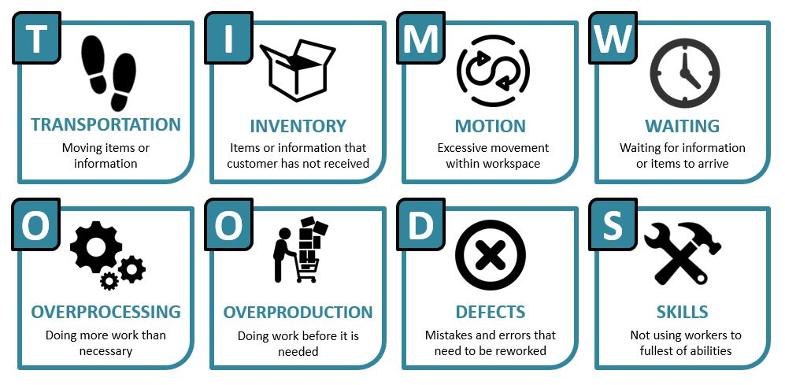
Types of Waste

Slide 4
Practice Round
Grey represents the assembly that is handed to you
Blue represents the new components to be added
Use the different view (top, side, front) to ensure that the bricks are properly placed.

Slide 5
PHASE-1 Traditional Production Rules
Aircraft must be assembled in batches of 5.
Each worker is responsible for refilling raw materials and raw materials can only be restocked once their current supply is fully empty.
Workers must only perform their assigned jobs. (No Thinking!)
All improperly assembled planes must be set aside for rework (Turned upside down)
QC problems can only be detected by the Inspector (Build it if you can)

Slide 6
PHASE-1 Data
Sold -good planes that meet a customer order or portion of a customer order
Backorder -the number of unfulfilled orders
Inventory - any excess planes that were produced
Rework- planes turned upside at workstations
WIP- incomplete assemblies at workstations
 | Time | Completed Planes | Sold | Backorder | Rework | Work in Progress (WIP)
 |  |  | Inventory
Phase-1

Slide 7

Phase-2 Cellular Layout
WS-3
2x4
blocks
WS-1
Intake area
Work Instructions
2x8
blocks
Work Instructions
Intake Area
WS-2
Work Instructions
Airplane staging area
2x2
blocks
Work Instructions
Work Instructions
WS-5
Intake Area
Timer
Intake Area
WS-4
WS-6
Work Instructions

Slide 8
PHASE-2 Production Rules
Aircraft must be assembled in batches of 5.
Each worker is responsible for refilling raw materials and raw materials can only be restocked at any time.
Workers must only perform their assigned jobs. (No Thinking!)
All QC problems must be set aside for rework. (Turned upside down)
The Inspector verbalizes QC problems to the workers.
The Inspector will announce the completion of the first good airplane.

Slide 9
PHASE-2 Data
Sold -good planes that meet a customer order or portion of a customer order
Backorder -the number of unfulfilled orders
Inventory - any excess planes that were produced
Rework- planes turned upside at workstations
WIP- incomplete assemblies at workstations
 | Time | Completed Planes | Sold | Backorder | Rework | Work in Progress (WIP)
 |  |  | Inventory
Phase-2

Slide 10
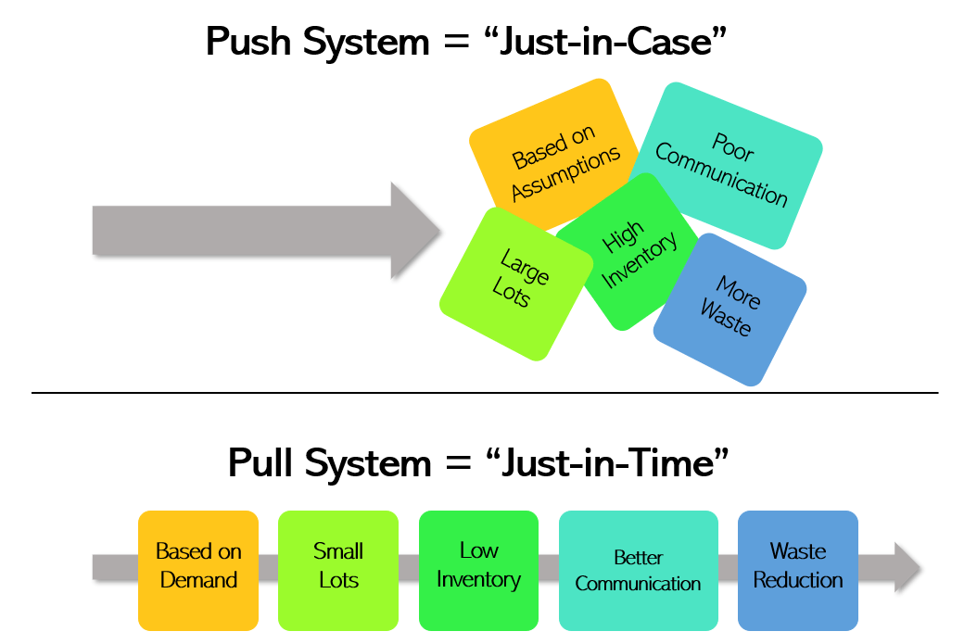
PHASE-3 Pull System

Slide 11
PHASE-3 Production Rules
Aircraft must be assembled in batches of 1.
Workers can have only 1 assembly of each color in their intake area.
Workers must only perform their assigned jobs.
All QC problems must be set aside for rework. (Turned upside down)
QC problems can be verbalized by any worker. (Some thinking allowed.)
Assemblies are passed to the next intake area only when that color is empty.
The Inspector will announce the completion of the first good airplane.

Slide 12
PHASE-3 Data
Sold -good planes that meet a customer order or portion of a customer order
Backorder -the number of unfulfilled orders
Inventory - any excess planes that were produced
Rework- planes turned upside at workstations
WIP- incomplete assemblies at workstations
 | Time | Completed Planes | Sold | Backorder | Rework | Work in Progress (WIP)
 |  |  | Inventory
Phase-3

Slide 13
Phase-4 Layout
2x2 blocks
WS-3
Work Instructions
2x4
blocks
WS-1
2x8
blocks
Work Instructions
WS-2
Work Instructions
2x4
blocks
Airplane staging area
Work Instructions
2x2
blocks
WS-5
Timer
Work Instructions
WS-4
Work Instructions
WS-6

Slide 14
PHASE-4 Production Rules
Aircraft must be assembled in batches of 1.
Workers can have only 1 assembly of each color at their workstation.
Assemblies are passed to the next workstation only when that color is empty.
Workers must use the PHASE-4 Instructions.
Workers may assist the next workstation by performing additional duties.
QC problems can be detected and repaired by any worker.
QC problems that cannot be repaired must be set aside for rework. (Turned upside down)
The Inspector will announce the completion of the first good airplane.

Slide 15
PHASE-4 Data
Sold -good planes that meet a customer order or portion of a customer order
Backorder -the number of unfulfilled orders
Inventory - any excess planes that were produced
Rework- planes turned upside at workstations
WIP- incomplete assemblies at workstations
 | Time | Completed Planes | Sold | Backorder | Rework | Work in Progress (WIP)
 |  |  | Inventory
Phase-4

