Slide 1
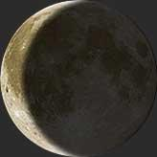
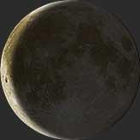
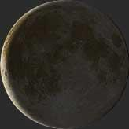
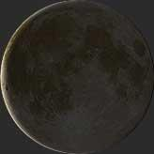
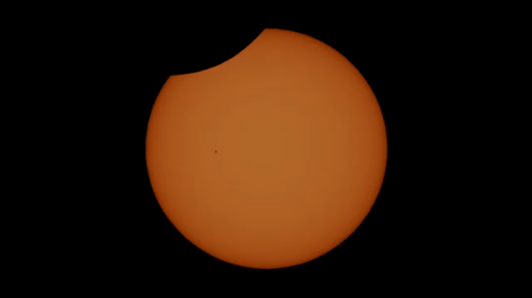
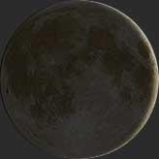
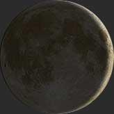
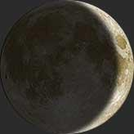
Feb 22, 2017
10:43 AM
Feb 23, 2017
11:33 AM
Feb 24, 2017
12:24 PM
Feb 25, 2017
1:15 PM
Coyhaique, Chile
Feb 26, 2017
The moon was not visible at any point during the day.
An interesting event did occur around at 2:00 PM.
Feb 27, 2017
2:56 PM
Feb 28, 2017
3:47 PM
Mar 1, 2017
4:39 PM
Mar 2, 2017
5:32 PM

Slide 2
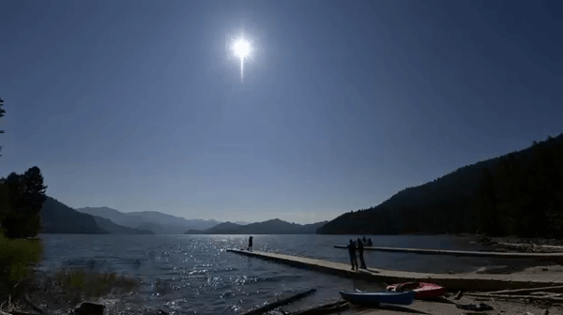
Aug 17, 2017
9:42 AM
Aug 18, 2017
10:41 AM
Aug 19, 2017
11:41 AM
Aug 20, 2017
12:39 PM
Idaho Falls, Idaho
Aug 21, 2017
The moon was not visible at any point during the day.
An interesting event did occur around at 11:30 AM.
Aug 22, 2017
2:26 PM
Aug 23, 2017
3:15 PM
Aug 24, 2017
4:03 PM
Aug 25, 2017
4:48 PM

