Slide 1





Do Now
Talk with a partner and answer the question:
  What does computational thinking mean to you?

Slide 2
Think Like a Drone
Learning Undefeated and Northrop Grumman

Slide 3
Objectives
Students will know:
  What operation polar eye is, and how it’s achieving its goals
  What computational thinking is
  Stem careers related to operation polar eye
Students will understand
  How computational thinking is used in stem
Students will be able to
  Write a pseudo-code sequence
  Debug another peer’s pseudo-code sequence

Slide 4
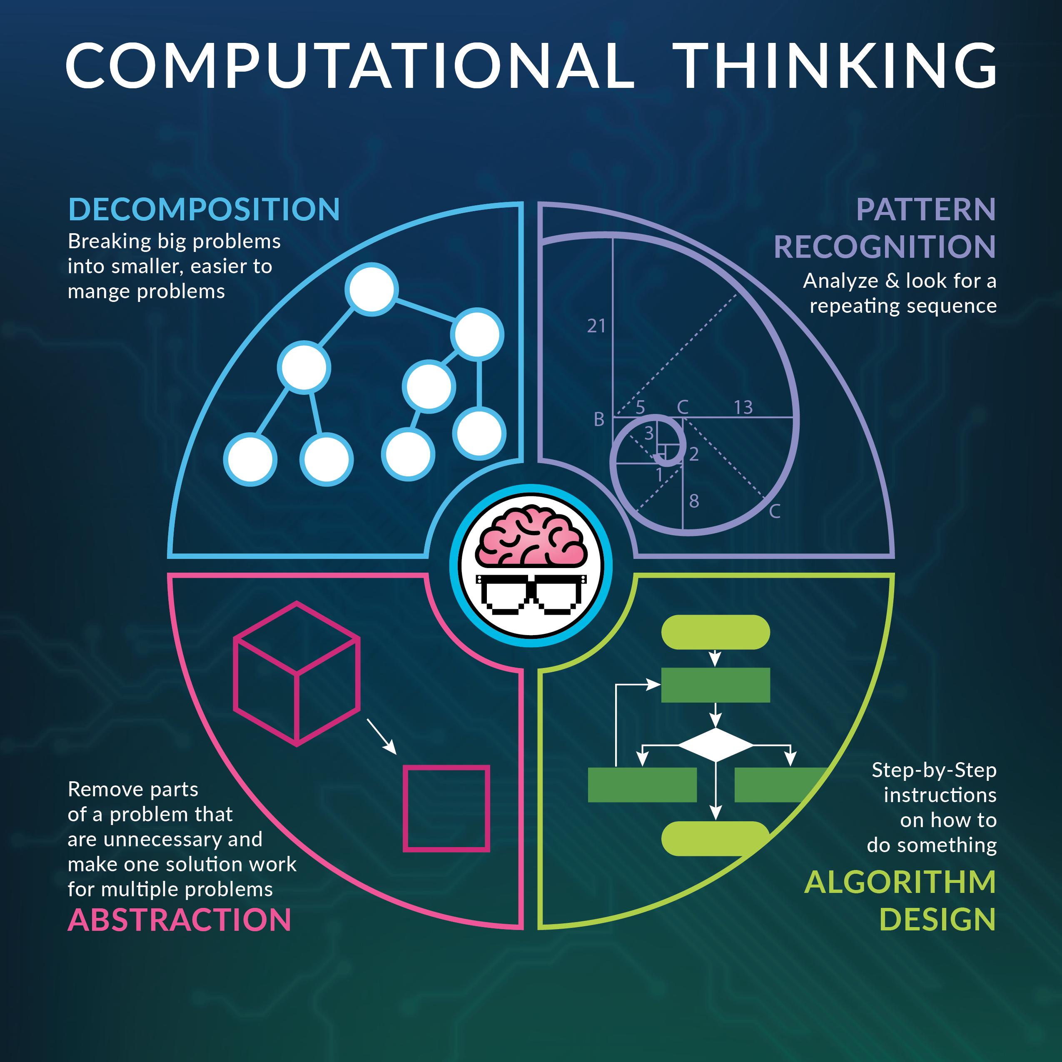
This Photo by Unknown Author is licensed under CC BY

Slide 5
CT in Government
Decomposition – How does the US government’s system work?
  Checks and Balances
    Three branches of government
      Legislative
      Executive
      Judicial

Slide 6
CT in Government
Pattern Recognition – What patterns do you find across government systems? Look at different governments and see what is the same across of them.
  Constitutions
  Separation of powers
    Judiciary is always independent

Slide 7
CT in Government
Abstraction – Summarize
  Fifth Amendment
    “No person shall be held to answer for a capital, or otherwise infamous crime, unless on a presentment or indictment of a Grand Jury, except in cases arising in the land or naval forces, or in the Militia, when in actual service in time of War or public danger; nor shall any person be subject for the same offence to be twice put in jeopardy of life or limb; nor shall be compelled in any criminal case to be a witness against himself, nor be deprived of life, liberty, or property, without due process of law; nor shall private property be taken for public use, without just compensation.”
      Double jeopardy
      Right to a fair trial and its processes
      Right to not testify against oneself; “I plead the fifth.”

Slide 8

CT in Government
Algorithm – How are new laws created?
  Draft and introduce bill
  Discuss, review, and amend bill
  Vote on bill
  Referral to other chamber
  President
  *Override veto
By American Broadcasting Company - A screen shot from “Just a Bill”, Fair use, https://en.wikipedia.org/w/index.php?curid=62824163

Slide 9

Operation Polar Eye

Slide 10
Drone mapping activity
Goal:
  Have your drone cover as much ground as possible within 20 commands.
Flight Constraints:
  You must begin where your drone is located on the map
  You cannot repeat squares; you may only go over each square once
  You cannot go over the mountains
  You may only make 20 individual commands
    Your commands may only include the following moves (1 move = 1 command):
Move Up 1 | Move Up 5
Move Right 1 | Move Right 5
Move Down 1 | Move Down 5
Move Left 1 | Move Left 5

Slide 11
Group Instructions
Break out into groups of 4
Make sure everyone in the group has the same map layout
  Mountains should be in the same place for everyone in the group
Each student needs to be in a different starting location
  NW, NE, SE, or SW corner
You will have approximately 10 minutes to solve and write your commands
After 10 minutes are up, switch with a group member and check their sequence

Slide 12
Debrief
What was the highest number of squares covered? State which map and starting location
What was easy? What was difficult?
What challenges did you face when trying to write your sequence?
Did you feel the starting point mattered significantly? Why or why not?
Which aspects of computational thinking were used in this activity?

Slide 13

Interview with Arizza and Katie

Slide 14
Exit Ticket
Before you leave, answer the following questions best you can:
  What careers paths in stem are available?
  What STEM opportunities do you think exist in your current career field of interest?
  How do you think computational skills are applied outside of non-programming problems?

