Slide 1





Finding My Dance

Slide 2

Read Aloud

Slide 3
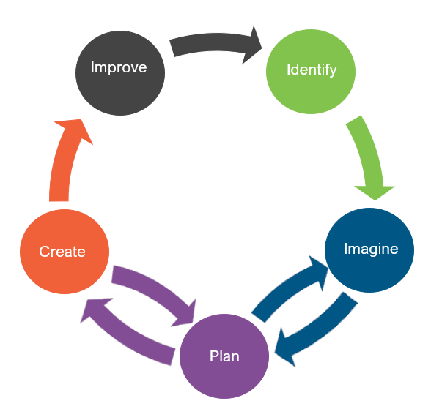
Engineering Design
What is engineering?

Slide 4
Engineering Design
What is engineering?
What are engineering jobs?

Slide 5
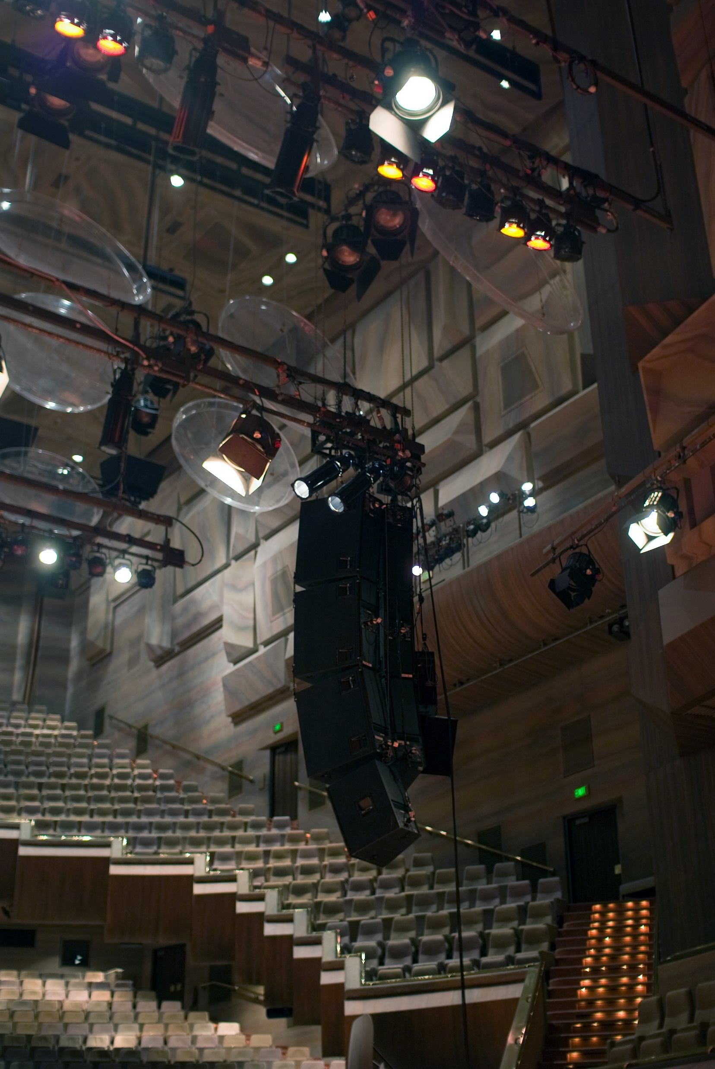
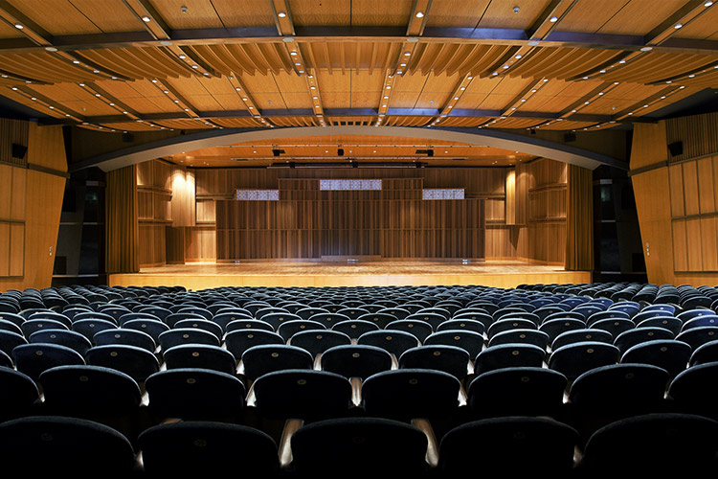
Engineering Jobs

Slide 6
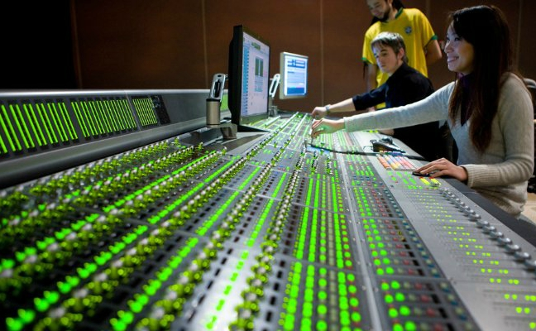
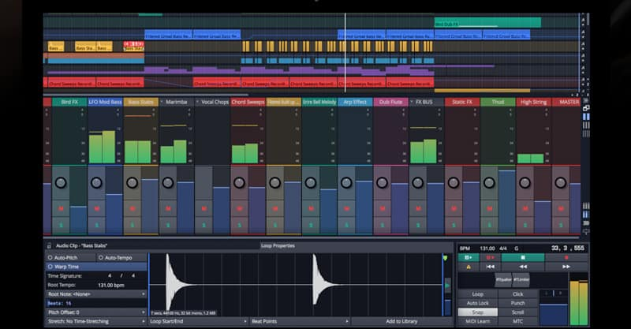
Engineering Jobs

Slide 7
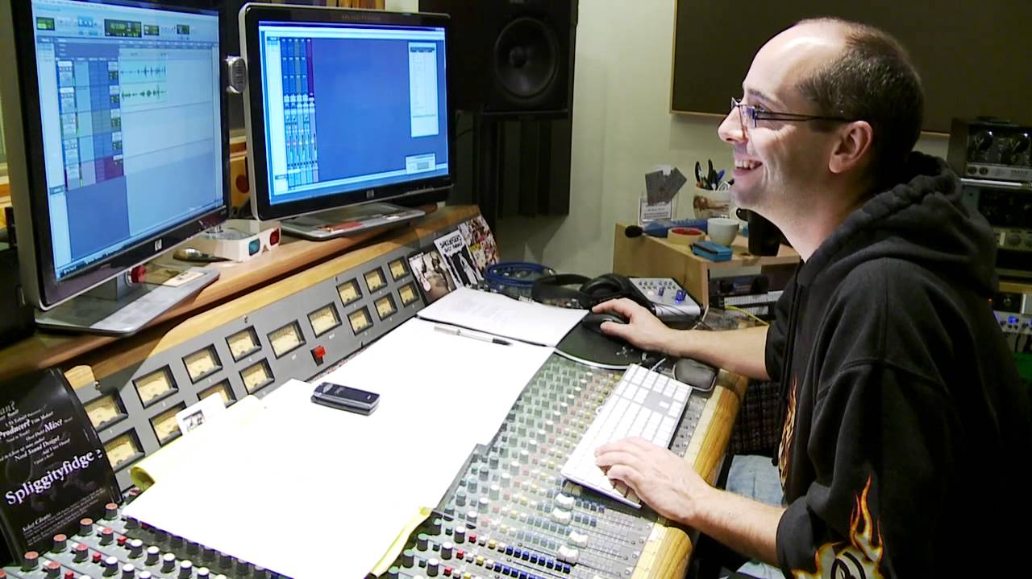

Engineering Jobs

Slide 8
Engineering Design
What is engineering?
What are engineering jobs?
Who can be an engineer?

Slide 9
Engineering Design Process
Identify
  What is the problem?
  What are the rules? (Criteria/Constraints)
Imagine
  Explore the materials
  Brainstorm ideas
Plan
  Think of an idea to share
  Select a group idea
  Gather materials
Create
  Create your idea
  Test your ideas
Improve
  Look at the score
  Make the design better
  Repeat if needed

Slide 10
Problem
Ria got invited to perform a new dance at an upcoming festival. She is looking for some musicians who can create unique instruments for her dance. The instruments must be loud enough for Ria to hear them on a stage that’s 6 meters away.
Today, you are going to put on your engineering hat to build some instruments for Ria’s dance performance. You will build an instrument in 25 minutes, create a rhythm to communicate choreography to Ria while she dances, and ensure that the instrument can be heard on a stage 6 meters away.
Identify
  What is the problem?
  What are the rules? (Criteria/Constraints)

Slide 11
Criteria (Desired Outcomes)
A successful instrument design should include the following:
  A height of 20 centimeters tall or wide
  At least 5 different materials
  Be played without falling apart for 30 seconds during the test
  Be heard from 6 meters away when played
  Create a rhythm that communicates choreography to Ria during the dance
  Bonus Points: The greater the number of different materials used to build the instrument the more bonus points students will receive.
Identify
  What is the problem?
  What are the rules? (Criteria/Constraints)

Slide 12
Constraints (Limitations)
Time Limit: You will have 25 minutes to build the instrument.
Materials: You will use no more than 20 items to build your instrument.
Counters: You will have 20 counters to complete this challenge.
Collaboration: One design element from each team member must be used in the final design.
Redesign: Each team can test their prototype as many times as needed during the 25-minute design phase.
Identify
  What is the problem?
  What are the rules? (Criteria/Constraints)

Slide 13
Explore Materials
Here are the materials we will be using.
Can you classify them?
What do they have in common?
Materials ​ | Cost ​
Construction Paper | 1 counter per sheet
Toilet Paper Rolls | 1 counter per roll
Scotch Tape | 5 counters per roll
Glue Sticks | 4 counters per stick
Pony Beads | 1 counters per 5 beads
Scissors | 1 counter per pair
Markers | 1 counter per marker
Plastic Eggs | 2 counters per egg
Plastic Spoon | 1 counters per spoon
Rubber Bands | 1 counter per band
Popsicle Sticks | 1 counter per 2 sticks
Imagine
  Explore the materials
  Brainstorm ideas

Slide 14
Brainstorm
1 minute: Individual Design
  Draw a plan of how you think the instrument for Ria should look.
5 minutes: Each member presents their ideas to the group.
  Share your ideas and focus on things you like the most about your idea that you would like to see be used as a design element for the final design.
Imagine
  Explore the materials
  Brainstorm ideas

Slide 15
Gather Materials
A successful instrument design should include the following:
  A height of 20 centimeters tall or wide
  At least 5 different materials
  Be played without falling apart for 30 seconds during the test
  Be heard from 6 meters away when played
  Create a rhythm that communicates choreography to Ria during the dance
  Bonus Points: The greater the number of different materials used to build the instrument the more bonus points students will receive.
Plan
  Think of an idea to share
  Select a group idea
  Gather materials

Slide 16
Team Member Responsibilities
Assign responsibilities of each team member during the process.
  Material Manager: collects materials
  Banker: manages the counters
  Head Engineer: measure the instrument
  Quality Control Manager: match the design to the prototype
Plan
  Think of an idea to share
  Select a group idea
  Gather materials

Slide 17
Design Your Instrument!
HAVE FUN
BE CREATIVE
WORK TOGETHER
Create
  Create your idea
  Test your ideas

Slide 18
Criteria (Desired Outcomes)
A successful instrument design should include the following:
  A height of 20 centimeters tall or wide
  At least 5 different materials
  Be played without falling apart for 30 seconds during the test
  Be heard from 6 meters away when played
  Create a rhythm that communicates choreography to Ria during the dance
  Bonus Points: The greater the number of different materials used to build the instrument the more bonus points students will receive.
Identify
  What is the problem?
  What are the rules? (Criteria/Constraints)

Slide 19
Scorecard
CRITERIA | POINTS |  |  | SCORE
 | 2 | 1 | 0
COLLABORATION | The design has elements contributed by three team members. | The design has elements contributed by two team members. | The design does not have elements from each team member.
INSTRUMENT HEIGHT OR WIDTH | The instrument is 20 centimeters tall or wide. | The instrument is less than 20 centimeters but more than 10 centimeters tall or wide. | The instrument is 10 centimeters or less tall or wide.
NUMBER OF MATERIALS USED | The instrument is made of 5 or more different materials. | The instrument is made of 3-4 materials. | The instrument is made with 2 or fewer materials.
PLAYABILITY TEST | The instrument is strong enough to be played for at least 30 seconds. | The instrument is strong enough to be played for 15-29 seconds. | The instrument is not strong enough to be played for more than 14 seconds.
DISTANCE TEST | When played, instrument is able to be heard from at least 6 meters away. | When played, instrument is able to be heard from 3-5 meters away. | When played, instrument is cannot be heard over 3 meters away.
COUNTERS USED | 14 counters or less. | 15 – 19 counters. | 20 counters or more.
CHOREOGRAPHY | Choreographed dance includes 5 or more moves. | Choreographed dance includes 1-4 moves. | There is no choreographed dance.
BONUS: NUMBER OF MATERIALS USED | The instrument is made of 10 or more different materials. | The instrument is made of 7-9 materials. | The instrument is made 5 with or fewer materials.
 |  |  | TOTAL SCORE

Slide 20
Redesign: Discussion
What worked?
What did not work?
What do you want to improve?
Improve
  Look at the score
  Make the design better
  Repeat if needed

