Slide 1
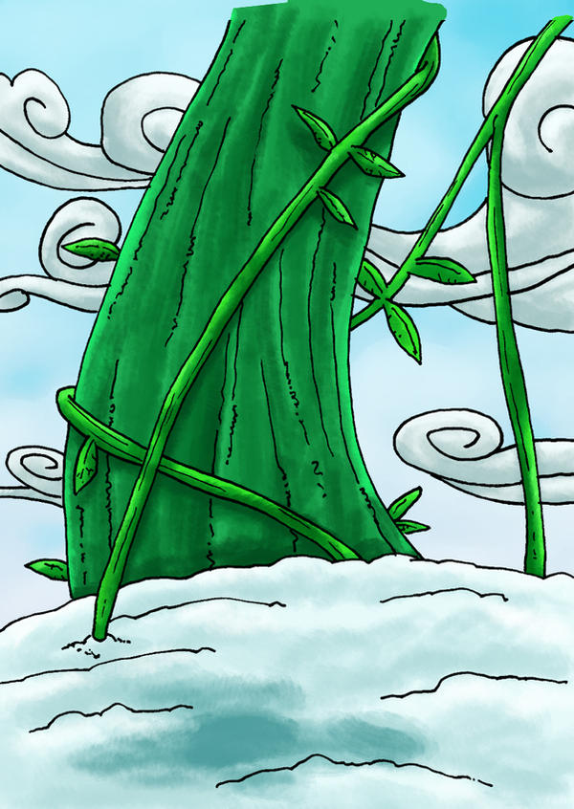





Jack and the Beanstalk
Image by theEzMaster CC

Slide 2

Read Aloud

Slide 3
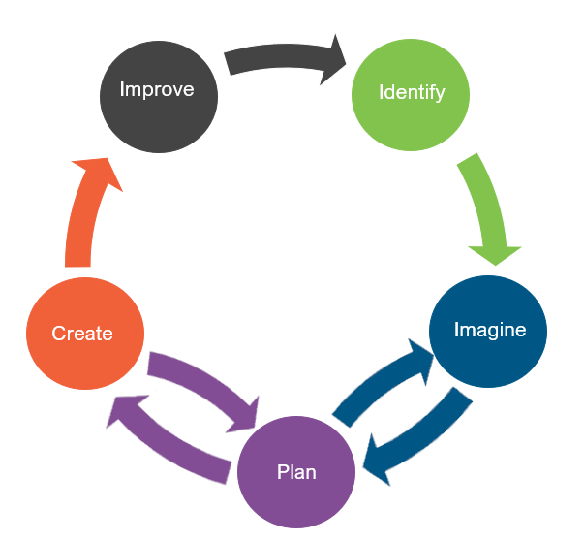
Engineering Design
What is engineering?

Slide 4
Engineering Design
What is engineering?
What are engineering jobs?

Slide 5
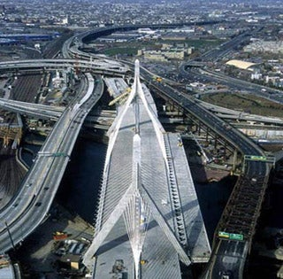
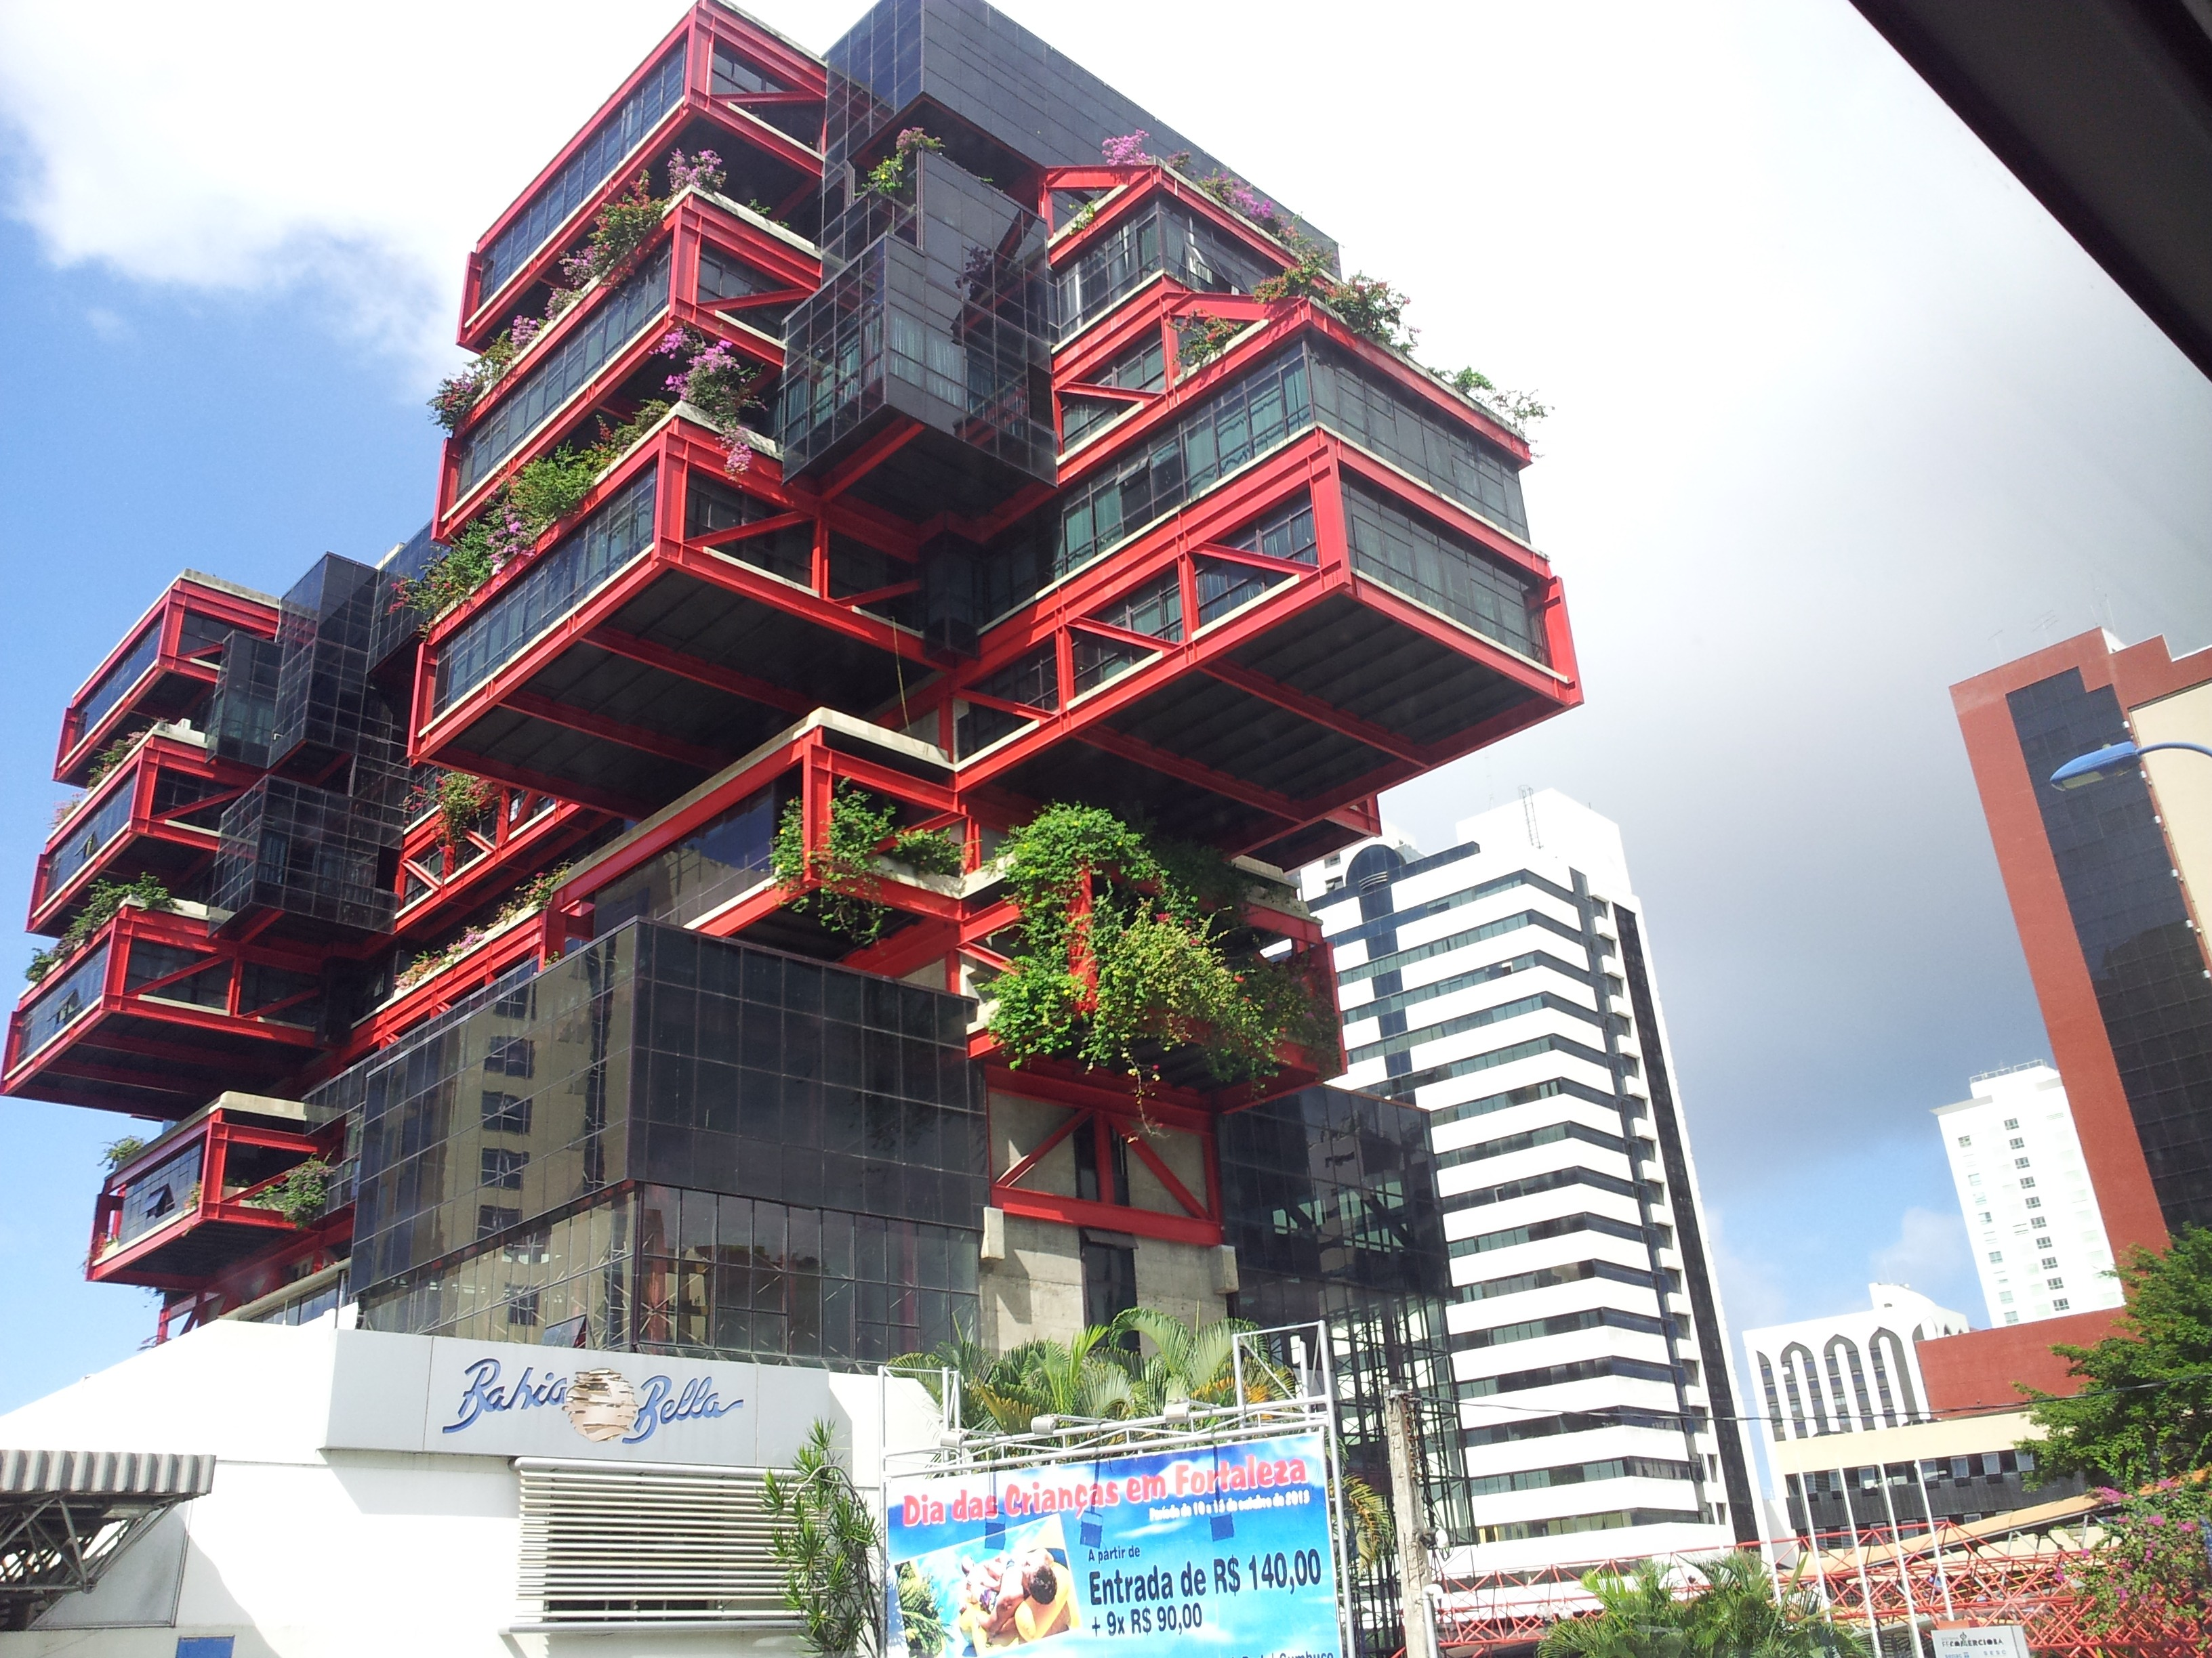
Engineering Jobs
This Photo by Unknown Author is licensed under CC BY-SA-NC

Slide 6

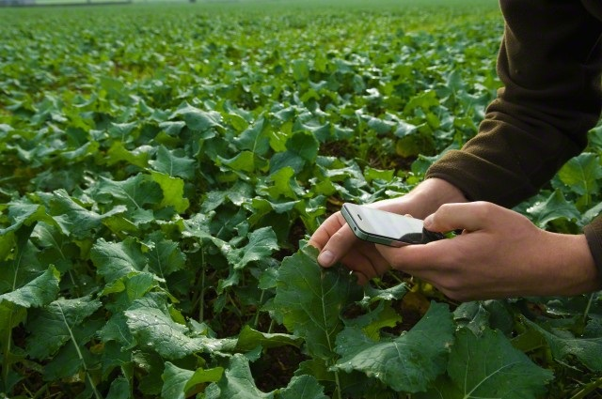
Engineering Jobs
This Photo by Unknown Author is licensed under CC BY
This Photo by Unknown Author is licensed under CC BY-NC-ND

Slide 7
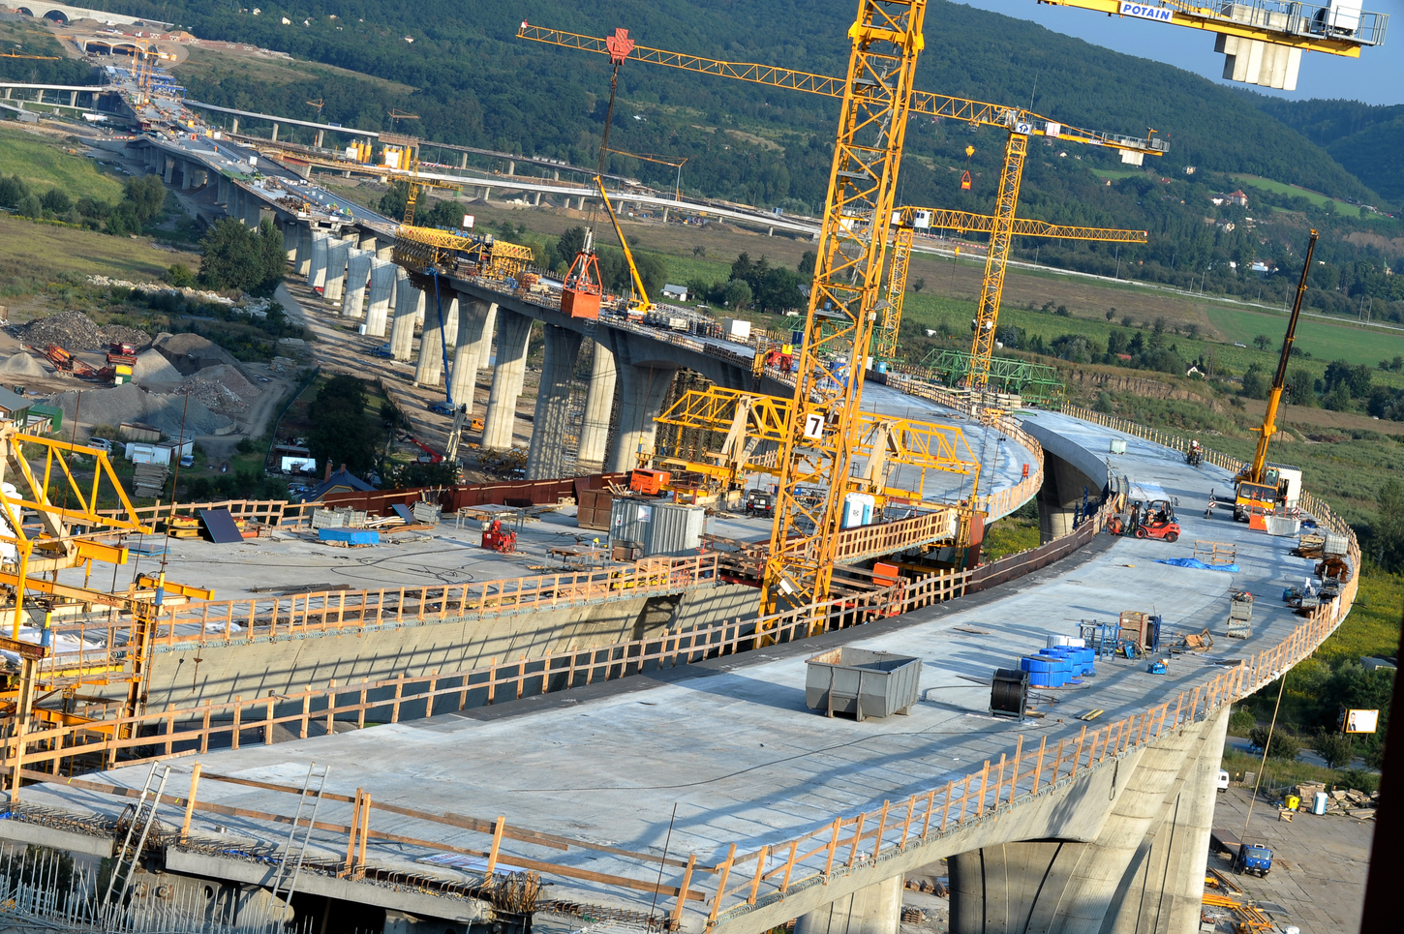
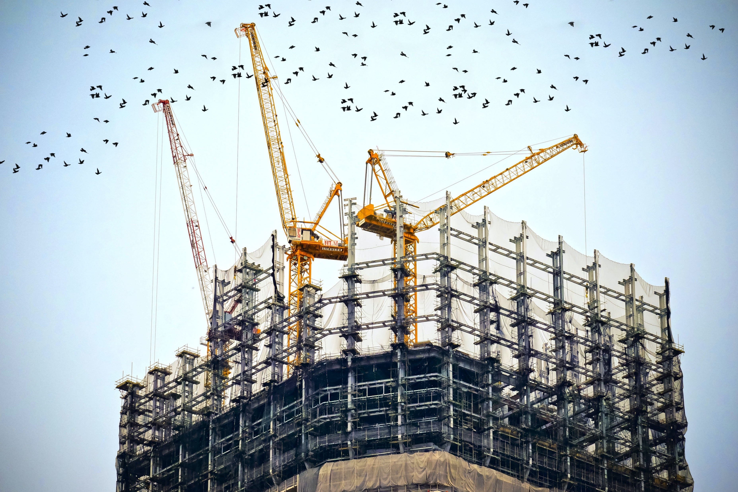
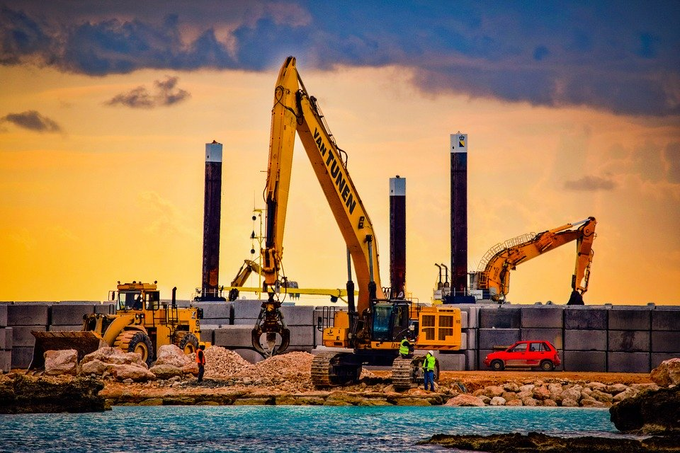
Engineering Jobs
This Photo by Unknown Author is licensed under CC BY-ND

Slide 8
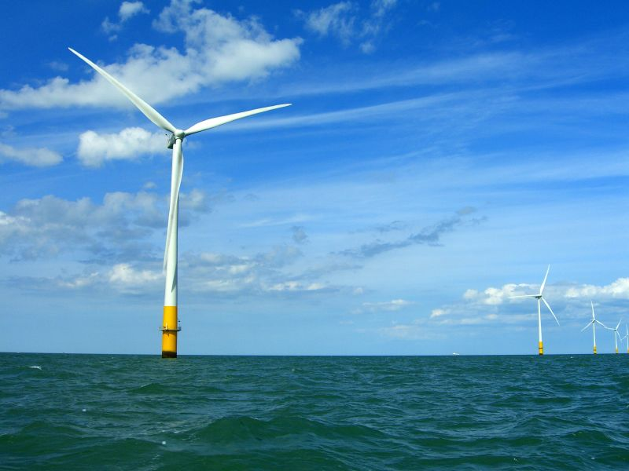
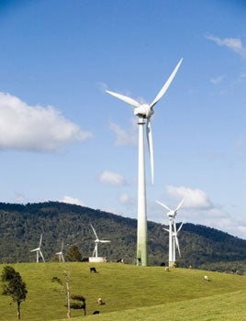
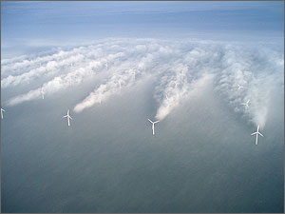
Engineering Jobs
This Photo by Unknown Author is licensed under CC BY-SA
This Photo by Unknown Author is licensed under CC BY-SA-NC
This Photo by Unknown Author is licensed under CC BY-SA
This Photo by Unknown Author is licensed under CC BY-SA

Slide 9
Engineering Design
What is engineering?
What are engineering jobs?
Who can be an engineer?

Slide 10
Engineering Design Process
Identify
Identify the Problem
Imagine
Explore the materials
Plan
Create
Build the product/prototype
Improve
Analyze results from test
Create a plan individually
Identify the Criteria and Constraints
Brainstorm ideas
Select a group
Gather materials
Test the product/prototype
Modify process or design to make it better
Repeat as many times as needed

Slide 11
Problem
Jack wants to go back to the castle in the sky to return the hen and the harp he stole, but he is out of magic beans. He does not know how he will get back to the castle.
Today, you are going to put on your engineering hat to help Jack build a “beanstalk” that can reach all the way to the giant’s castle the sky so he can return the stolen items.
Identify the Problem
Identify the Criteria and Constraints
Identify

Slide 12
Criteria: (Desired Outcomes)
A successful tower design should include the following:
A height of 40 centimeters
A “leaf/stem seat” for Jack to sit on the beanstalk
Hold Jack for one minute during the test
Bonus Points: The tower holds Jack for 30 seconds during a windstorm!
Identify the Problem
Identify the Criteria and Constraints
Identify

Slide 13
Constraints: (Limitations)
Time Limit: You will have 25 minutes to build the tower.
Materials: You will be able to use 20 items to build your tower.
Counters: You will have 20 counters to complete this challenge.
Collaboration: One design element from each team member must be used in the final design.
Redesign: Each team can test their prototype as many times as needed during the 25-minute design phase.
Identify the Problem
Identify the Criteria and Constraints
Identify

Slide 14
Explore Materials
Here are the materials we will be using.
Can you classify them?
What do they have in common?
Materials | Cost
Construction Paper | 1 counter per sheet
Toilet Paper Rolls | 1 counter per roll
Tape | 5 counters per roll
Glue Stick | 4 counters per stick
Newspaper | 1 counter per sheet
Scissors | 1 counter per pair
Chenille Stick | 1 counter per stick
Toy Jack | No cost
Explore the materials
Brainstorm ideas
Imagine

Slide 15
Brainstorm!
1 minute: Individual Design
Draw a plan of how you think Jack should build his beanstalk.
5 minutes: Each member presents their ideas to the group.
Share your ideas and focus on things you like the most about your idea that you would like to see be used as a design element for the final design
Explore the materials
Brainstorm ideas
Imagine

Slide 16
Gather Materials
A successful tower design should include the following:
A height of 40 centimeters
A “leaf/stem seat” for Jack to sit on the beanstalk
Hold Jack for one minute during the test
Bonus Points: The tower holds Jack for 30 seconds during a windstorm!
Create a plan individually
Select a group
Gather materials
Plan

Slide 17
Team Member Responsibilities
Assign responsibilities of each team member during the process.
Material Manager: collects materials
Banker: manages the counters
Head Engineer: measure the instrument
Quality Control Manager: match the design to the prototype
Create a plan individually
Select a group
Gather materials
Plan

Slide 18
Design Your Tower!
HAVE FUN
BE CREATIVE
WORK TOGETHER
Build the product/prototype
Test the product/prototype
Create

Slide 19
Criteria
Constraints
A successful tower design should include the following:
A height of 40 centimeters
A “leaf/stem seat” for Jack to sit on the beanstalk
Hold Jack for one minute during the test
Bonus Points: The tower holds Jack for 30 seconds during a windstorm!
Time Limit: You will have 25 minutes to build the tower.
Materials: You will be able to use 20 items to build your tower.
Counters: You will have 20 counters to complete this challenge.
Collaboration: One design element from each team member must be used in the final design.
Redesign: Each team can test their prototype as many times as needed during the 25-minute design phase.
Identify the Problem
Identify the Criteria and Constraints
Identify

Slide 20
CRITERIA | POINTS |  |  | SCORE
 | 2 | 1 | 0
COLLABORATION | The design has elements contributed by all team members. | The design has elements contributed by two team members. | The design does not have elements contributed by each team member.
SEAT | There is a seat for Jack, and it supports his weight. | There is a seat for Jack, but it does not support his weight. | There is no seat for Jack.
TOWER HEIGHT | The tower is above the 40-centimeter marker. | The tower is above the 30-centimeter marker, but below the 40-centimeter marker. | The tower is below the 30-centimeter marker.
STABILITY TEST | The tower is stable for one minute holding Jack. | The tower is stable for 30 seconds holding Jack. | The tower is stable for less than 30 seconds holding Jack, or there is no seat for Jack.
COUNTERS USED | 14 counters of less. | 15 – 20 counters. | 20 counters or more.
BONUS: WINDSTORM | Jack stays on the tower for 30 seconds. | Jack stays on the tower for 15 seconds. | Jack does not stay on the tower.
 |  |  | TOTAL SCORE
Test

Slide 21
Redesign: Discussion
What worked?
What did not work?
What do you want to improve?
Analyze results from test
Modify process or design to make it better
Repeat as many times as needed
Improve

