Slide 1





Maintaining a Balance

Slide 2
Ecosystem
Hawk
Snake
Rabbit
Lizard
Mouse
Grasshopper
Grass

Slide 3
Predator vs Prey
Establish in your team who is the picker for this round.
Lay your piece of turf on the table (grass side up) and dump the biodiversity box on top of the turf. Make sure to empty all contents onto the turf.
Using just one hand the picker will pick up as many pieces of wildlife (beads and seeds) for 30 seconds. Picker can only pick up one species at a time.
Once the 30 seconds is up, separate your species into the mini cups according to their color and size and count.

Slide 4
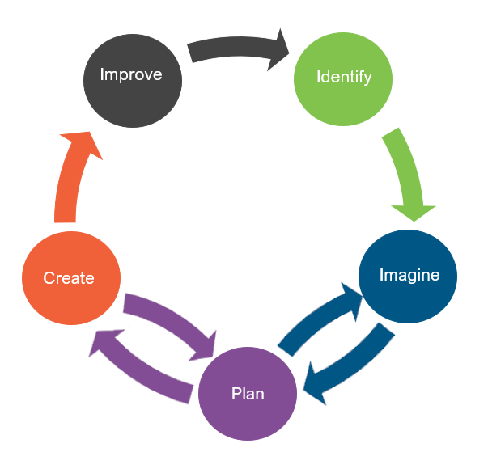
Engineering Design
What is engineering?

Slide 5
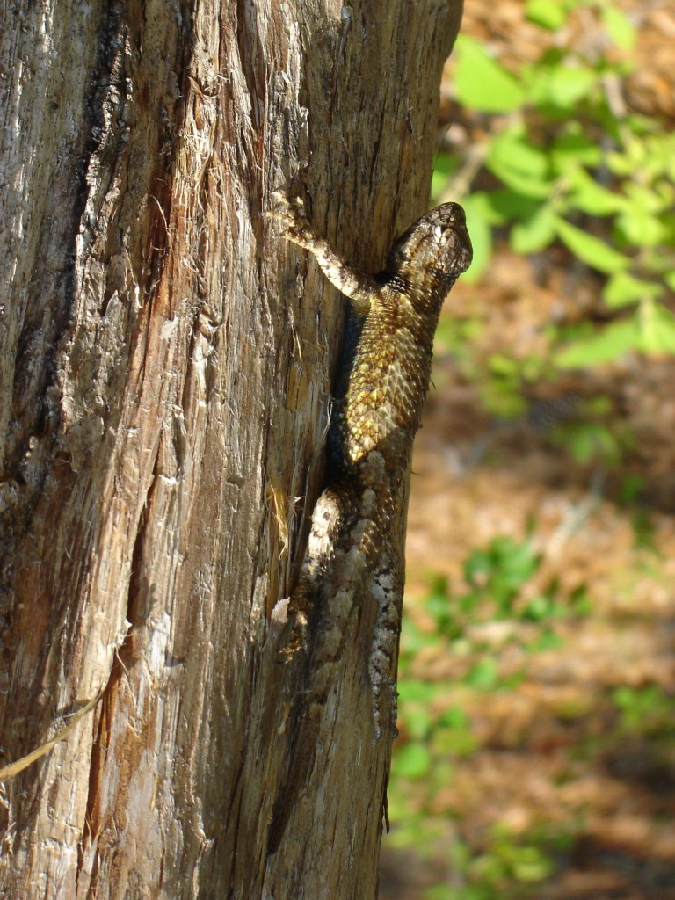
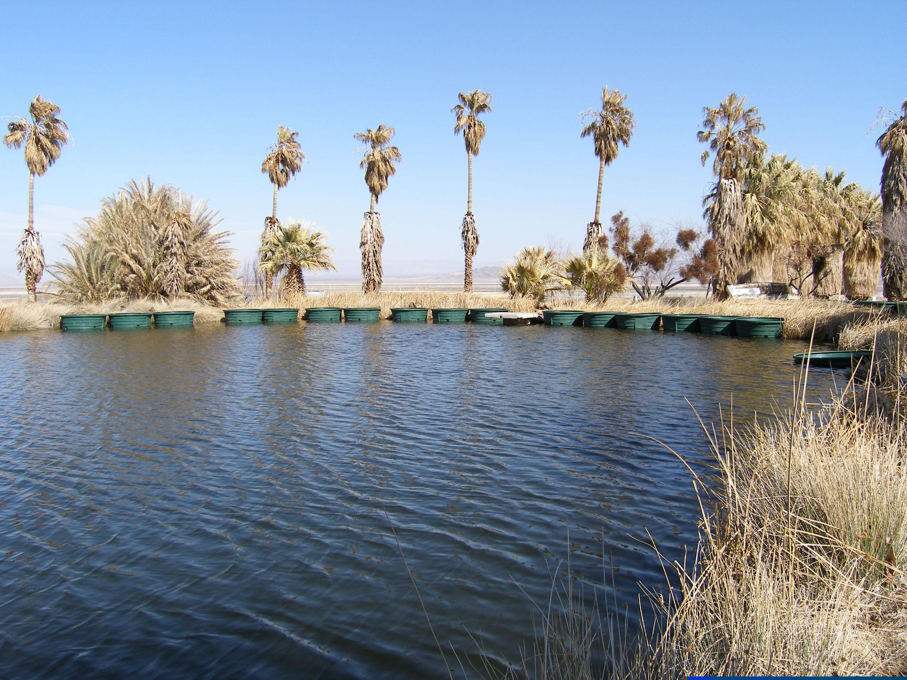
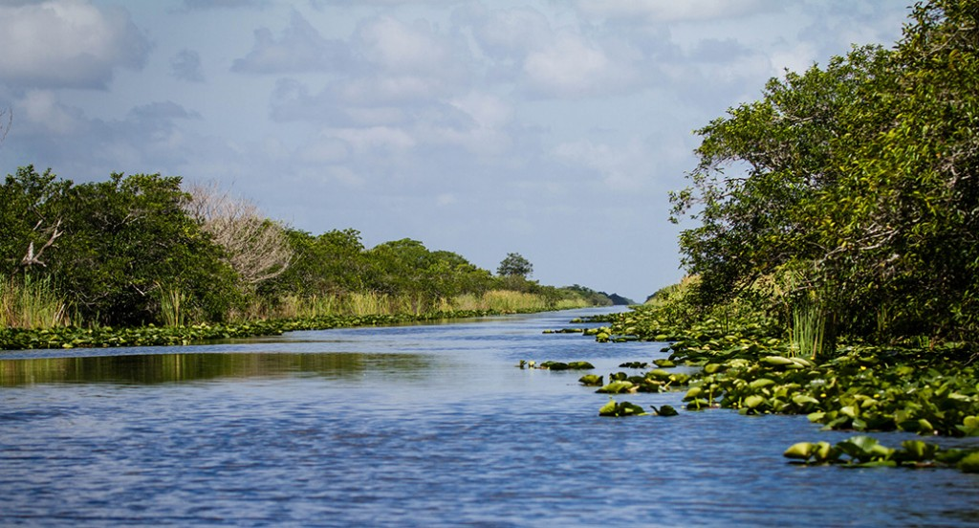
Engineering Jobs
This Photo by Unknown Author is licensed under CC BY-NC-ND
This Photo by Unknown Author is licensed under CC BY-SA-NC
This Photo by Unknown Author is licensed under CC BY-SA

Slide 6
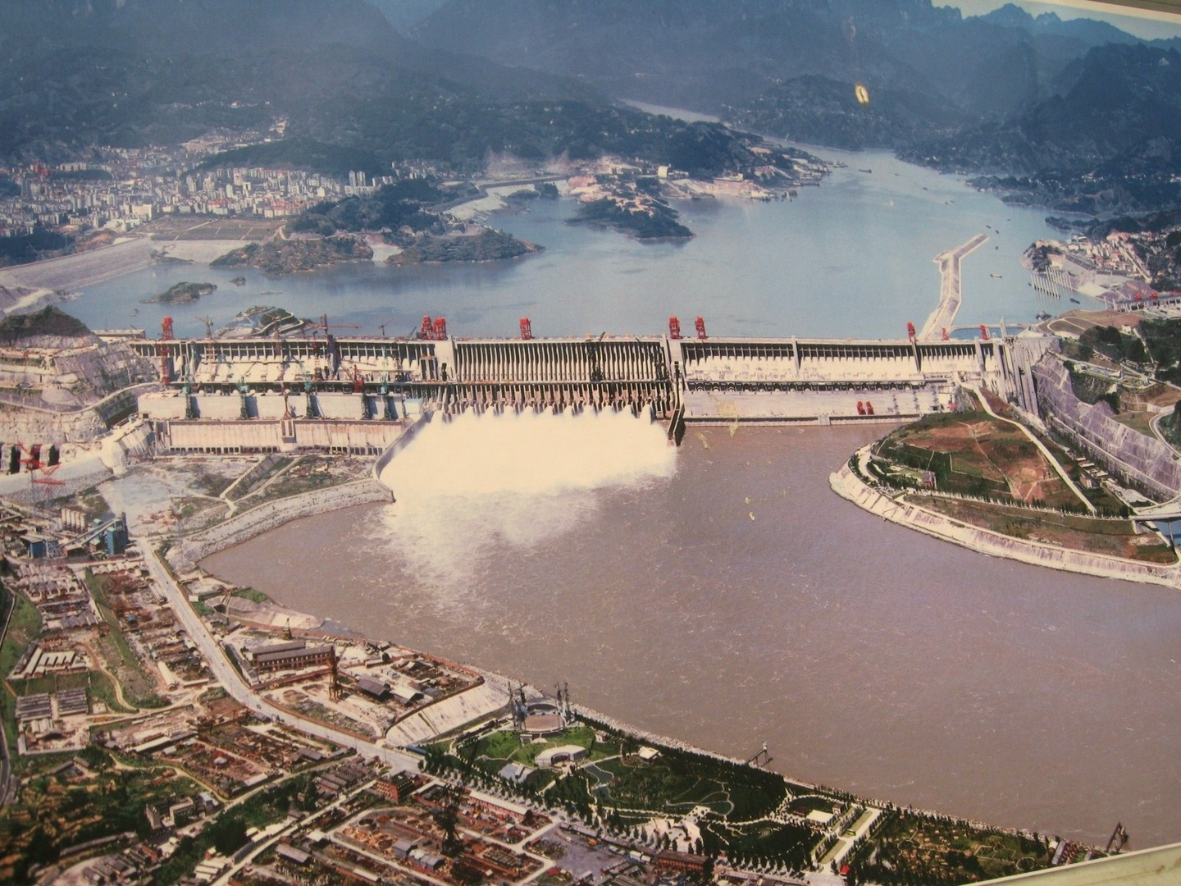
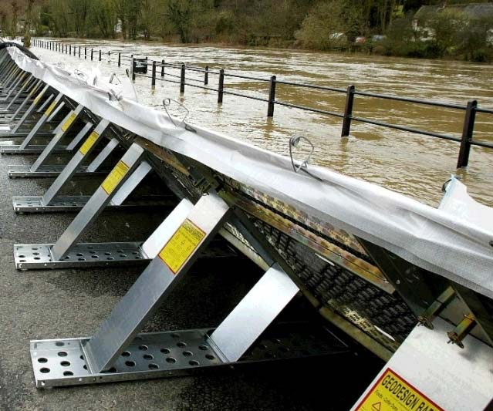
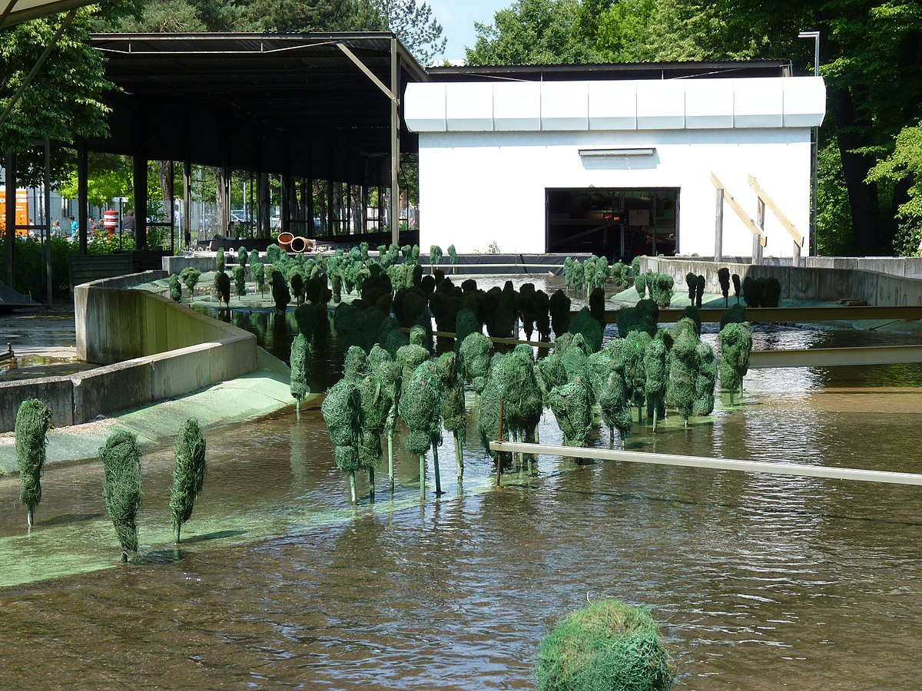
Engineering Jobs
This Photo by Unknown Author is licensed under CC BY-SA
This Photo by Unknown Author is licensed under CC BY-SA-NC
This Photo by Unknown Author is licensed under CC BY-SA
Credit - Dennis Schroeder / NREL

Slide 7
Engineering Design
What is engineering?
What are engineering jobs?
Who can be an engineer?

Slide 8
Engineering Design Process
Identify
Identify the Problem
Imagine
Explore the materials
Plan
Create
Build the product/prototype
Improve
Analyze results from test
Create a plan individually
Identify the Criteria and Constraints
Brainstorm ideas
Select a group
Gather materials
Test the product/prototype
Modify process or design to make it better
Repeat as many times as needed

Slide 9
Problem
Our ecosystem’s population balance has a problem with an invasive species. It is running rampant and out of control. There’s simply too many of them due to having no natural predator. As a result, some of the native species are being negatively impacted.
Today, you will put on your engineering hat to assist in removing an invasive species population within an ecosystem. Your team will have an opportunity to design a process that will remove the invasive species and restore the health of your ecosystem.
  Identify the Problem
  Identify the Criteria and Constraints
Identify

Slide 10
Criteria: (Desired Outcomes)
A successfully designed process will do the following in one minute:
  Eliminates the invasive species (lettuce seeds)
  Protects the native species (beads)
  Limits environmental damage
  Identify the Problem
  Identify the Criteria and Constraints
Identify

Slide 11
Constraints: (Limitations)
Time Limit: You will have 25 minutes to design a process.
Materials: You can only use the materials available.
Budget: You will have $10,000 to complete this challenge.
Collaboration: One design element from each team member must be used in the final design.
Redesign: Each team can test their prototype as many times as needed during the 25-minute design phase
  Identify the Problem
  Identify the Criteria and Constraints
Identify

Slide 12
Explore Materials
Free Materials
Biodiversity Box
Artificial Turf
Turf Container
Materials | Cost
Tweezers | $4,000 per pair​
Straws | $1,000 per straw
Scissors | $1,000 per pair
Tape | $1,000 per roll
Hand Rake | $4,000 per rake
Hand Shovel | $3,000 per shovel
Sieve | $3,000 per sieve
Comb | $3,000 per comb
Materials (Materiales)​​ | Cost (Costo)​​
Plastic Spoon | $1,500 per spoon
Plastic Fork | $1,500 per fork
Chenille sticks | $1,000 per stick
Fan | $2,000 per fan
Flashlight | $2,000 per flashlight
String | $1,000 per 10 cm
Water | $2,000 per 1000 mL
  Explore the materials
  Brainstorm ideas
Imagine

Slide 13
Brainstorm!
1 minute: Individual Design
  Develop a process to eliminate the invasive species
5 minutes: Collaborate. Each member presents their ideas to the group.
  Share your ideas and focus on things you like the most about your idea that you would like to see be used as a design element for the final design.
  Draw out your final design
  .
  Explore the materials
  Brainstorm ideas
Imagine

Slide 14
Gather Materials
A successfully designed process will do the following in one minute:
  Eliminate the invasive species (lettuce seeds)
  Protect the native species (beads)
  Limit environmental damage
  Create a plan individually
  Select a group
  Gather materials
Plan

Slide 15
Gather Materials
Score card and criteria
  In one minute, design a process that:
    Eliminates the invasive species (lettuce seeds)
    Protects the native species (beads)
    Limits environmental damage
Select what materials will be used for the design
  Create a plan individually
  Select a group
  Gather materials
Plan

Slide 16
Design Your Process!
HAVE FUN
BE CREATIVE
WORK TOGETHER
  Build the product/prototype
  Test the product/prototype
Create

Slide 17
Criteria
Constraints
Time Limit: You will have 25 minutes to design a process.
Materials: You can only use the materials available.
Budget: You will have $10,000 to complete this challenge.
Collaboration: One design element from each team member must be used in the final design.
Redesign: Each team can test their prototype as many times as needed during the 25-minute design phase.
In one minute, design a process that:
Eliminates the invasive species (lettuce seeds)
Protects the native species (beads)
Limits environmental damage
  Identify the Problem
  Identify the Criteria and Constraints
Identify

Slide 18
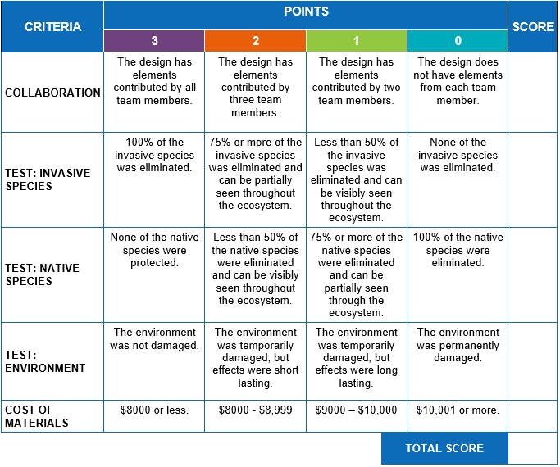
Test

Slide 19
Redesign: Discussion
What worked?
What did not work?
What do you want to improve?
  Analyze results from test
  Modify process or design to make it better
  Repeat as many times as needed
Improve

