Slide 1
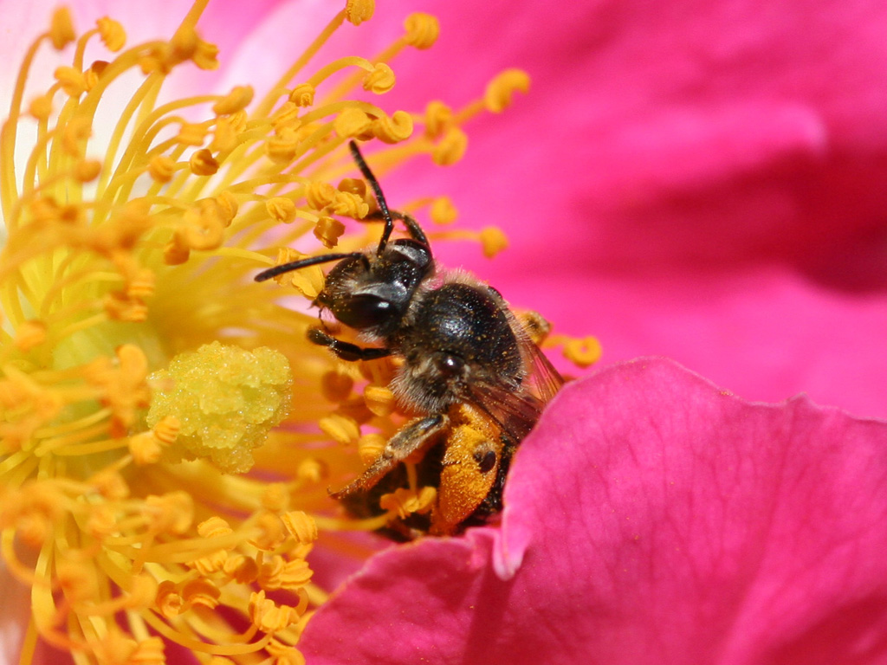





What if There Were No Bees?

Slide 2
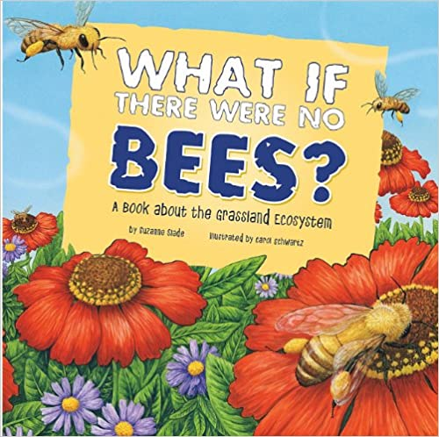
Read
Aloud

Slide 3
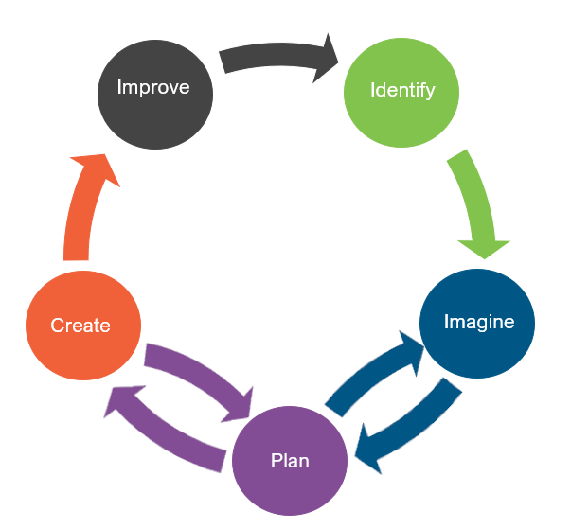
Engineering Design
What is engineering?
What are engineering jobs?

Slide 4
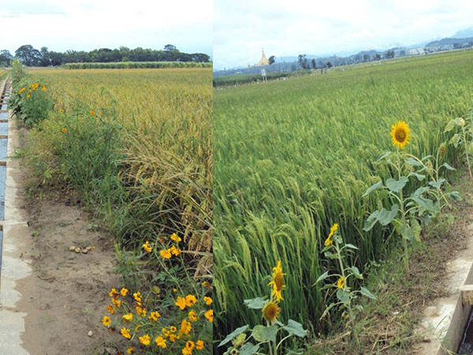
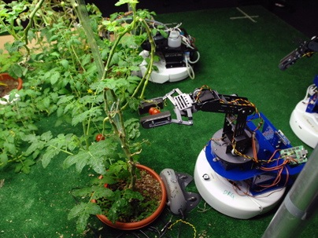
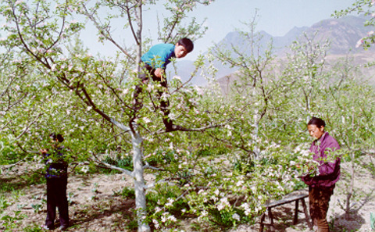
Engineering Jobs
This Photo by Unknown Author is licensed under CC BY-SA-NC
This Photo by Unknown Author is licensed under CC BY
This Photo by Unknown Author is licensed under CC BY-SA-NC

Slide 5
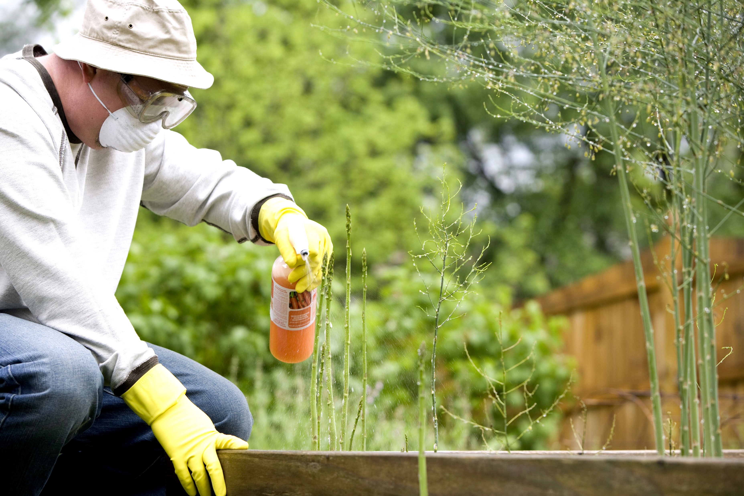
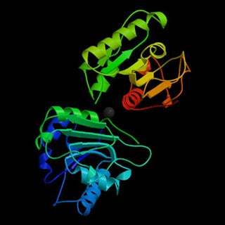
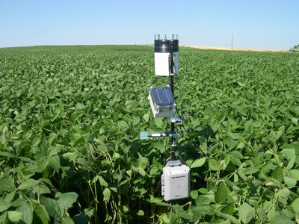
Engineering Jobs
This Photo by Unknown Author is licensed under CC BY-SA-NC
This Photo by Unknown Author is licensed under CC BY-SA
This Photo by Unknown Author is licensed under CC BY

Slide 6
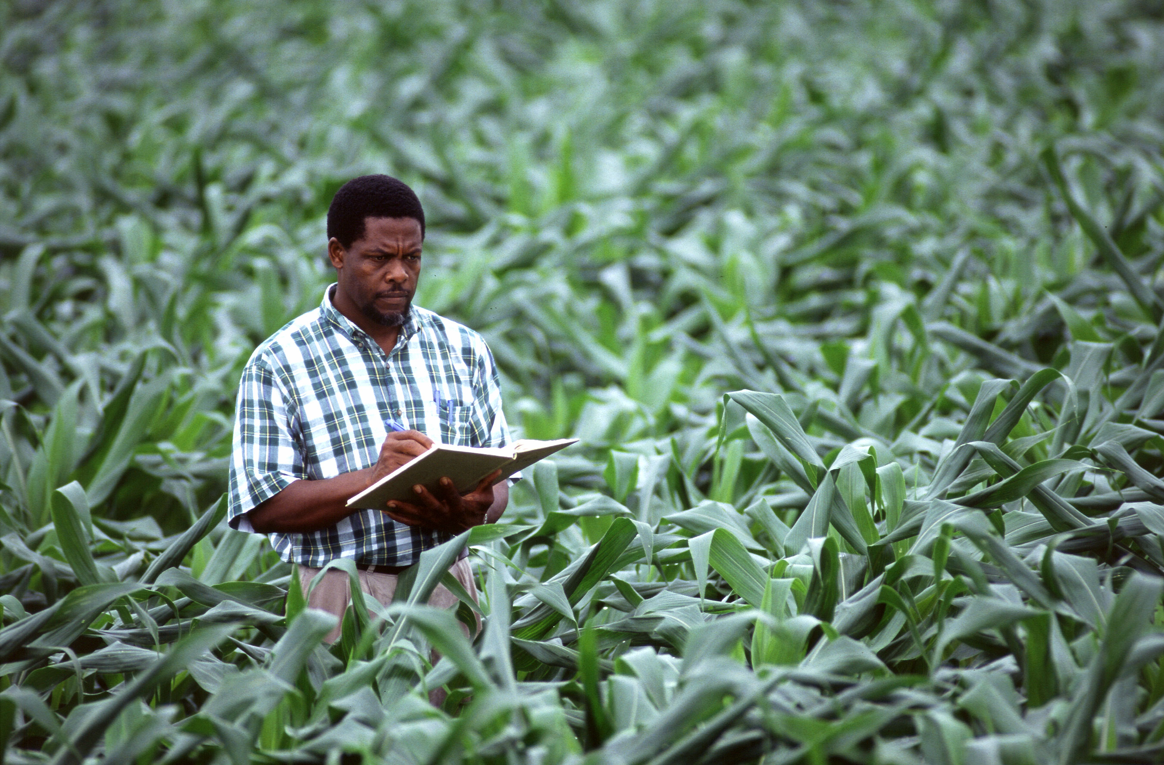
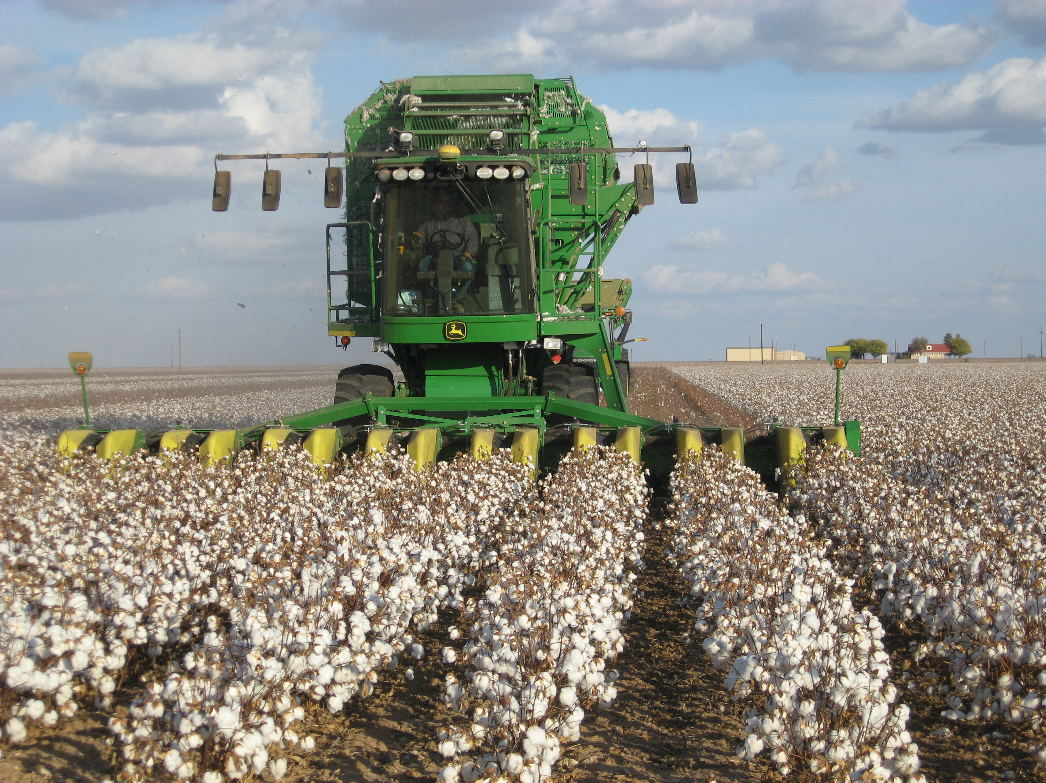
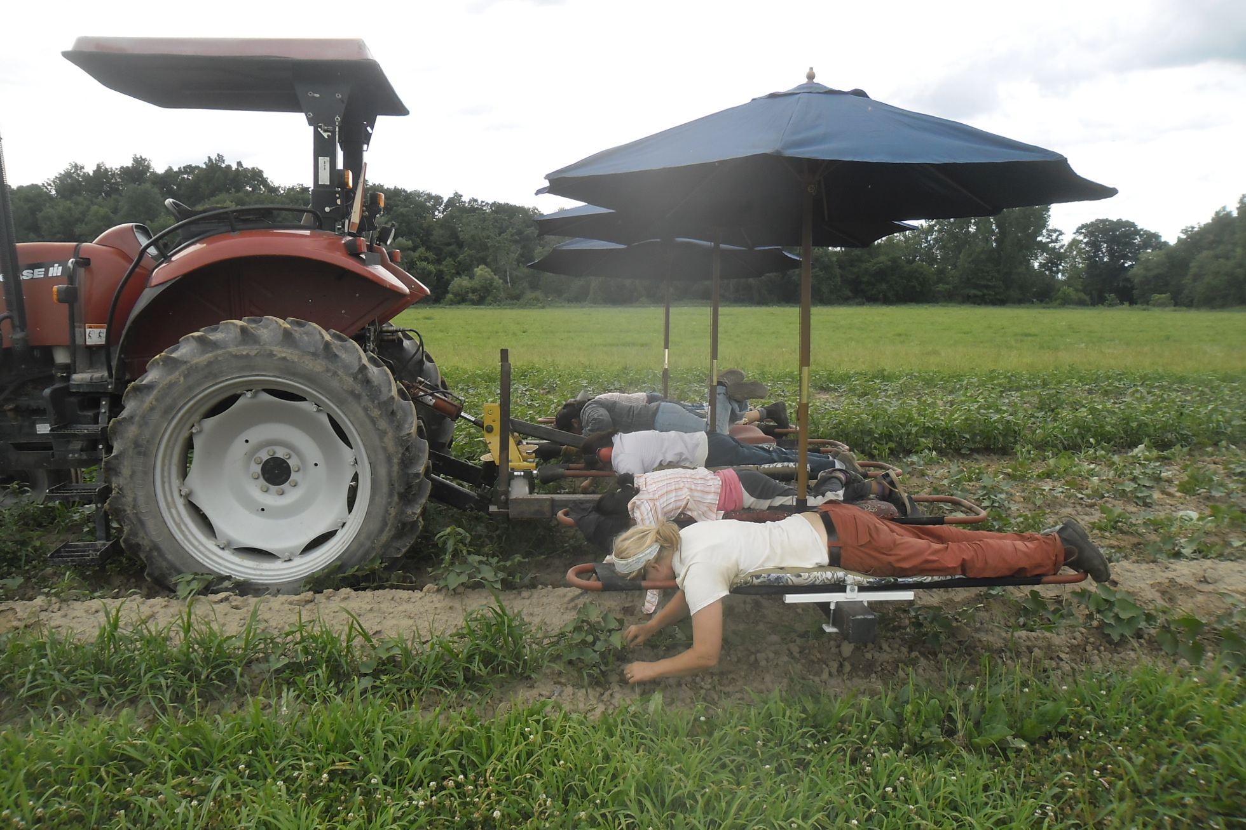
Engineering Jobs
This Photo by Unknown Author is licensed under CC BY-SA
This Photo by Unknown Author is licensed under CC BY-SA
This Photo by Unknown Author is licensed under CC BY-SA

Slide 7
Engineering Design
What is engineering?
What are engineering jobs?
Who can be an engineer?

Slide 8
Engineering Design Process
Identify
Identify the Problem
Imagine
Explore the materials
Plan
Create
Build the product/prototype
Improve
Analyze results from test
Create a plan individually
Identify the Criteria and Constraints
Brainstorm ideas
Select a group
Gather materials
Test the product/prototype
Modify process or design to make it better
Repeat as many times as needed

Slide 9
Problem
The Lee, Martínez, and Smith families have noticed that there are fewer bees around their farm. They are worried that over time, there may be no bees left to pollinate their crops. What can they do to make sure their crops and surrounding lands get pollinated?
Today, you are going to put on your engineering hat to design an artificial pollinator that can do the work of honeybees.
  Identify the Problem
  Identify the Criteria and Constraints
Identify

Slide 10
Criteria: (Desired Outcomes)
A successful pollinator design should include the following:
  A handle that can fit in the palm of an adult’s hand
  Ability to transfer 0.2 g of pollen over three attempts
  Look like a natural pollinator (bee, hummingbird, butterfly, etc.)
Bonus Points: Artificial pollinator works in a medium and small opening.
  Identify the Problem
  Identify the Criteria and Constraints
Identify

Slide 11
Constraints: (Limitations)
Time Limit: You will have 25 minutes to build the pollinator.
Materials: You will only be able to use the materials provided.
Budget: You will have $25 to complete this challenge.
Collaboration: One design element from each team member must be used in the final design.
Redesign: Each team can test their prototype as many times as needed during the 25-minute design phase.
  Identify the Problem
  Identify the Criteria and Constraints
Identify

Slide 12
Explore Materials
Materials ​ | Cost
Chenille Sticks | $4 per stick
Pompom | $2 per pompom
Popsicle Sticks | $5 per stick
Clothespins | $5 per pin
Straws | $2 per straw
Tape | $3 per roll
Glue Stick | $4 per stick
Scissors | $3 per pair
Construction Paper | $3 per sheet
Cotton Swabs | $1 each
Here are the materials we will be using.
Can you classify them?
What do they have in common?
  Explore the materials
  Brainstorm ideas
Imagine

Slide 13
Brainstorm!
1 minute: Individual Design
  Draw a plan of how you think the Lee, Martinez, and Smith families should design their artificial pollinator.
5 minutes: Each member presents their ideas to the group.
  Share your ideas and focus on things you like the most about your idea that you would like to see be used as a design element for the final design.
  Explore the materials
  Brainstorm ideas
Imagine

Slide 14
Gather Materials
A successful pollinator design should include the following:
  A handle that can fit in the palm of an adult’s hand
  Ability to transfer 0.2 g of pollen over three attempts
  Look like a natural pollinator (bee, hummingbird, butterfly, etc.)
Bonus Points: Artificial pollinator works in a medium and small opening.
  Create a plan individually
  Select a group
  Gather materials
Plan

Slide 15
Team Member Responsibilities
Assign responsibilities of each team member during the process
  Material Manager: collects materials
  Banker: manages the budget
  Head Engineer: measures the handle
  Quality Control Manager: matches the design to the prototype
  Create a plan individually
  Select a group
  Gather materials
Plan

Slide 16
Design Your Pollinator!
HAVE FUN
BE CREATIVE
WORK TOGETHER
  Build the product/prototype
  Test the product/prototype
Create

Slide 17
Criteria
Constraints
A successful pollinator design should include the following:
  A handle that can fit in the palm of an adult’s hand
  Ability to transfer 0.2 g of pollen over three attempts
  Look like a natural pollinator (bee, hummingbird, butterfly, etc.)
Bonus Points: Artificial pollinator works in a medium and small opening.
Time Limit: You will have 25 minutes to build the pollinator.
Materials: You will only be able to use the materials provided.
Budget: You will have $25 to complete this challenge.
Collaboration: One design element from each team member must be used in the final design.
Redesign: Each team can test their prototype as many times as needed during the 25-minute design phase.
  Identify the Problem
  Identify the Criteria and Constraints
Identify

Slide 18
CRITERIA | SCORE
 | 2 | 1 | 0
COLLABORATION | The design has elements contributed by all team members. | The design has elements contributed by two team members. | The design does not have elements contributed by each team member.
POLLEN | The pollinator transfers 0.2g or more pollen over three attempts. | The pollinator transfers 0.1g - 0.19g of pollen over three attempts. | The pollinator transfers less than 0.1g of pollen over three attempts.
HANDLE | The design’s handle fits in the palm of an adult’s hand. | The design’s handle fits in the palm of a youth’s hand, but not an adult’s hand. | The design’s handle does not fit in the palm of a youth’s hand.
POLLINATOR | The design looks like a pollinator. (Bee, hummingbird, butterfly, etc.) | The design has at least one aspect pulled from a pollinator but does not look like one. | The design does not look like a pollinator.
BUDGET USED | $19 or less. | $20 – $25. | $26 or more.
BONUS: MEDIUM OPENING | The pollinator transfers 0.2g or more pollen over three attempts. | The pollinator transfers 0.1g - 0.19g of pollen over three attempts. | The pollinator transfers less than 0.1g of pollen over three attempts.
BONUS: SMALL OPENING | The pollinator transfers 0.2g or more pollen over three attempts. | The pollinator transfers 0.1g - 0.19g of pollen over three attempts. | The pollinator transfers less than 0.1g of pollen over three attempts.
 |  |  | TOTAL SCORE
Test

Slide 19
Redesign: Discussion
What worked?
What did not work?
What do you want to improve?
  Analyze results from test
  Modify process or design to make it better
  Repeat as many times as needed
Improve

