Slide 1
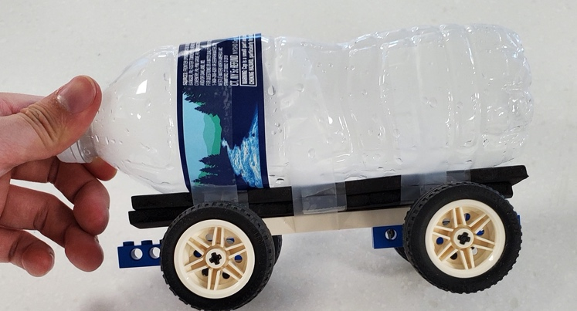





Bottle Rocket Truck

Slide 2
Objectives
The students will be able to:
Investigate how evidence of chemical reactions indicates that new substances with different properties are formed, and how that relates to the conservation of mass
Demonstrate how unbalanced forces change the speed or direction of an object’s motion
Investigate and describe applications of Newton’s three laws of motion
Solve a problem using the engineering design process

Slide 3
Newton’s Laws
Newton’s First Law:
  An object in motion will remain in motion until influenced by an outside force.
Newton’s Second Law
  Force equals mass times acceleration (F=ma).
Newton’s Third Law
  For every action there is an equal and opposite reaction.

Slide 4
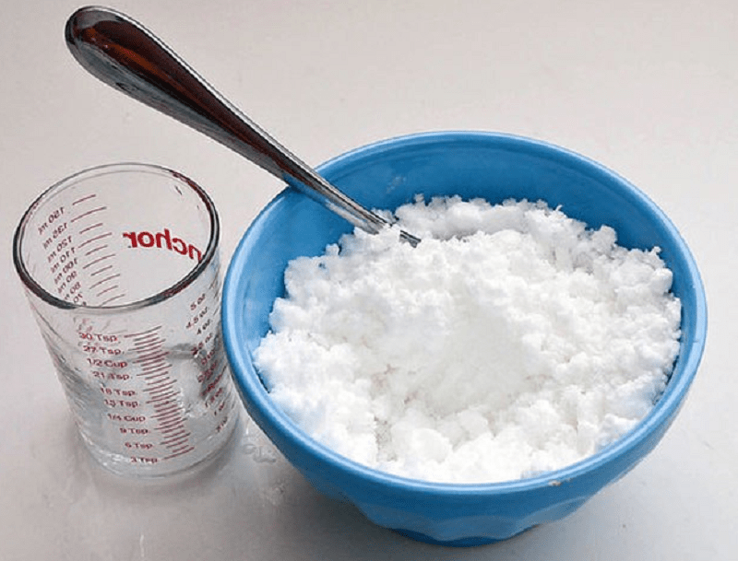
Reaction in a Bag
What happens when we combine acetic acid and sodium bicarbonate?
This Photo by Unknown Author is licensed under CC BY-SA-NC

Slide 5
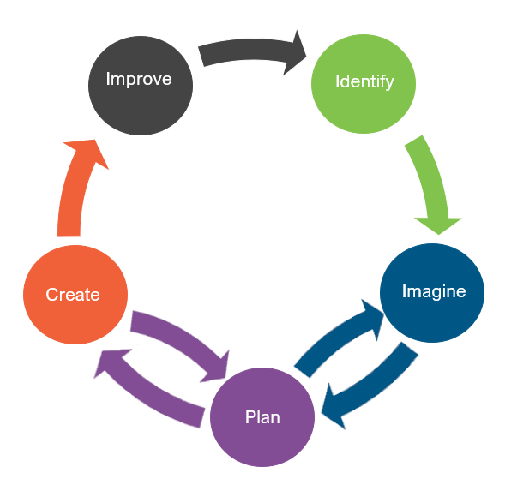
Engineering Design
What is engineering?
What are engineering jobs?

Slide 6
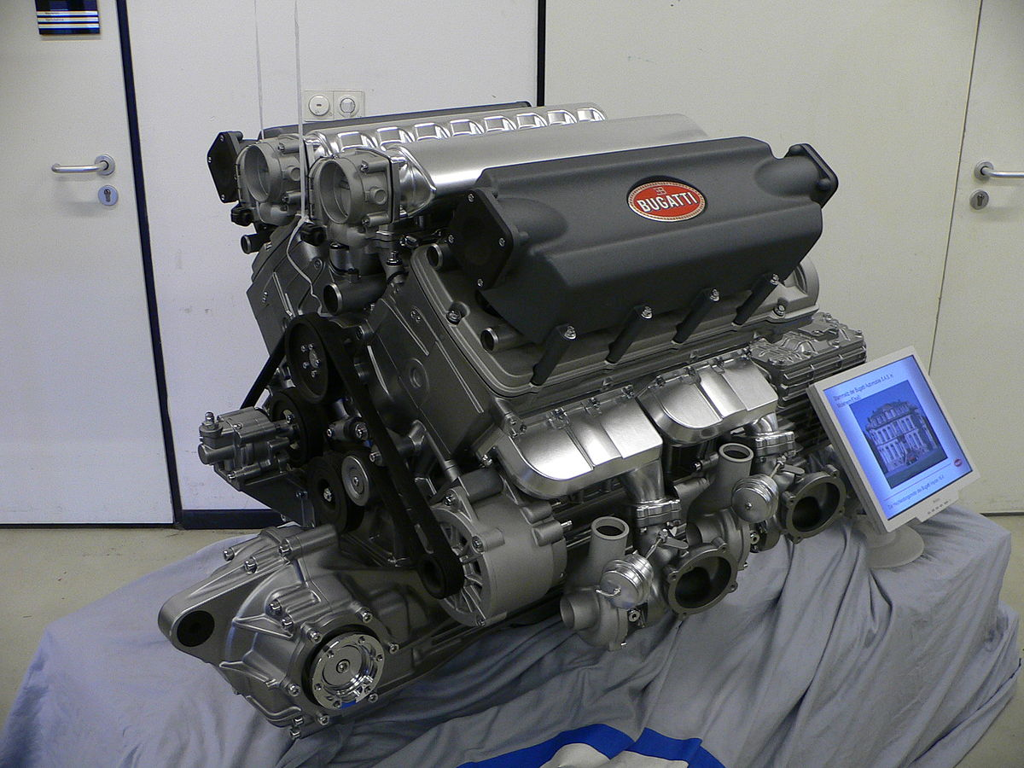
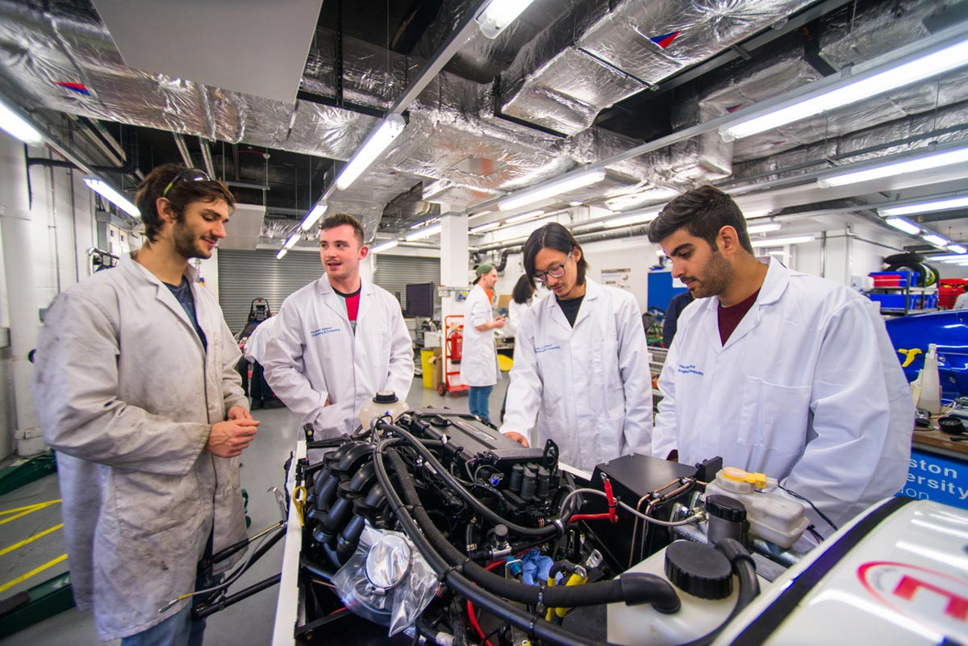
Engineering Jobs
This Photo by Unknown Author is licensed under CC BY-SA
This Photo by Unknown Author is licensed under CC BY-SA

Slide 7
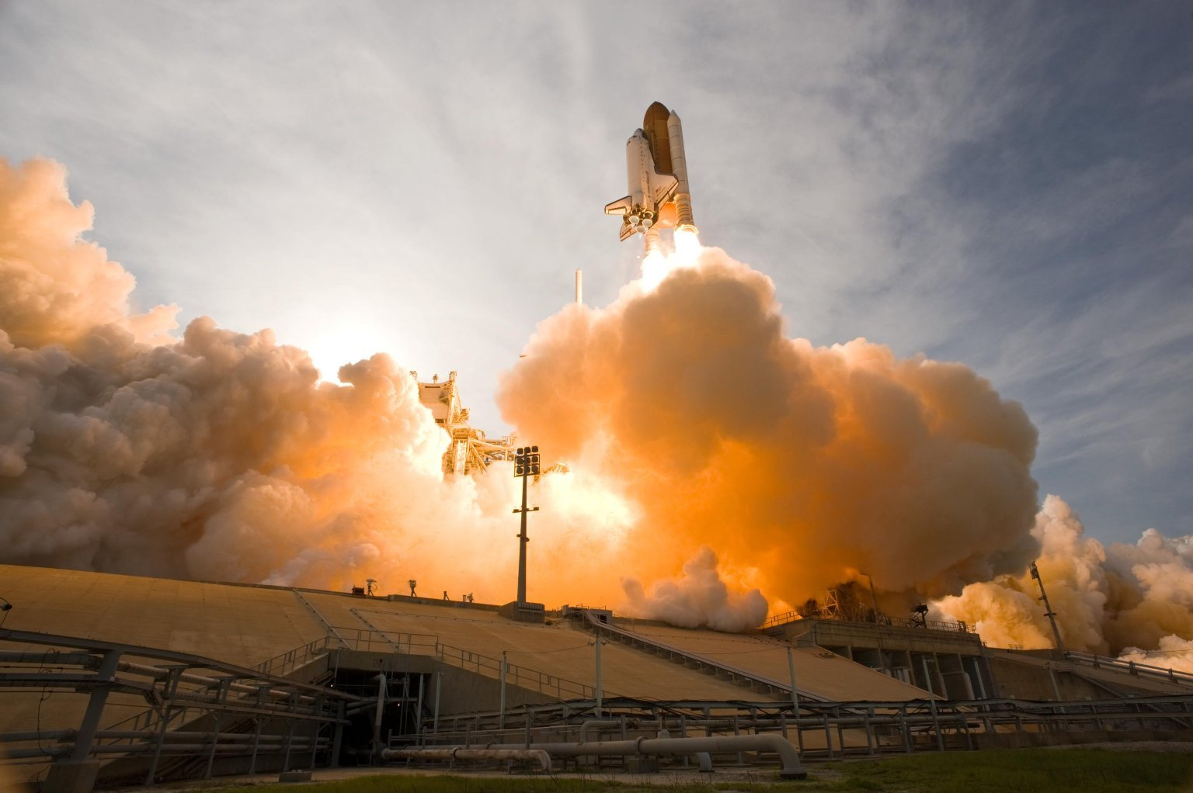
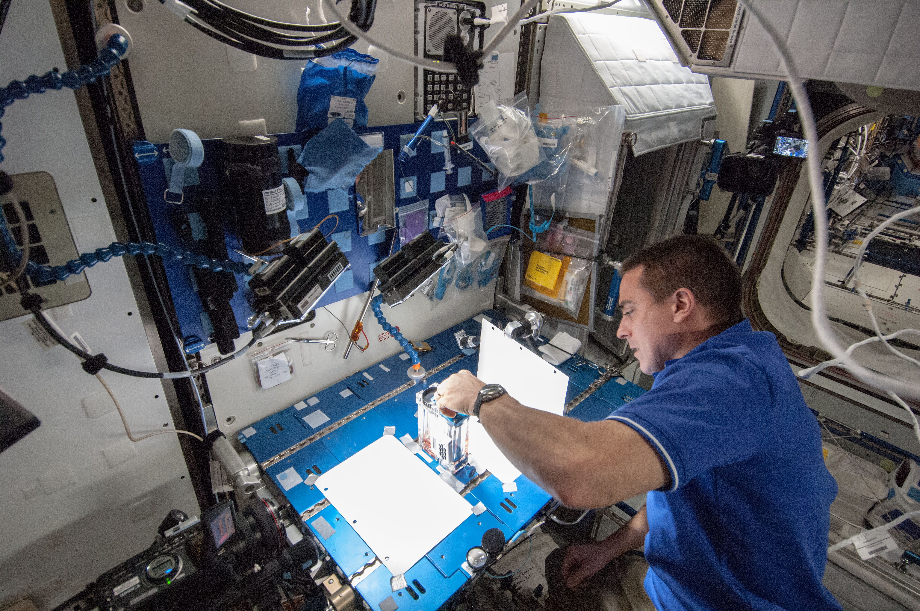
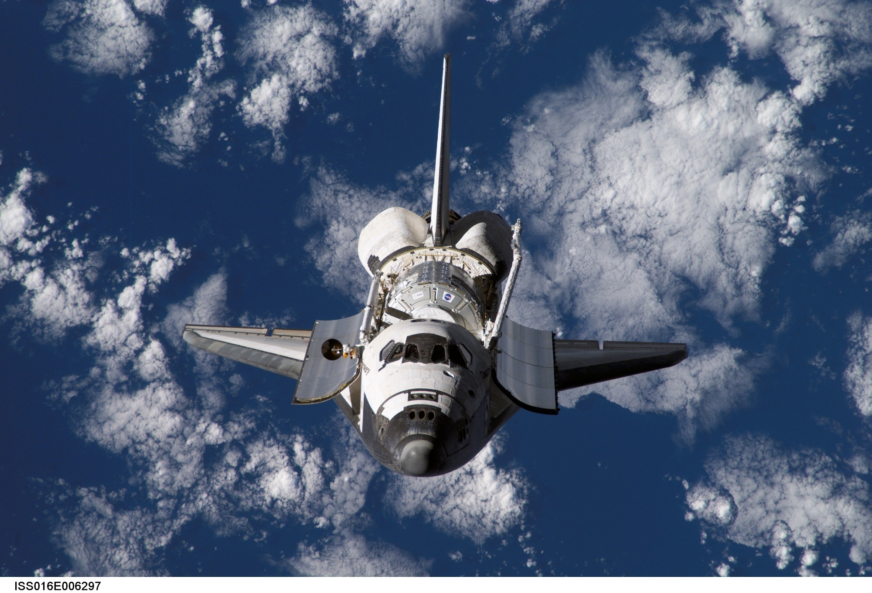
Engineering Jobs
This Photo by Unknown Author is licensed under CC BY-SA

Slide 8
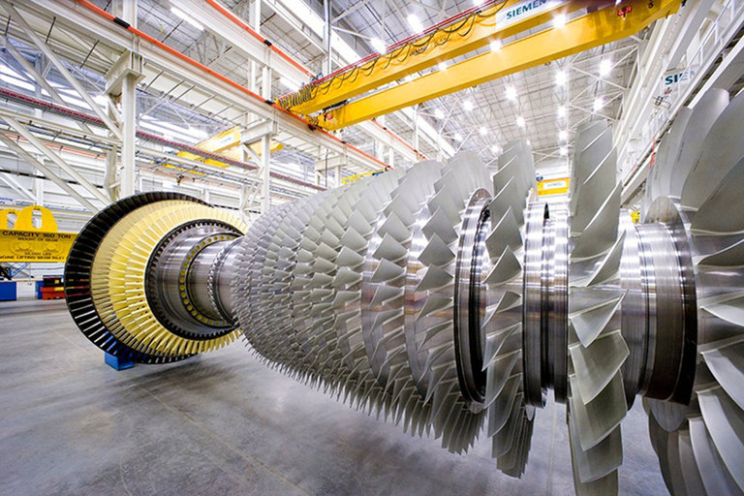
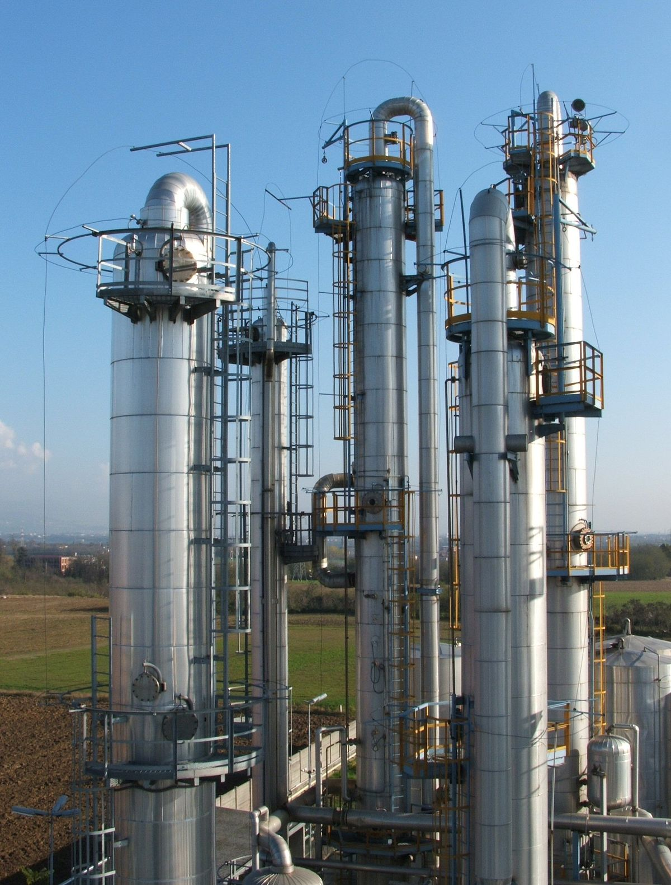
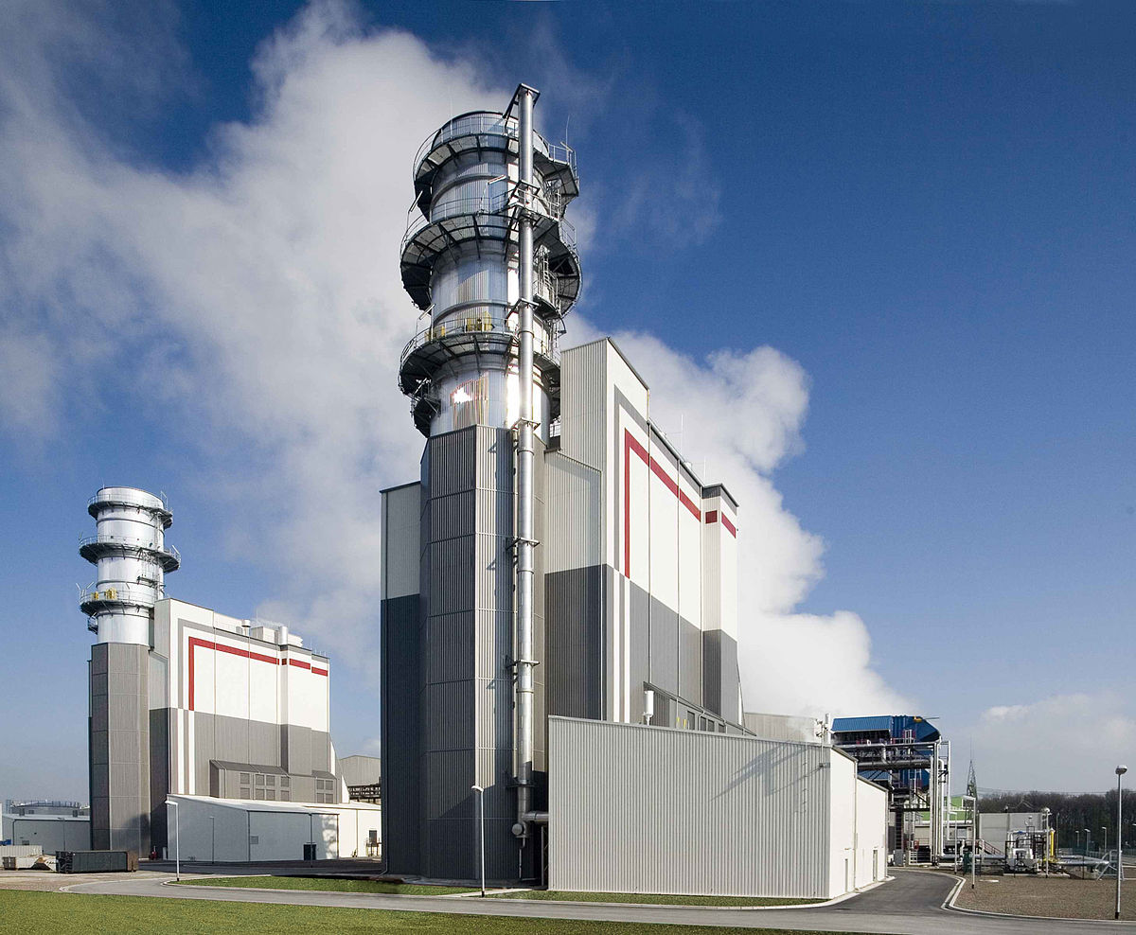
Engineering Jobs
This Photo by Unknown Author is licensed under CC BY
This Photo by Unknown Author is licensed under CC BY-SA
This Photo by Unknown Author is licensed under CC BY-SA

Slide 9
Engineering Design
What is engineering?
What are engineering jobs?
Who can be an engineer?

Slide 10
Engineering Design Process
Identify
Identify the Problem
Imagine
Explore the materials
Plan
Create
Build the product/prototype
Improve
Analyze results from test
Create a plan individually
Identify the Criteria and Constraints
Brainstorm ideas
Select a group
Gather materials
Test the product/prototype
Modify process or design to make it better
Repeat as many times as needed

Slide 11
Problem
Jennifer’s transportation company is currently trying to figure out how to maximize the output of her trucks. They travel far distances with a lot of goods and do not want to waste any fuel.
Today, you will put on your engineering hat to build a truck that will travel an exact distance on a single tank of gas.
  Identify the Problem
  Identify the Criteria and Constraints
Identify

Slide 12
Criteria: (Desired Outcomes)
The truck must:
Be self-propelled by the chemical reaction occurring in the water bottle
Stop after traveling 2.5 meters
Not crash
**Bonus points: The truck delivers payloads of 50 mL, 100 mL, and 150 mL of water while traveling 2.5 meters
  Identify the Problem
  Identify the Criteria and Constraints
Identify

Slide 13
Constraints: (Limitations)
Time Limit: You will have 25 minutes to build the truck.
Materials: You can only use the materials available.
Budget: You will have $500 to complete this challenge.
Collaboration: One design element from each team member must be used in the final design.
Redesign: Each team can test their prototype as many times as needed during the 25-minute design phase.
  Identify the Problem
  Identify the Criteria and Constraints
Identify

Slide 14
Explore Materials
Materials | Cost
Sodium bicarbonate (Max: 25 g) | $15 per 5 grams
Acetic acid (Max: 125 mL) | $15 per 25 mL
Lego wheels (small/medium/large) | $10/$20/$30 per wheel
Lego axle | $5 per axle
Lego long chassis - White | $50 per chassis
Lego short chassis - Blue | $25 per chassis
Straw | $10 per straw
Tape | $15 per roll
Scissors | $10 per pair
Thick foam sheet or cardboard | $50 per sheet
Construction paper or cardstock | $25 per sheet
Free materials
Water bottle + cap - 750 mL
Water
Thumbtack or push pin
Tissue paper
Safety goggles
Lab gloves
  Explore the materials
  Brainstorm ideas
Imagine

Slide 15
Brainstorm!
1 minute: Individual Design
  Draw a plan of how you think Jennifer should design her truck.
5 minutes: Each member presents their ideas to the group.
  Share your ideas and focus on things you like the most about your idea that you would like to see be used as a design element for the final design
  Explore the materials
  Brainstorm ideas
Imagine

Slide 16
Gather Materials
Score card and criteria
  The truck must:
    Be self-propelled by the chemical reaction occurring in the water bottle
    Stop after traveling 2.5 meters
    Not crash
    Bonus points: The truck delivers payloads of 50 mL, 100 mL, and 150 mL of water while traveling 2.5 meters
Select what materials will be used for the design
  Create a plan individually
  Select a group
  Gather materials
Plan

Slide 17
Team Member Responsibilities
Assign responsibilities of each team member during the process
  Material Manager: collects materials
  Banker: manages the budget
  Head Engineer: measure the height of the barriers
  Quality Control Manager: match the design to the prototype
  Create a plan individually
  Select a group
  Gather materials
Plan

Slide 18
Design Your Truck!
HAVE FUN
BE CREATIVE
WORK TOGETHER
  Build the product/prototype
  Test the product/prototype
Create

Slide 19
Criteria
Constraints
Be self-propelled by the chemical reaction occurring in the water bottle
Stop after traveling 2.5 meters
Not crash
**Bonus points: The truck delivers payloads of 50 mL, 100 mL, and 150 mL of water while traveling 2.5 meters
Time Limit: You will have 25 minutes to build the truck.
Materials: You can only use the materials available.
Budget: You will have $500 to complete this challenge.
Collaboration: One design element from each team member must be used in the final design.
Redesign: Each team can test their prototype as many times as needed during the 25-minute design phase.
  Identify the Problem
  Identify the Criteria and Constraints
Identify

Slide 20
\ | SCORE
 | 2 | 1 | 0
COLLABORATION | The design has elements contributed by all team members. | The design has elements contributed by three team members. | The design has elements contributed by two team members.
TEST: CRASH | The truck did not crash. | The truck grazed the wall. | The truck hit the wall.
TEST: DISTANCE | The truck travelled 2.5 meters. | The truck travelled within 10 cm of the destination line. | The truck travelled within 20 cm of the destination line.
TEST: SELF-PROPULSION | The truck did not receive any assistance after removing the thumb tack. | The truck required assistance to make minor adjustments after removing the thumb tack, i.e. re-align axels. | The truck required outside assistance to begin initial movement after removing the thumb tack.
COST OF MATERIALS | $350 or less. | $351 - $499 | $400 – $500
BONUS POINTS: Payload 1 | The truck travelled 2.5 meters. | The truck travelled within 10 cm of the destination line. | The truck travelled within 20 cm of the destination line.
BONUS POINTS: Payload 2 | The truck travelled 2.5 meters. | The truck travelled within 10 cm of the destination line. | The truck travelled within 20 cm of the destination line.
 |  |  | TOTAL SCORE
Test

Slide 21
Redesign: Discussion
What worked?
What did not work?
What do you want to improve?
  Analyze results from test
  Modify process or design to make it better
  Repeat as many times as needed
Improve

