Slide 1
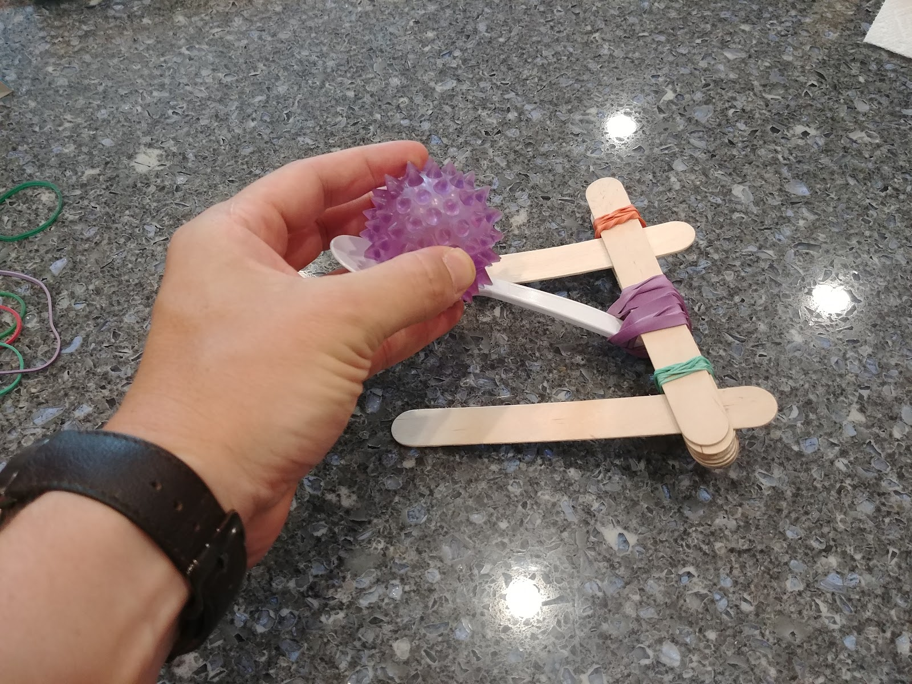





Care Package Launch
This Photo by Unknown Author is licensed under CC BY

Slide 2
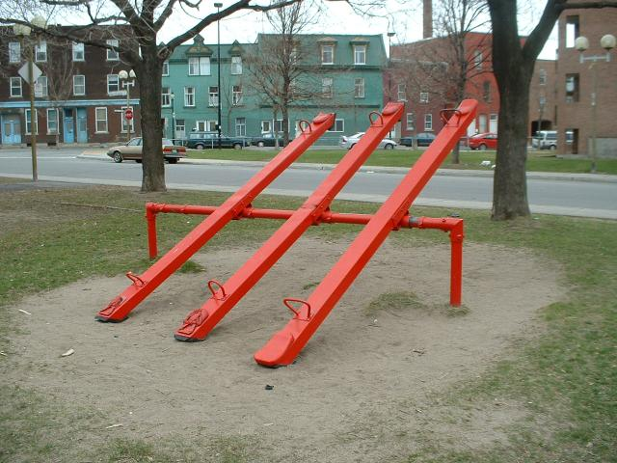
What is a Lever?
This Photo by Unknown Author is licensed under CC BY-SA

Slide 3

Catapults!

Slide 4
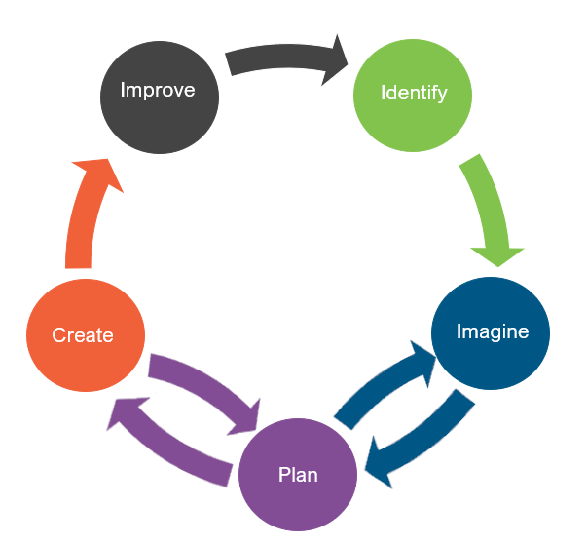
Engineering Design
What is engineering?
What are engineering jobs?

Slide 5

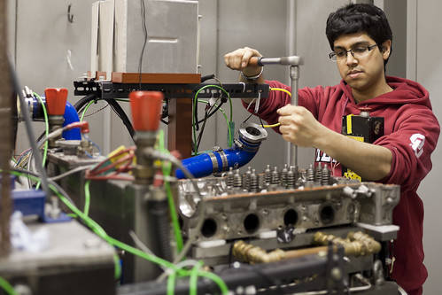
Engineering Jobs
This Photo by Unknown Author is licensed under CC BY
This Photo by Unknown Author is licensed under CC BY-NC-ND

Slide 6
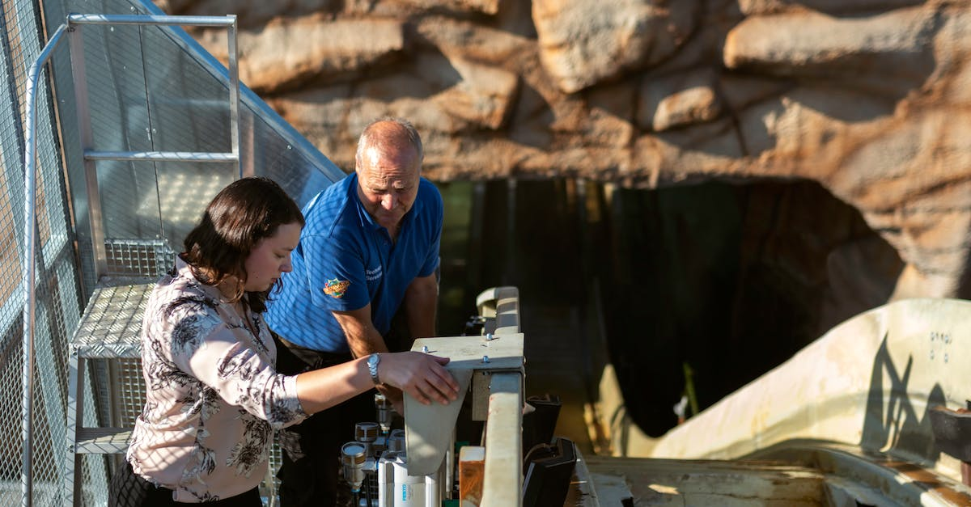

Engineering Jobs

Slide 7


Engineering Jobs
This Photo by Unknown Author is licensed under CC BY

Slide 8
Engineering Design
What is engineering?
What are engineering jobs?
Who can be an engineer?

Slide 9
Engineering Design Process
Identify
Identify the Problem
Imagine
Explore the materials
Plan
Create
Build the product/prototype
Improve
Analyze results from test
Create a plan individually
Identify the Criteria and Constraints
Brainstorm ideas
Select a group
Gather materials
Test the product/prototype
Modify process or design to make it better
Repeat as many times as needed

Slide 10
Problem
The Kingdom of Raventown is looking to deliver care packages to the town of Oriola but is prevented by a canyon. Raventown needs your help in figuring out how to send the care packages over the canyon.
Today, you will put on your engineering hat to help Raventown build a catapult that can send care packages to two different locations in the town of Oriola.
Identify the Problem
Identify the Criteria and Constraints
Identify

Slide 11
Criteria: (Desired Outcomes)
A successful catapult design should include the following:
A seat for the care package
An accurate launch system (measured by the package landing in both locations, as indicated by the tape, within five tries)
A lever
Maintain structural integrity during use
Three different materials
Bonus points will be awarded if the catapult can successfully send a larger care package to the two locations.
Identify the Problem
Identify the Criteria and Constraints
Identify

Slide 12
Constraints: (Limitations)
Time Limit: You will have 30 minutes to build the catapult.
Materials: You may only use the available materials.
Budget: You will have $100 to complete this challenge.
Collaboration: One design element from each team member must be used in the final design.
Redesign: Each team can test their prototype as many times as needed during the 30-minute design phase.
Identify the Problem
Identify the Criteria and Constraints
Identify

Slide 13
Explore Materials
Here are the materials we will be using.
What could be used for a beam?
Or a fulcrum?
Materials ​ | Cost
Care Package | Free
Small Popsicle Sticks | $10 for 10 sticks
Large Popsicle Sticks | $30 for 10 sticks
Straw | $10
Glue | $20
Hot Glue | $30
Rubber Bands | $10 for 10 bands
Bottle Cap | $10
Plastic Spoon | $20
Explore the materials
Brainstorm ideas
Imagine

Slide 14
Brainstorm!
1 minute: Individual Design
Draw a plan of how you think the catapult should look like.
5 minutes: Each member presents their ideas to the group.
Share your ideas and focus on things you like the most about your idea that you would like to see be used as a design element for the final design
Explore the materials
Brainstorm ideas
Imagine

Slide 15
Gather Materials
A successful catapult design should include the following:
A seat for the care package
An accurate launch system (measured by the package landing in both locations, as indicated by the tape, within five tries)
A lever
Maintain structural integrity during use
Three different materials
**Bonus points will be awarded if the catapult can successfully send a larger care package to the two locations.
Create a plan individually
Select a group
Gather materials
Plan

Slide 16
Team Member Responsibilities
Assign responsibilities of each team member during the process
Material Manager: collects materials
Banker: manages the counters
Head Engineer: ensure accurate launch system
Quality Control Manager: match the design to the prototype
Create a plan individually
Select a group
Gather materials
Plan

Slide 17
Design Your Catapult!
HAVE FUN
BE CREATIVE
WORK TOGETHER
Build the product/prototype
Test the product/prototype
Create

Slide 18
Criteria
Constraints
A successful catapult design should include the following:
A seat for the care package
An accurate launch system (measured by the package landing in both locations, as indicated by the tape, within five tries)
A lever
Maintain structural integrity during use
Three different materials
Bonus points will be awarded if the catapult can successfully send a larger care package to the two locations.
Time Limit: You will have 30 minutes to build the catapult.
Materials: You may only use the available materials.
Budget: You will have $100 to complete this challenge.
Collaboration: One design element from each team member must be used in the final design.
Redesign: Each team can test their prototype as many times as needed during the 30-minute design phase.
Identify the Problem
Identify the Criteria and Constraints
Identify

Slide 19
CRITERIA | SCORE
 | 2 | 1 | 0
COLLABORATION | The design has elements contributed by all team members. | The design has elements contributed by two team members. | The design does not have elements contributed by each team member.
CARE PACKAGE SEAT | The catapult has a seat for the care package without assistance on launch. | The catapult has a seat for the care package but requires assistance on launch. | There is no seat for the care package.
LANDING ACCURACY | The care package lands in both target locations in 5 tries. | The care package lands in one target location in 5 tries. | The care package does not land in any target location in 5 tries.
USABILITY | The catapult is structurally sound and the same after 5 tries. | The catapult is usable, but some parts break down after 5 tries. | The catapult cannot be used anymore.
LEVER | The catapult includes both a beam and a fulcrum. | The catapult includes either a beam or a fulcrum. | The catapult does not include a lever.
MATERIALS USED | The catapult is comprised of at least 3 different materials. | The catapult is comprised of at least 2 different materials. | The catapult is comprised of only 1 material.
BUDGET USED | $50 or less. | $51 - $99. | $100 or more.
BONUS POINTS: JUMBO DROP | The jumbo care package lands in both target locations in 5 tries. | The jumbo care package lands in one target location in 5 tries. | The jumbo care package does not land in any target location in 5 tries.
 |  |  | TOTAL SCORE
Test

Slide 20
Redesign: Discussion
What worked?
What did not work?
What do you want to improve?
Analyze results from test
Modify process or design to make it better
Repeat as many times as needed
Improve

