Slide 1





Wigglebots:
Moving Energy through Circuits

Slide 2

Electricity
What is electricity?
What is an electrical circuit?
Simulation: https://phet.colorado.edu/sims/html/circuit-construction-kit-dc/latest/circuit-construction-kit-dc_en.html

Slide 3
Today’s Objectives
After today’s activity I will be able to:
Demonstrate that electricity travels in a closed path, creating an electrical circuit.
Demonstrate that the flow of electricity in closed circuits can produce light, heat, and sound.
Solve a problem using the engineering design process.

Slide 4
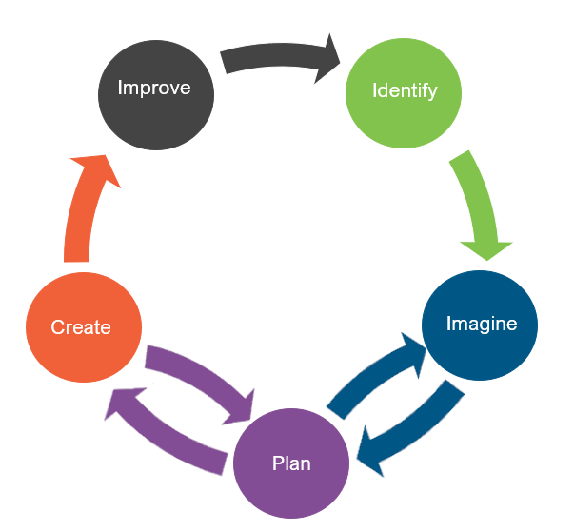
Engineering Design
What is engineering?
What are engineering jobs?

Slide 5
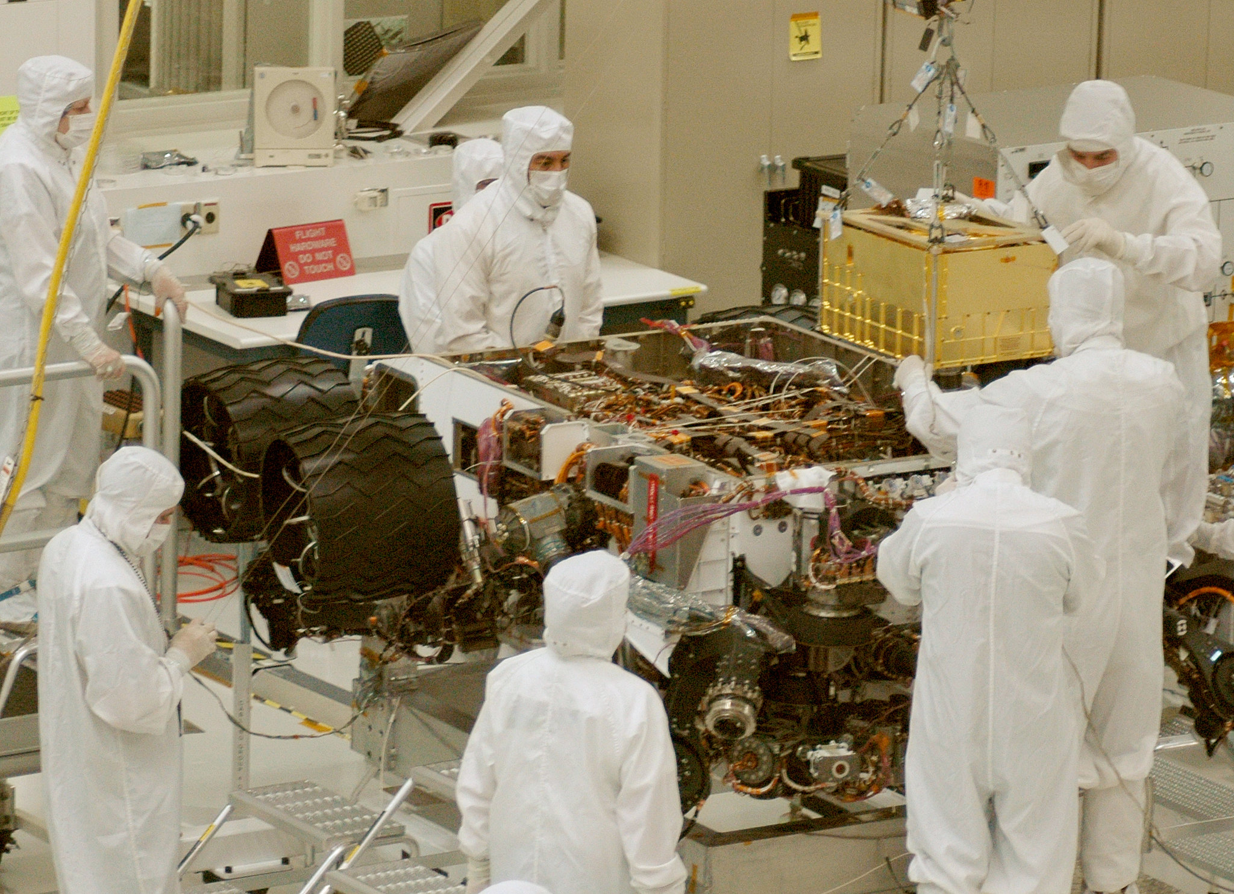
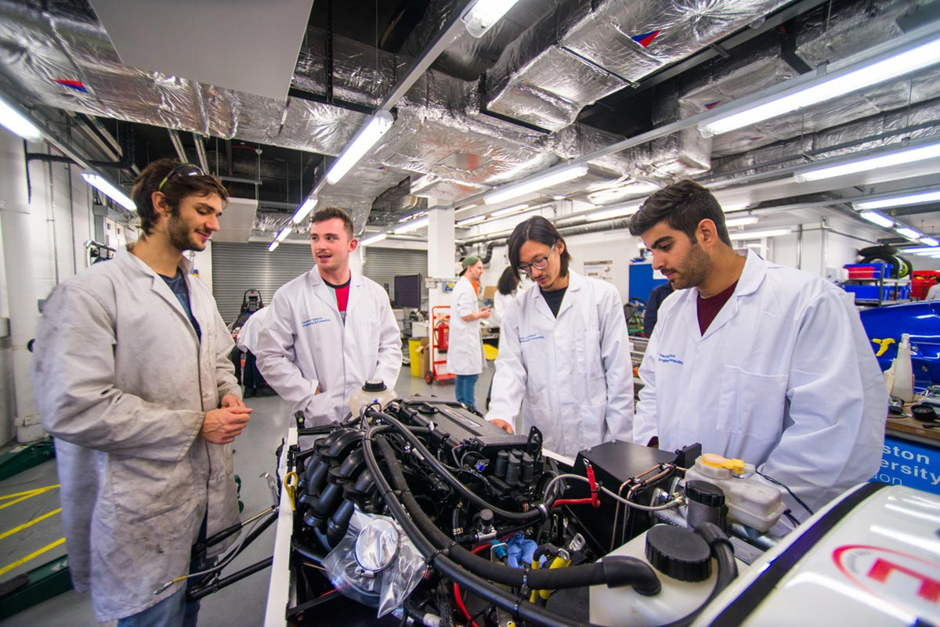
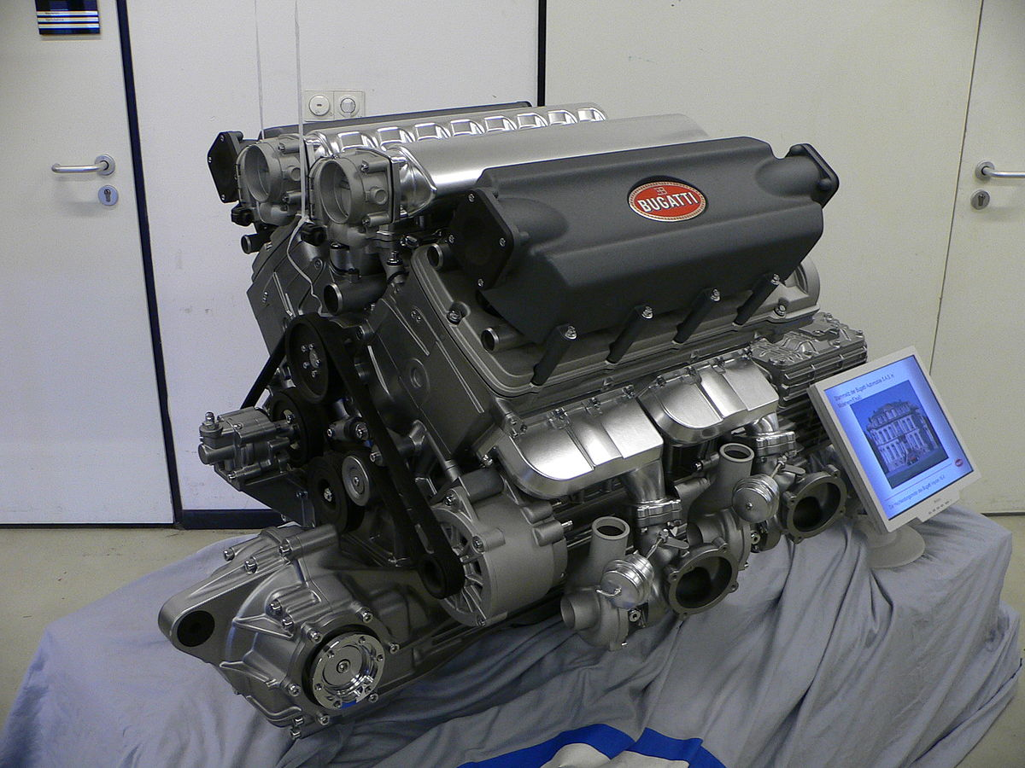
Engineering Jobs
Image Credit: NASA/JPL-Caltech
This Photo by Unknown Author is licensed under CC BY-SA

Slide 6

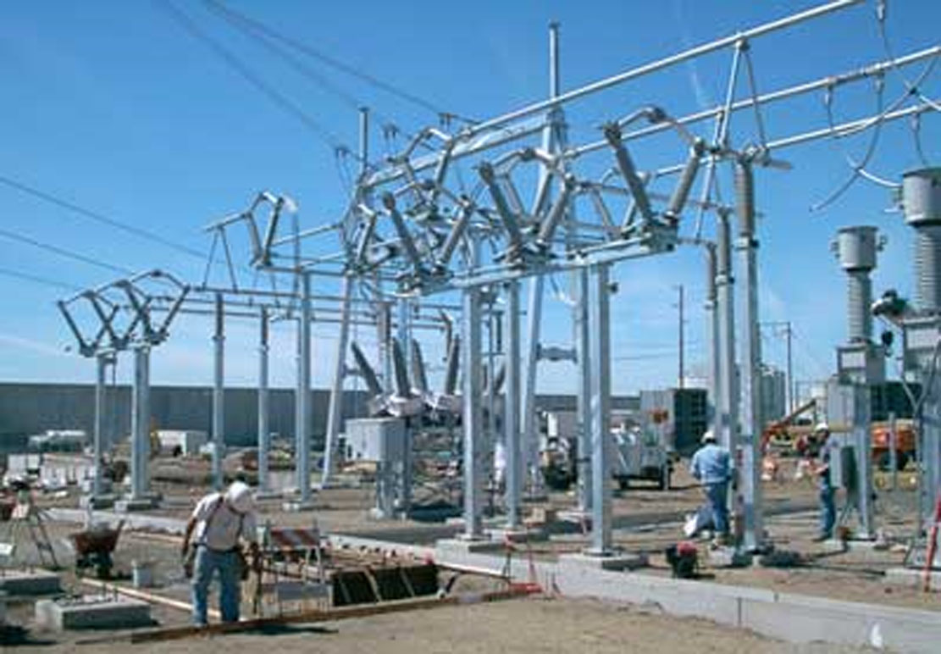

Engineering Jobs
This Photo by Unknown Author is licensed under CC BY-NC-ND
This Photo by Unknown Author is licensed under CC BY-SA
Credit - Dennis Schroeder / NREL

Slide 7
Engineering Design
What is engineering?
What are engineering jobs?
Who can be an engineer?

Slide 8
Engineering Design Process
Identify
Identify the Problem
Imagine
Explore the materials
Plan
Create
Build the product/prototype
Improve
Analyze results from test
Create a plan individually
Identify the Criteria and Constraints
Brainstorm ideas
Select a group
Gather materials
Test the product/prototype
Modify process or design to make it better
Repeat as many times as needed

Slide 9
Problem
Maria’s company currently sells Wigglebot robots but has gotten feedback from her market research that they need to do more than just wiggle. She is looking to improve the design of this toy to include more features, while keeping its’ same look.
Today, you will be putting on your engineering hat to help Maria improve the design of her toy. This toy needs to be able to produce light and sound all while still wiggling!
Identify the Problem
Identify the Criteria and Constraints
Identify

Slide 10
Criteria: (Desired Outcomes)
The Wigglebot must:
Light up
Wiggle
Not fall over when powered
Bonus Points: Create a technical drawing of your Wigglebot including labels and energy transformations.
Identify the Problem
Identify the Criteria and Constraints
Identify

Slide 11
Constraints: (Limitations)
Time Limit: You will have 30 minutes to build the Wigglebot.
Materials: You can only use the materials available.
Budget: You will have $20.00 to complete this challenge.
Collaboration: One design element from each team member must be used in the final design.
Redesign: Each team can test their prototype as many times as needed during the 30-minute design phase.
Identify the Problem
Identify the Criteria and Constraints
Identify

Slide 12
Explore Materials
Free Materials
Plastic cup
DC motor
Battery pack holder
Batteries
Pencils – First 3 free
Materials | Cost
Pencils | $1 per marker
LEDS (lights) | $5 per LED
Electrical tape | $5 per roll
Pipe Cleaner | $1 per stick
Googly eyes | $1 per eye
Clothespins | $1 per pin
Alligator clips( Wires) | $1 per clip
Scissors | $5 per pair
Explore the materials
Brainstorm ideas
Imagine

Slide 13
Brainstorm!
1 minute: Individual Design
Draw a plan of how you think Maria should build her new and improved Wigglebot.
5 minutes: Collaborate. Each member presents their ideas to the group.
Share your ideas and focus on things you like the most about your idea that you would like to see be used as a design element for the final design.
Draw out your final design
.
Explore the materials
Brainstorm ideas
Imagine

Slide 14
Gather Materials
Each group should collect:
Score card and criteria
The Wigglebot must:
Light up
Wiggle
Not fall over when powered.
Bonus Points: Create a technical drawing of your Wigglebot including labels and energy transformations.
Materials that will be used for the design
Create a plan individually
Select a group
Gather materials
Plan

Slide 15
Team Member Responsibilities
Assign responsibilities of each team member during the process
Materials Manager: collects materials
Banker: manages the budget
Head Engineer: check for connections and battery control
Quality Control Manager: matches the design to the prototype
Create a plan individually
Select a group
Gather materials
Plan

Slide 16
Design Your Toy!
HAVE FUN
BE CREATIVE
WORK TOGETHER
Build the product/prototype
Test the product/prototype
Create

Slide 17
Criteria
Constraints
Time Limit: You will have 30 minutes to build the Wigglebot.
Materials: You can only use the materials available.
Budget: You will have $20.00 to complete this challenge.
Collaboration: One design element from each team member must be used in the final design.
Redesign: Each team can test their prototype as many times as needed during the 30-minute design phase.
The Wigglebot must:
Light up
Wiggle
Not fall over when powered
Bonus Points: Create a technical drawing of your Wigglebot including labels and energy transformations.
Identify the Problem
Identify the Criteria and Constraints
Identify

Slide 18
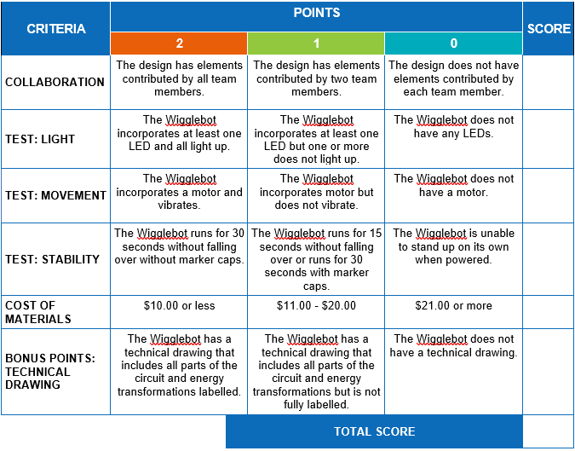
Test

Slide 19
Redesign: Discussion
What worked?
What did not work?
What do you want to improve?
Analyze results from test
Modify process or design to make it better
Repeat as many times as needed
Improve

