Slide 1
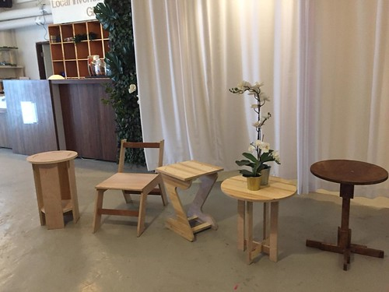





Goldilocks and the Three Bears
This Photo by Unknown Author is licensed under CC BY-SA-NC

Slide 2

Read
Aloud

Slide 3
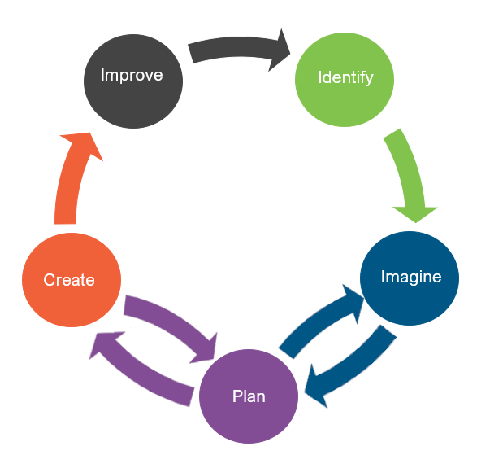
Engineering Design
What is engineering?
What are engineering jobs?

Slide 4
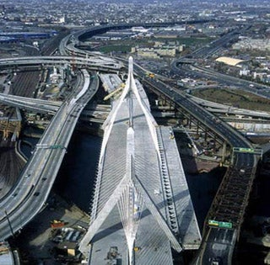
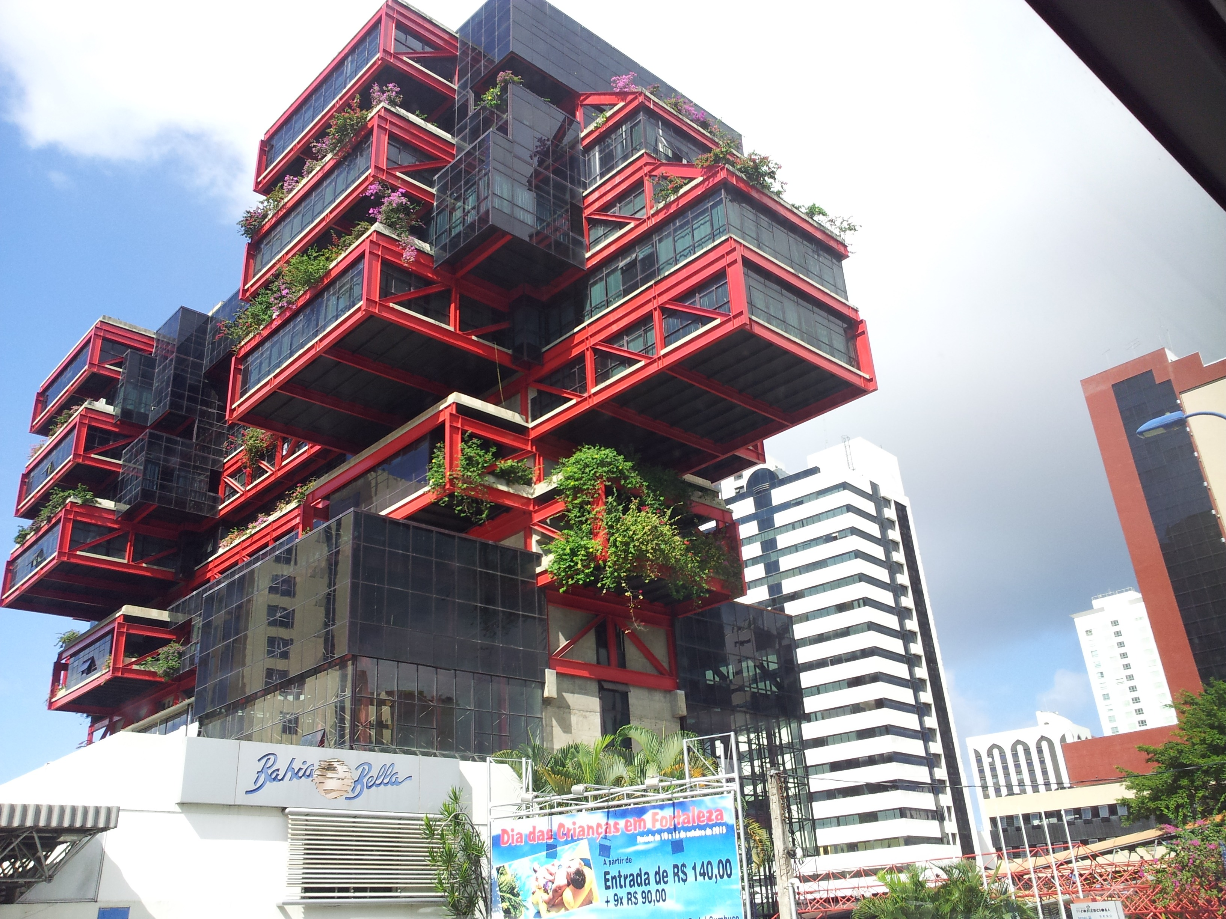
Engineering Jobs

Slide 5
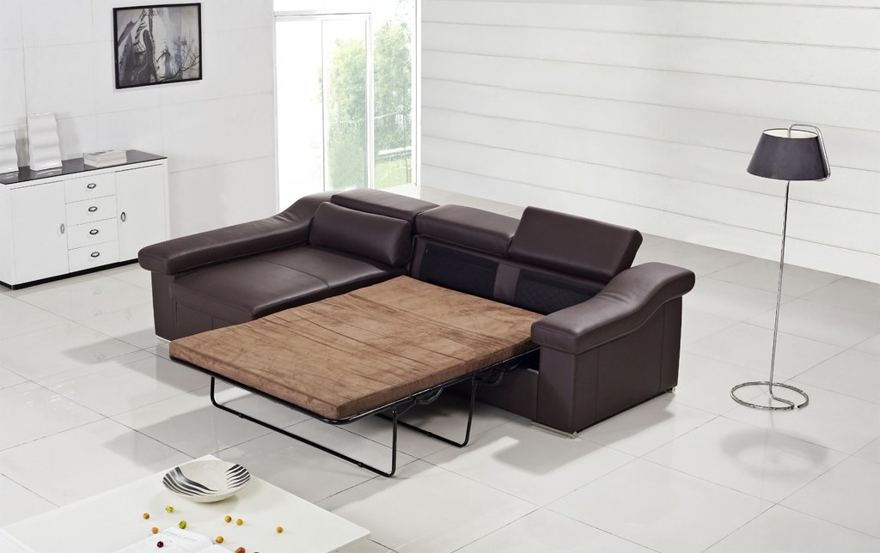
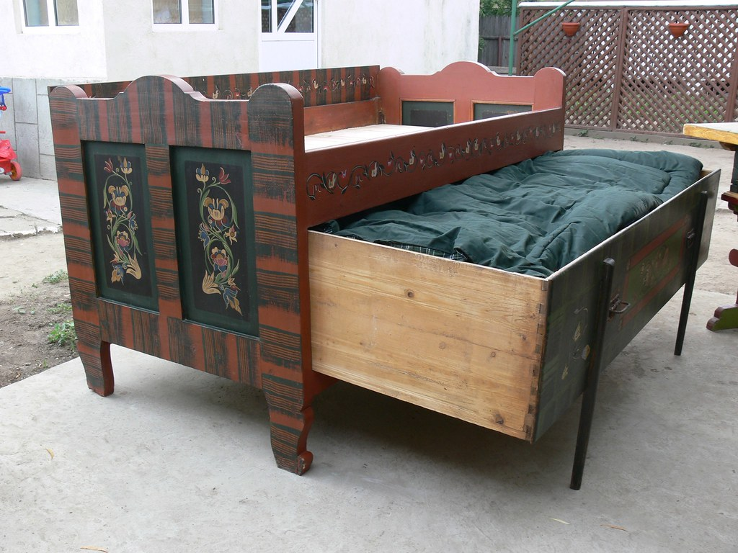
Engineering Jobs
This Photo by Unknown Author is licensed under CC BY
This Photo by Unknown Author is licensed under CC BY-SA

Slide 6
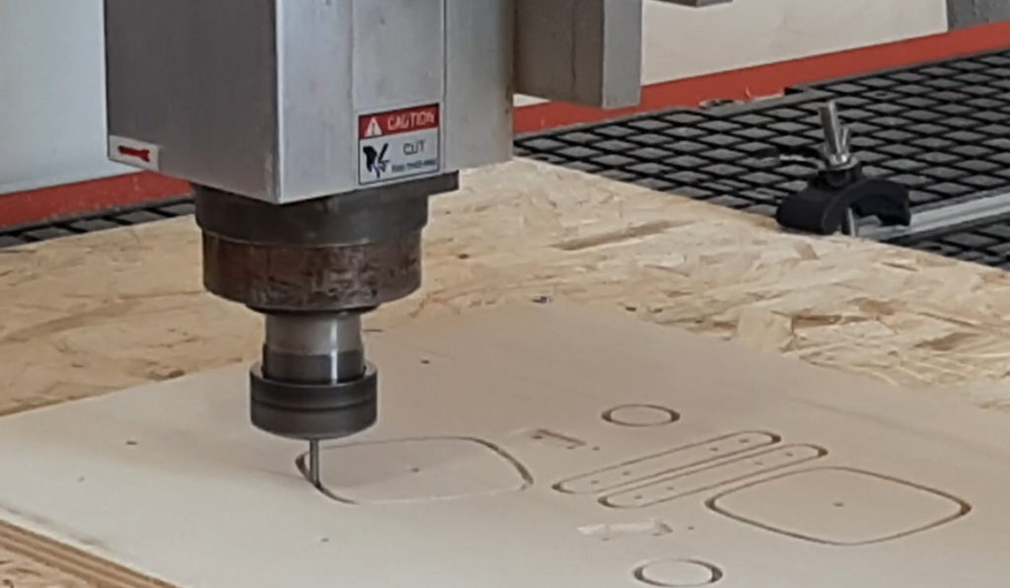
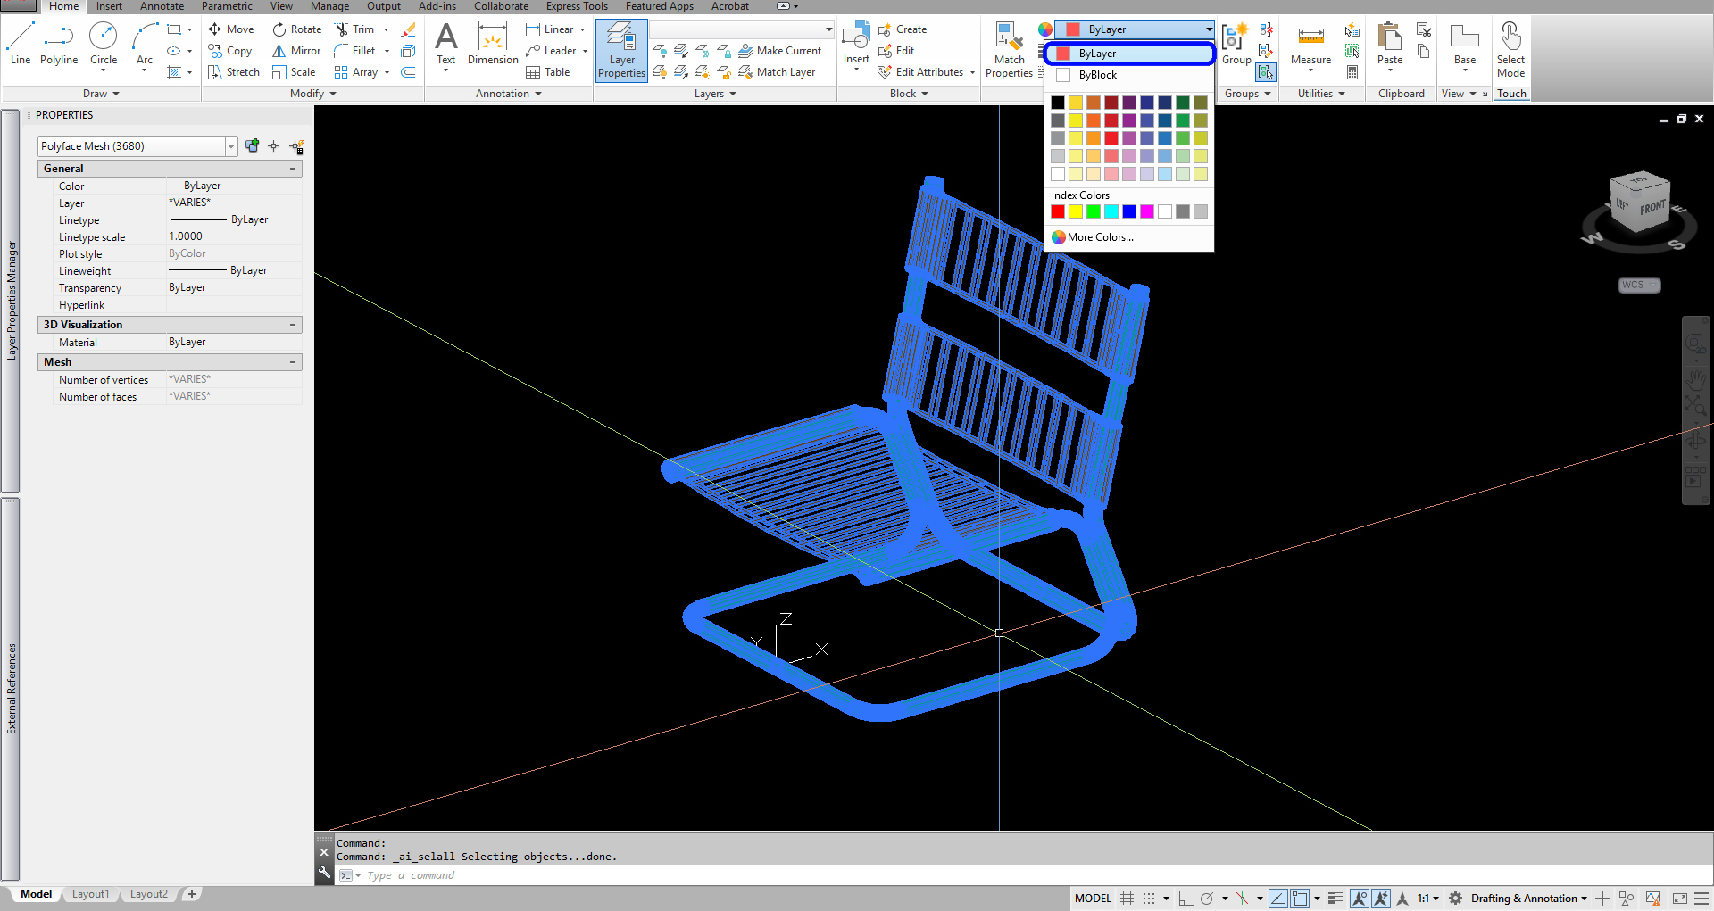
Engineering Jobs
This Photo by Unknown Author is licensed under CC BY
This Photo by Unknown Author is licensed under CC BY-NC

Slide 7
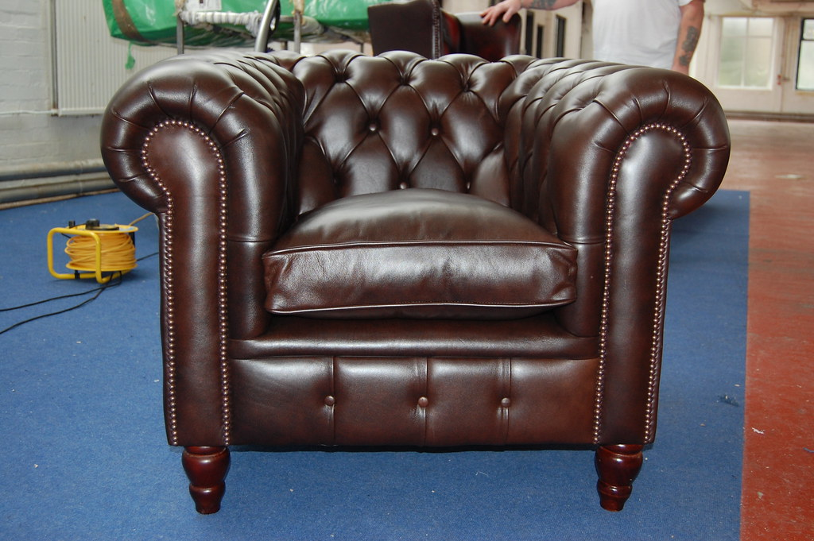

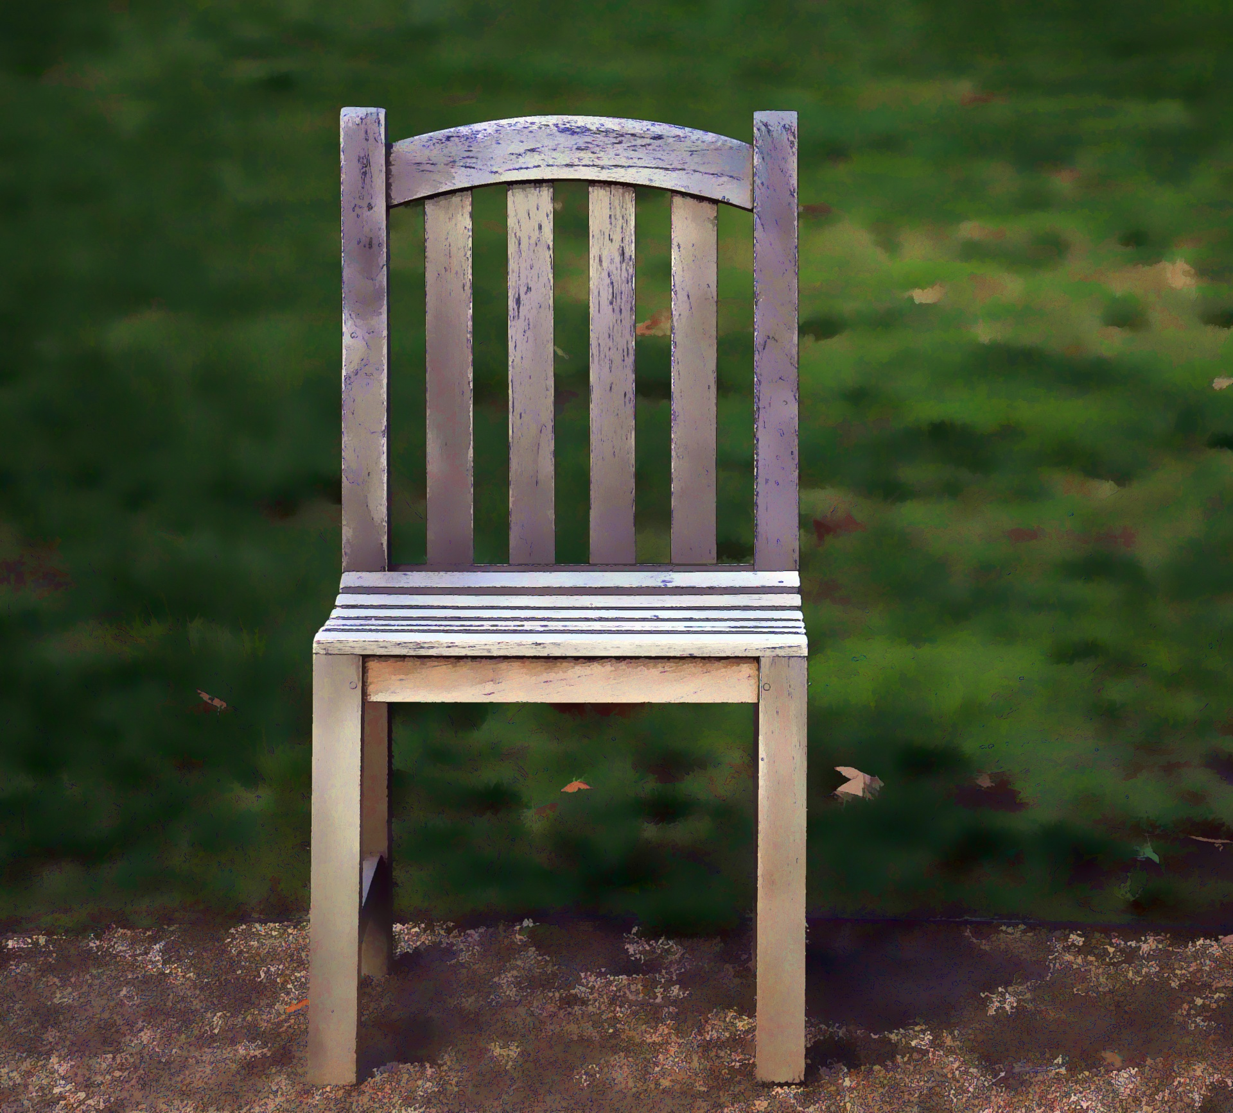
Engineering Jobs
This Photo by Unknown Author is licensed under CC BY
This Photo by Unknown Author is licensed under CC BY-NC

Slide 8
Engineering Design
What is engineering?
What are engineering jobs?
Who can be an engineer?

Slide 9
Engineering Design Process
Identify
Identify the Problem
Imagine
Explore the materials
Plan
Create
Build the product/prototype
Improve
Analyze results from test
Create a plan individually
Identify the Criteria and Constraints
Brainstorm ideas
Select a group
Gather materials
Test the product/prototype
Modify process or design to make it better
Repeat as many times as needed

Slide 10
Problem
The Bear family realized that their chair is only comfortable for them. However, if a guest was to come over, the Bear family realizes their chair may be uncomfortable for the guest! The Bear family needs help getting an extra chair that will be “just right” for their guest.
Today, you will put on your engineering hat to help the Bear family build a chair that is “just right” if a bear guest visits the family.
  Identify the Problem
  Identify the Criteria and Constraints
Identify

Slide 11
Criteria: (Desired Outcomes)
A successful chair design should include the following:
  Does not break into pieces when the bear guest sits on it
  Is not too big and not too small for the bear guest
  Has the seat at least 15 centimeters off the ground
**Bonus Points: A team member can sit on the chair!
  Identify the Problem
  Identify the Criteria and Constraints
Identify

Slide 12
Constraints: (Limitations)
Time Limit: You will have 25 minutes to build the chair.
Materials: You will be able to use no more than 20 items to build your chair.
Counters: You will have 20 counters to complete this challenge.
Collaboration: One design element from each team member must be used in the final design.
Redesign: Each team can test their prototype as many times as needed during the 25-minute design phase.
  Identify the Problem
  Identify the Criteria and Constraints
Identify

Slide 13
Explore Materials
Here are the materials we will be using.
Can you classify them?
What do they have in common?
Materials ​ | Cost
Construction Paper | 1 counter per sheet
Toilet Paper Rolls | 1 counter per roll
Foam Sheet | 1 counter per sheet
Scotch Tape | 3 counters per roll
Duct Tape | 5 counters per roll
Cardboard | 2 counters per sheet
Scissors | 1 counter per pair
Chenille Stick | 1 counter per stick
Bear Guest | No cost
  Explore the materials
  Brainstorm ideas
Imagine

Slide 14
Brainstorm!
1 minute: Individual Design
    Draw a plan of how you think the chair should look for the Bear family.
5 minutes: Each member presents their ideas to the group.
    Share your ideas and focus on things you like the most about your idea that you would like to see be used as a design element for the final design.
  Explore the materials
  Brainstorm ideas
Imagine

Slide 15
Gather Materials
A successful chair design should include the following:
  Does not break into pieces when the bear guest sits on it
  Is not too big and not too small for the bear guest
  Has the seat at least 15 centimeters off the ground
***Bonus Points: A team member can sit on the chair!
  Create a plan individually
  Select a group
  Gather materials
Plan

Slide 16
Team Member Responsibilities
Assign responsibilities of each team member during the process.
  Material Manager: collects materials
  Banker: manages the counters
  Head Engineer: measure the instrument
  Quality Control Manager: match the design to the prototype
  Create a plan individually
  Select a group
  Gather materials
Plan

Slide 17
Design Your Chair!
HAVE FUN
BE CREATIVE
WORK TOGETHER
  Build the product/prototype
  Test the product/prototype
Create

Slide 18
Criteria
Constraints
A successful chair design should include the following:
  Does not break into pieces when the bear guest sits on it
  Is not too big and not too small for the bear guest
  Has the seat at least 15 centimeters off the ground
Bonus Points: A team member can sit on the chair!
Time Limit: You will have 25 minutes to build the chair.
Materials: You will be able to use no more than 20 items to build your chair.
Counters: You will have 20 counters to complete this challenge.
Collaboration: One design element from each team member must be used in the final design.
Redesign: Each team can test their prototype as many times as needed during the 25-minute design phase.
  Identify the Problem
  Identify the Criteria and Constraints
Identify

Slide 19
CRITERIA | POINTS |  |  | SCORE
 | 2 | 1 | 0
COLLABORATION | The design has elements contributed by all team members. | The design has elements contributed by two team members. | The design does not have elements contributed by each team member.
SEAT | There is a seat for the bear guest, and it supports his weight. | There is a seat for the bear guest, but it does not support his weight. | There is no place for the bear guest to sit.
SEAT HEIGHT | The chair seat is at or above the 15-centimeter marker. | The chair seat is above the 8-centimeter, but below the 15-centimeter marker. | The chair seat is below the 8-centimeter marker.
JUST RIGHT | The chair is just right for the bear guest. (Approximately 3-centimeters of space on either side of the bear guest) | The chair is too big for the bear guest. (More than 3-centimeters of space on either side of the bear guest) | The bear guest does not fit in the chair.
COUNTERS USED | 14 counters or less. | 15 – 20 counters. | 20 counters or more.
BONUS: HUMAN GUEST | A student from the team can sit on the chair without breaking it for 5 seconds and fit in it. | A student can sit on the chair without breaking it for 5 seconds or can fit in the chair. | A student cannot sit on the chair nor fit in it.
 |  |  | TOTAL SCORE
Test

Slide 20
Redesign: Discussion
What worked?
What did not work?
What do you want to improve?
  Analyze results from test
  Modify process or design to make it better
  Repeat as many times as needed
Improve

