Slide 1



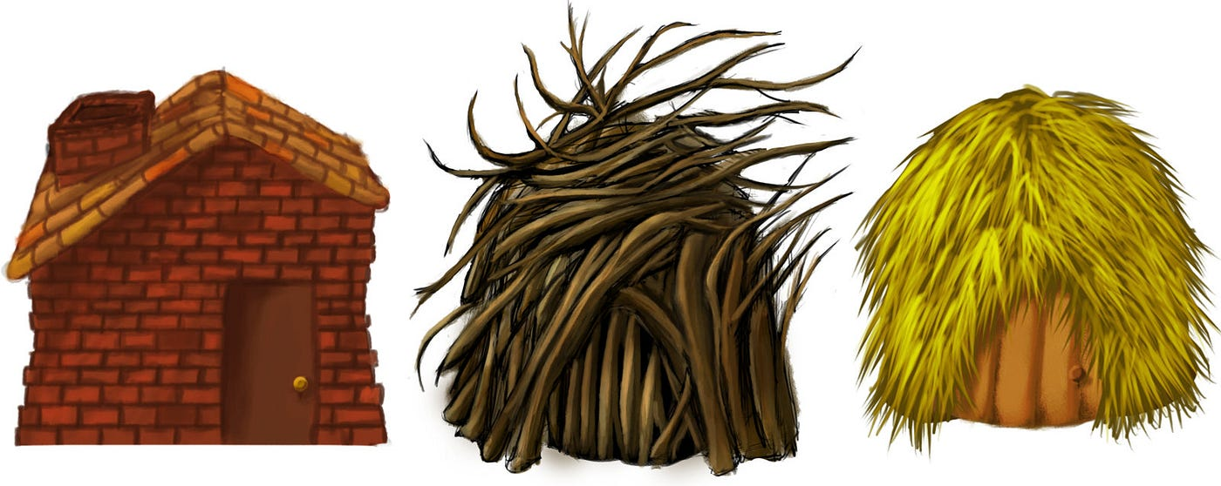



The True Story of the Three Little Pigs

Slide 2
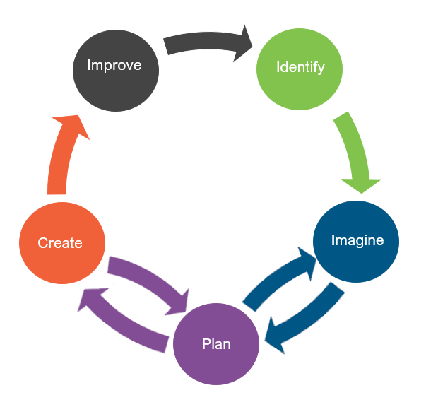
Engineering Design
What is engineering?
What are engineering jobs?

Slide 3
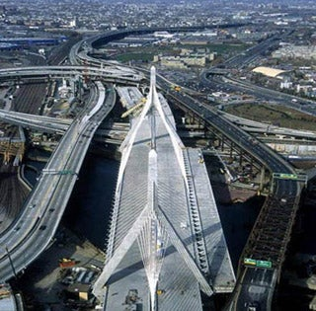
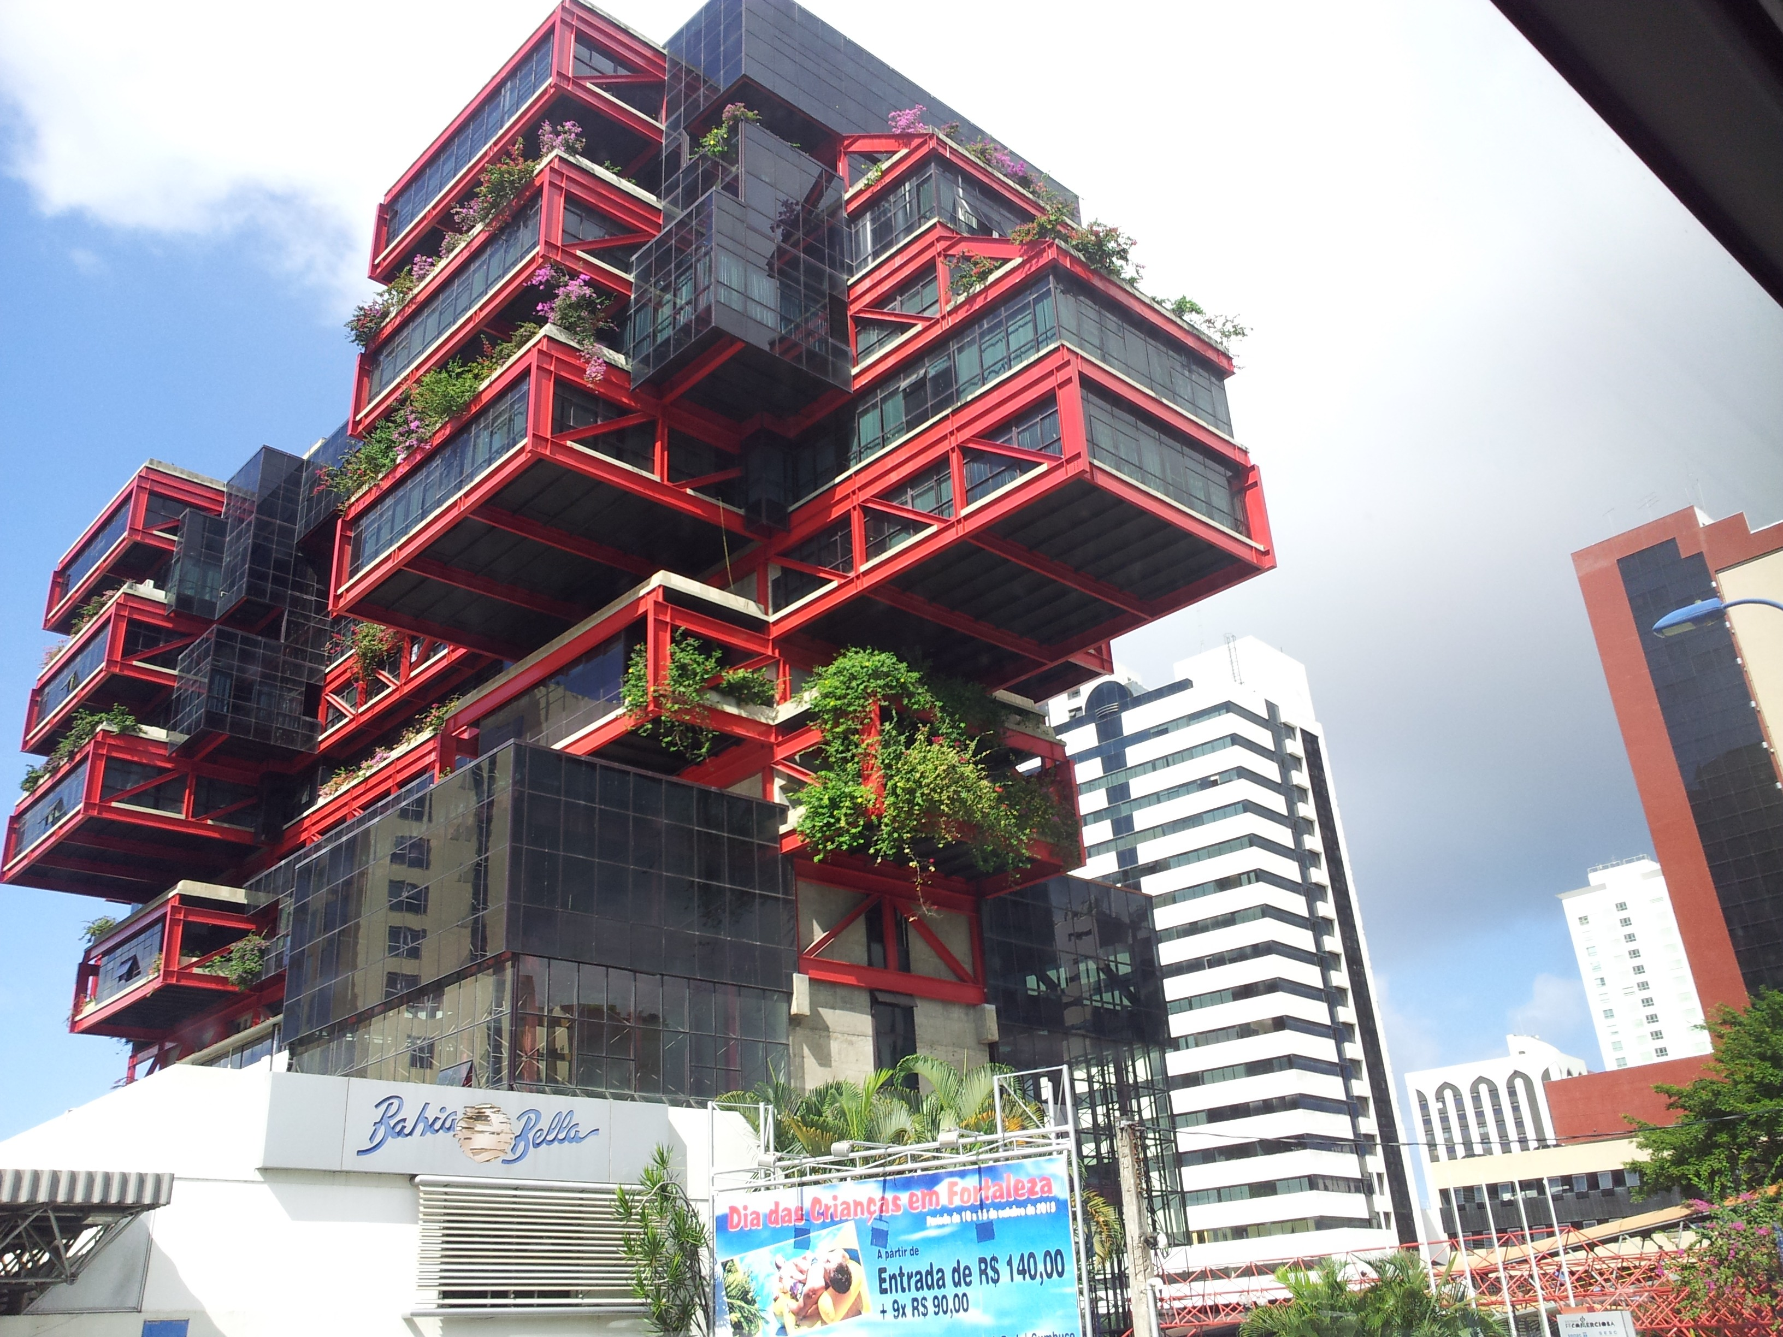
Engineering Jobs

Slide 4

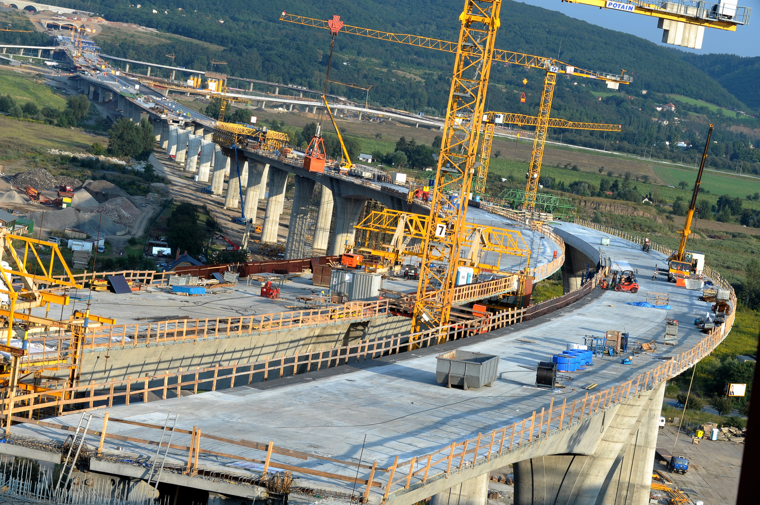
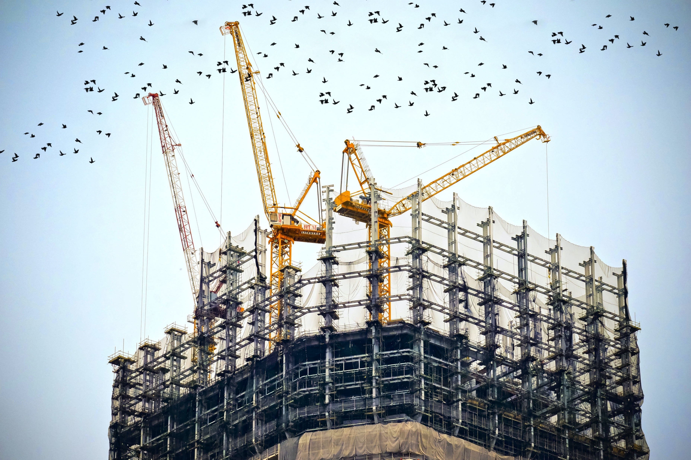
Engineering Jobs
This Photo by Unknown Author is licensed under CC BY-ND

Slide 5



Engineering Jobs
This Photo by Unknown Author is licensed under CC BY-SA
This Photo by Unknown Author is licensed under CC BY-SA
This Photo by Unknown Author is licensed under CC BY-SA-NC

Slide 6
Engineering Design
What is engineering?
What are engineering jobs?
Who can be an engineer?

Slide 7
Engineering Design Process
Identify
Identify the Problem
Imagine
Explore the materials
Plan
Create
Build the product/prototype
Improve
Analyze results from test
Create a plan individually
Identify the Criteria and Constraints
Brainstorm ideas
Select a group
Gather materials
Test the product/prototype
Modify process or design to make it better
Repeat as many times as needed

Slide 8
Problem
The eldest brother of the three little pigs is looking to rebuild the destroyed homes in his community after the sneezing wind disaster caused by the wolf.
Today, you are going to put on your engineering hat to help the eldest brother rebuild homes in the community.
  Identify the Problem
  Identify the Criteria and Constraints
Identify

Slide 9
Criteria: (Desired Outcomes)
A successful house design should include the following:
  Space available to fit a little pig inside
  Withstand the wolf’s sneeze for 5 seconds
  A roof
Bonus Points: The house can withstand the wolf’s super sneeze for 5 seconds
  Identify the Problem
  Identify the Criteria and Constraints
Identify

Slide 10
Constraints: (Limitations)
Time Limit: You will have 25 minutes to build the house.
Materials: You will be able to use no more than 20 items to build your house.
Counters: You will have 20 counters to complete this challenge.
Collaboration: One design element from each team member must be used in the final design.
Redesign: Each team can test their prototype as many times as needed during the 25-minute design phase.
  Identify the Problem
  Identify the Criteria and Constraints
Identify

Slide 11
Explore Materials
Here are the materials we will be using.
Can you classify them?
What do they have in common?
Materials ​ | Cost
Popsicle Sticks | 1 counter per 5 sticks
Straws | 1 counter per 5 straws
Construction Paper | 1 counter per sheet
Tape | 5 counters per roll
Glue Stick | 4 counters per stick
Scissors | 5 counters
  Explore the materials
  Brainstorm ideas
Imagine

Slide 12
Criteria
Constraints
A successful house design should include the following:
  Space available to fit a little pig inside
  Withstand the wolf’s sneeze for 5 seconds
  A roof
Bonus Points: The house can withstand the wolf’s super sneeze for 5 seconds
Time Limit: You will have 25 minutes to build the house.
Materials: You will be able to use no more than 20 items to build your house.
Counters: You will have 20 counters to complete this challenge.
Collaboration: One design element from each team member must be used in the final design.
Redesign: Each team can test their prototype as many times as needed during the 25-minute design phase.
  Identify the Problem
  Identify the Criteria and Constraints
Identify

