Slide 1
The Next Generation of Innovators
Post Curriculum for Medtronic Spark Explore
Prepared by Learning Undefeated
REV SEPTEMBER 14, 2026

Slide 2
Do Now
Discuss with a partner:
Remember back to your experience on the Medtronic Spark Explore mobile lab. What was the most exciting moment or successful “fix” you completed?

Slide 3
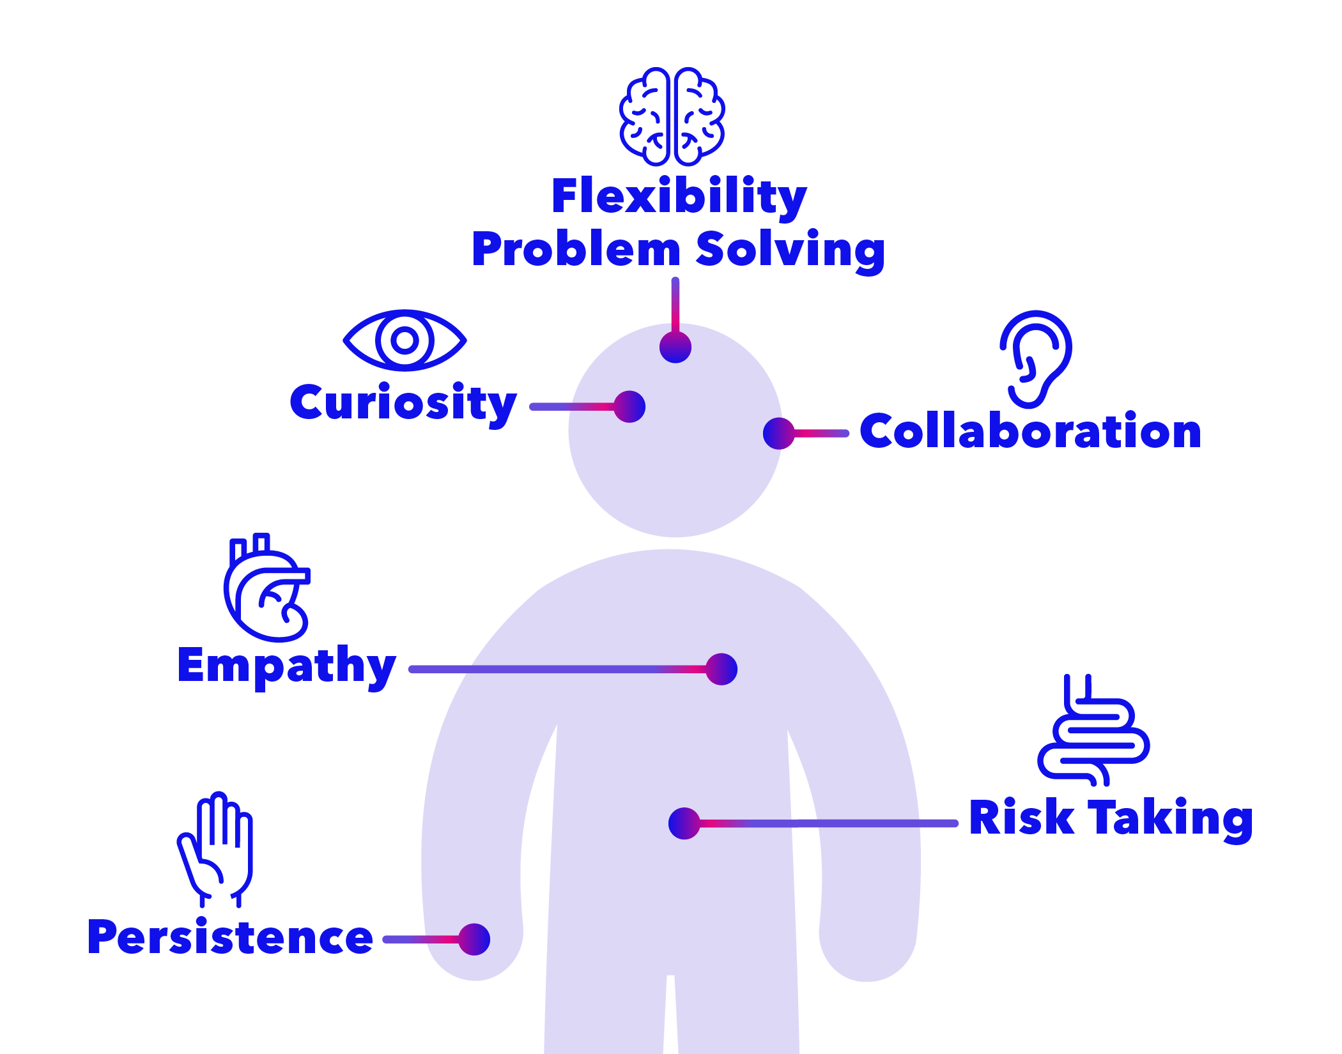
Innovator Identity: Anatomy of an Innovator

Slide 4
What Did You Do?
What parts of your innovator anatomy did you use during the lab experience?
    Check off your top 2 on your handout.
    Write how you used those traits on the cards.

Slide 5
Find the Career Match
Find the career card that matches your experience in the mobile lab.
  Write it on your handout and why it matches
Find another career card that you find interesting
  Write what you like about that career on your handout

Slide 6
Your Innovator Identity
Fill in the blanks:
    I was acting like a (career name) when I used my innovator (trait name) by (what you did in the mobile lab).

