Slide 1
Medtronic Spark Explore: Spark of Life
Pre Curriculum for Medtronic Spark Explore
Prepared by Learning Undefeated
REV SEPTEMBER 14, 2026

Slide 2
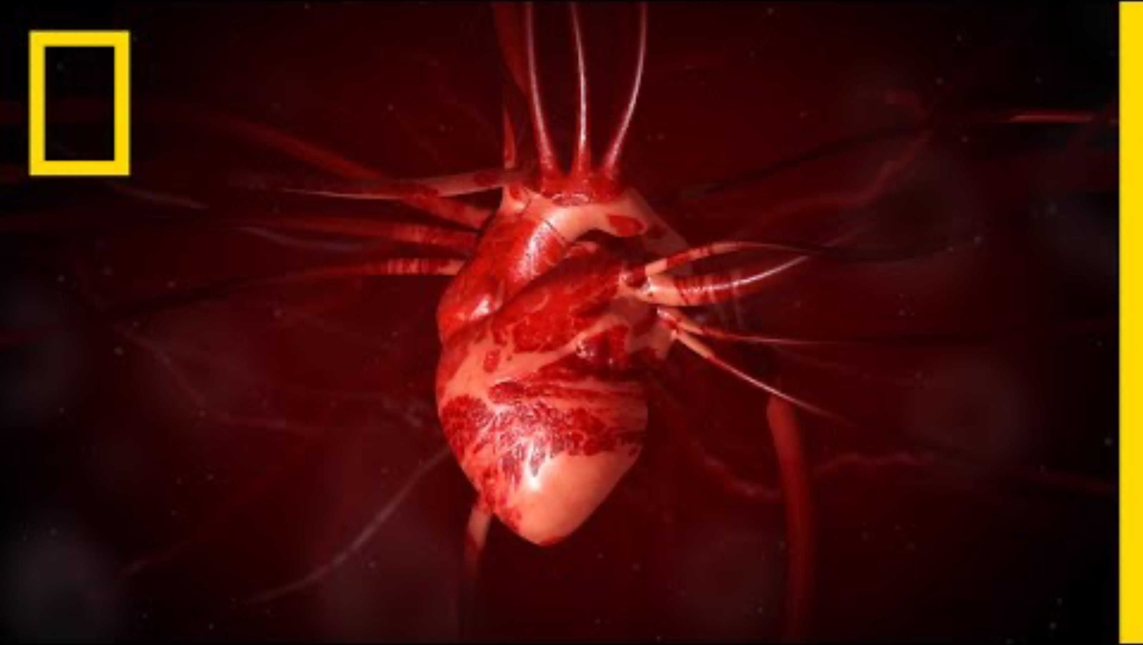
The Heart: A Pump with Intelligence
Anatomy Overview
For Educational Purposes
SOURCE: Heart 101, National Geographic
youtube.com/watch?feature=oembed&v=GMBSU-2GK3E

Slide 3
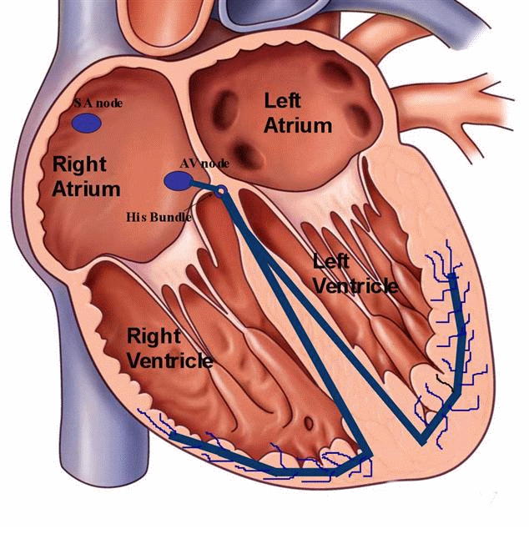
Electricity in the Body
The SA Node
Initiating the Heartbeat: The SA node triggers each heartbeat by generating an action potential without requiring external nerve stimulation, serving as the heart's primary pacemaker.
Controlling Heart Rate: It sends electrical impulses that travel through the cardiac conduction system, starting with the contraction of the atria.
Adjusting to Body Needs: Under the direction of the autonomic nervous system, it accelerates heart rate during physical activity (sympathetic nervous system) and slows it down during rest (parasympathetic nervous system).
For Educational Purposes
SOURCE: Atrioventricular (AV) Block, Washington Heart Rhythm Association
washingtonhra.com/arrhythmias/atrioventricular-av-block.php

Slide 4
Steady the Beat Simulation
Round 1
Student teams demonstrate a normal heart rhythm with Sinoatrial “SA” Node delivering pulse to the Heart.
Metronome on Screen
Pace-maker
Atria
bucket
Ventricle
bucket
Organs
bucket
SA Node
Heart
Body

Slide 5
Steady the Beat Simulation
Round 1 Roles
SA Node
The Heart
The Body
The Pacemaker
Tap the Heart’s shoulder with each beat of the metronome
When tapped, move one token from the atria → ventricle
Only move one token at a time
Move a token from ventricle → organs
Only move one token at a time
Move as quickly as possible, but keep note if 3 seconds pass without a token to pick up
Observe the system and keep note of what appears to work and what needs fixing

Slide 6
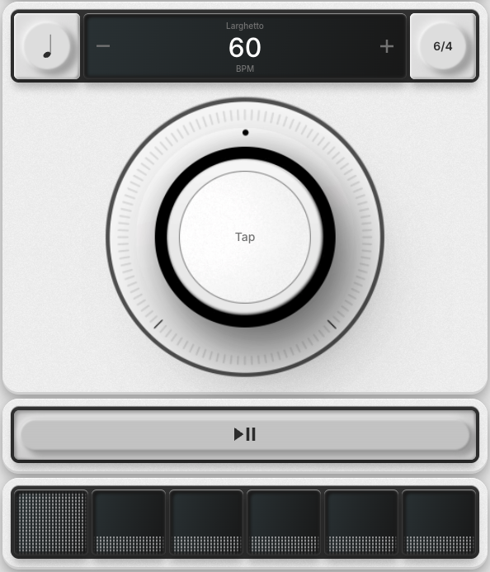
Digital Metronome
metronome.soundbrenner.com
Open the digital metronome.
Round 1
Set to 60 BPM
6/4 Time Signature

Slide 7
Steady the Beat Simulation
Round 1 Discussion
Which role controlled the speed of the entire system?
Did the system feel stable or unstable during this round? Why?
If the SA Node stopped tapping consistently, what do you think would happen?

Slide 8
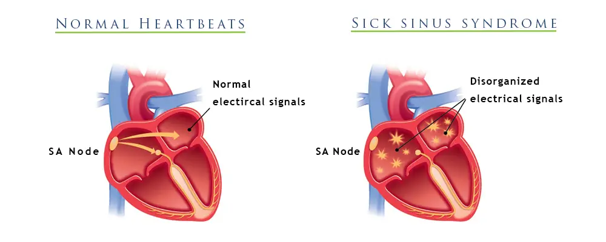
When the spark fails
Introduction to Sinus Node Disorder
Normal Heartbeats
Sinus Node Disorder
Sinus Node Disorder occurs when electrical impulses in the heart are irregular or inconsistent
For Educational Purposes SOURCE: Jackson Heart Atrial Fibrillation Brochure
jacksonheart.com/wp-content/uploads/2018/10/JHC8729-14_Atrial_Fibrillation_Brochure.pdf

Slide 9
Steady the Beat Simulation
Round 2
Student teams will model what happens when the heart is not receiving a regular signal from the SA Node.
Metronome on Screen
Pace-maker
Atria
bucket
Ventricle
bucket
Organs
bucket
SA Node
Heart
Body

Slide 10
Steady the Beat Simulation
Round 2 Roles
SA Node
The Heart
The Body
The Pacemaker
Tap the Heart’s shoulder on specific metronome beats
Beats 1 and 5
Only Beat 5
Only Beat 1
Repeat steps 1-3
When tapped, move one token from the atria → ventricle
Only move one token at a time
Move a token from ventricle → organs
Only move one
token at a time
3 seconds without token in ventricle bin — say “Heartbeat is irregular”
5 seconds without token in ventricle bin — say “I need help!”
Observe the system and keep note of what appears to work and what needs fixing

Slide 11
Digital Metronome
metronome.soundbrenner.com
Open the digital metronome.
Round 2
Set to 60 BPM
6/4 Time Signature

Slide 12
Steady the Beat Simulation
Round 2 Discussion
Was the SA Node signal consistent or inconsistent?
What happened to token movement when the
SA Node skipped beats?
If someone was experiencing this, what could be done to help?

Slide 13
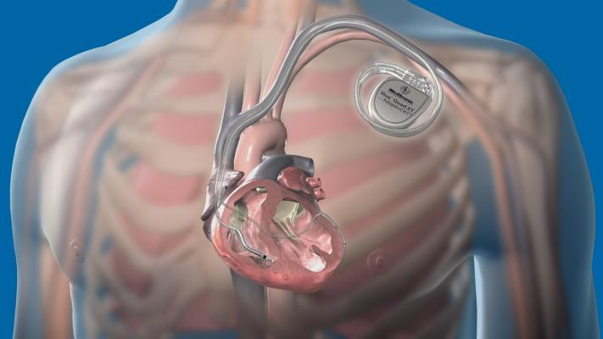
The Engineering Solution
The Pacemaker
A pacemaker is designed to mimic
the heart’s natural pacemaker, the
sinus node.
The pacemaker has two main purposes:
Pacing
A pacemaker sends an electrical impulse to the heart when the heart’s own rhythm is too slow or is interrupted. This electrical impulse starts a heartbeat.
Sensing
A pacemaker will also “sense” (monitor) the heart’s natural electrical activity. When the pacemaker senses a natural heartbeat, it will not deliver a pacing pulse.
For Educational Purposes
SOURCE: Advances in Implantable Cardioverter Defibrillator Technology | Diagnostic and Interventional Cardiology
https://www.dicardiology.com/article/advances-implantable-cardioverter-defibrillator-technology

Slide 14
The Simulation
Student teams will model what happens when the engineered “pacemaker” is used to support the SA Node.
Round 3
Metronome on Screen
Atria
bucket
Ventricle
bucket
Organs
bucket
SA Node
Heart
Body
Pace-maker

Slide 15
Steady the Beat Simulation
Round 3 Roles
SA Node
The Heart
The Body
The Pacemaker
Tap the Heart’s shoulder on specific metronome beats
Beats 1 and 5
Only Beat 5
Only Beat 1
Repeat steps 1-3
When tapped, move one token from the atria → ventricle
Only move one token at a time
Move a token from ventricle → organs
Only move one
token at a time
3 seconds without token in ventricle bin — say “Heartbeat is irregular”
5 seconds without token in ventricle bin — say “I need help!”
Tap the Heart’s shoulder when the SA Node misses a metronome beat

Slide 16
Digital Metronome
metronome.soundbrenner.com
Open the digital metronome.
Round 3
Set to 60 BPM
6/4 Time Signature

Slide 17
Steady the Beat Simulation
Round 3 Discussion
What was different about how the system worked before the pacemaker and after it was added?
What controlled the timing of the Heart in this round?
How does the Pacemaker know when to intervene?

